Slide 1
Review of peripheral blood and bone marrow morphology – Non-malignant hematology
Matthew Oberley MD, PhD
Caris Life Sciences Children’s Hospital Los Angeles

Slide 2
Review of peripheral blood and bone marrow morphology – Benign hematology Matthew Oberley MD, PhD
WBC
RBC
Platelets

Slide 3
WBC – Normal myeloid maturation
Myeloblast
Promyelocyte
Myelocyte
Metamyelocyte
Band
Mature Neutrophil

Slide 4
Reactive changes: Toxic granulation of neutrophils
Associated with infections, burns, trauma, and cytokines administration (GCSF)
Accentuated cytoplasmic granulation
Cytoplasmic vacuolization is often seen in concert with toxic granulation

Slide 5
Döhle Body
Bluish inclusions of variable size and shape in the cytoplasm
Represents remnants of the rough endoplasmic reticulum
Generally seen in association with toxic changes
Associated with infections, burns, trauma, and cytokines administration (GCSF)

Slide 6
Neutrophils with prominent Dohle-body like cytoplasmic inclusions
Giant or large platelets
Thrombocytopenia
Normal Hemoglobin/Hematocrit
May-Hegglin anomaly

Slide 7
May-Hegglin anomaly Syn: myosin heavy chain 9 (MHY9) – related disorder
The peripheral blood smear shows macrothrombocytopenia with otherwise normal platelet granulation. The neutrophils have prominent Döhle-like cytoplasmic inclusions.
The smear is consistent with May-Hegglin anomaly caused by mutations in MYH9
MYH9-related diseases includes Epstein syndrome, Fechtner syndrome, and May–Hegglin anomaly
Macrothrombocytopenias:
Bernard Soulier (GP-1Ba)
Grey Platelet Syndrome (NBEAL2)
vWF type 2b
Paris-Trousseau thrombocytopenia (deletion of 11q23-terminus)

Slide 8
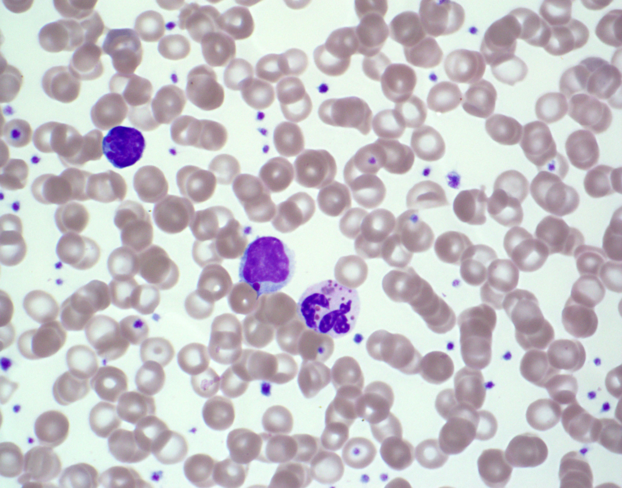
The peripheral blood smear shows abnormally large azurophilic or grey granules in the neutrophils
T-cells have enlarged mature cytolytic secretory granules which do not function properly
Granules stain positive for myeloperoxidase and acid phosphatase
Chediak-Higashi Syndrome

Slide 9
Chediak-Higashi Syndrome
Chediak-Higashi Syndrome is a rare autosomal recessive disorder due to abnormal lysosomal biogenesis
Patients in the stable phase have increased susceptibility to infection and occulocutaneous albinism.
An accelerated phase with hemophagocytic lymphohistiocytosis is typically fatal.
Disorder due to missense or nonsense mutations in CHS/LYST gene

Slide 10
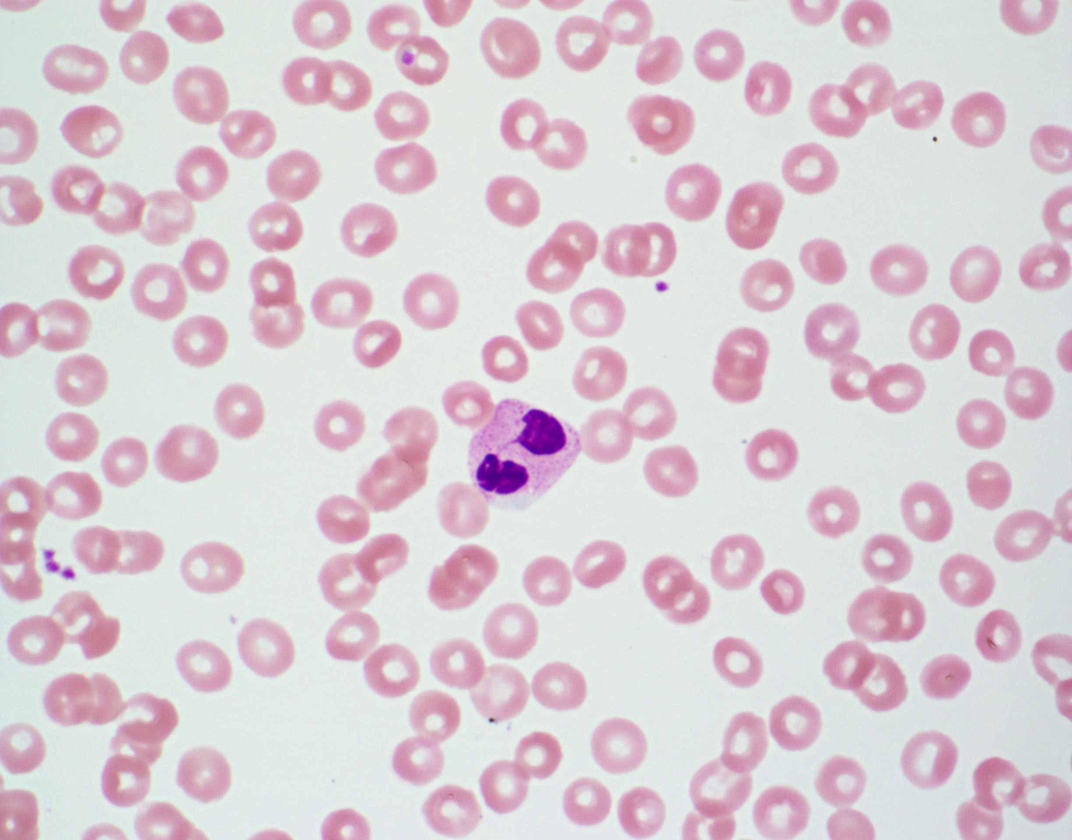
The neutrophils on this peripheral smear all had the same morphology: A bilobed nucleus with normal cytoplasmic granulation
This child has Pelger-Huet anomaly
This is caused by mutations in the Lamin B receptor
Heterozygotes have bilobed neutrophils while homozygotes have neutrophils with round unilobed nuclei

Slide 11
Similar morphology in neutrophils can also be seen with:
Myelodysplastic syndrome
Medications
Infection
In these cases, the morphologist will refer to these cells as:
Pseudo Pelger-Huet cells

Slide 12
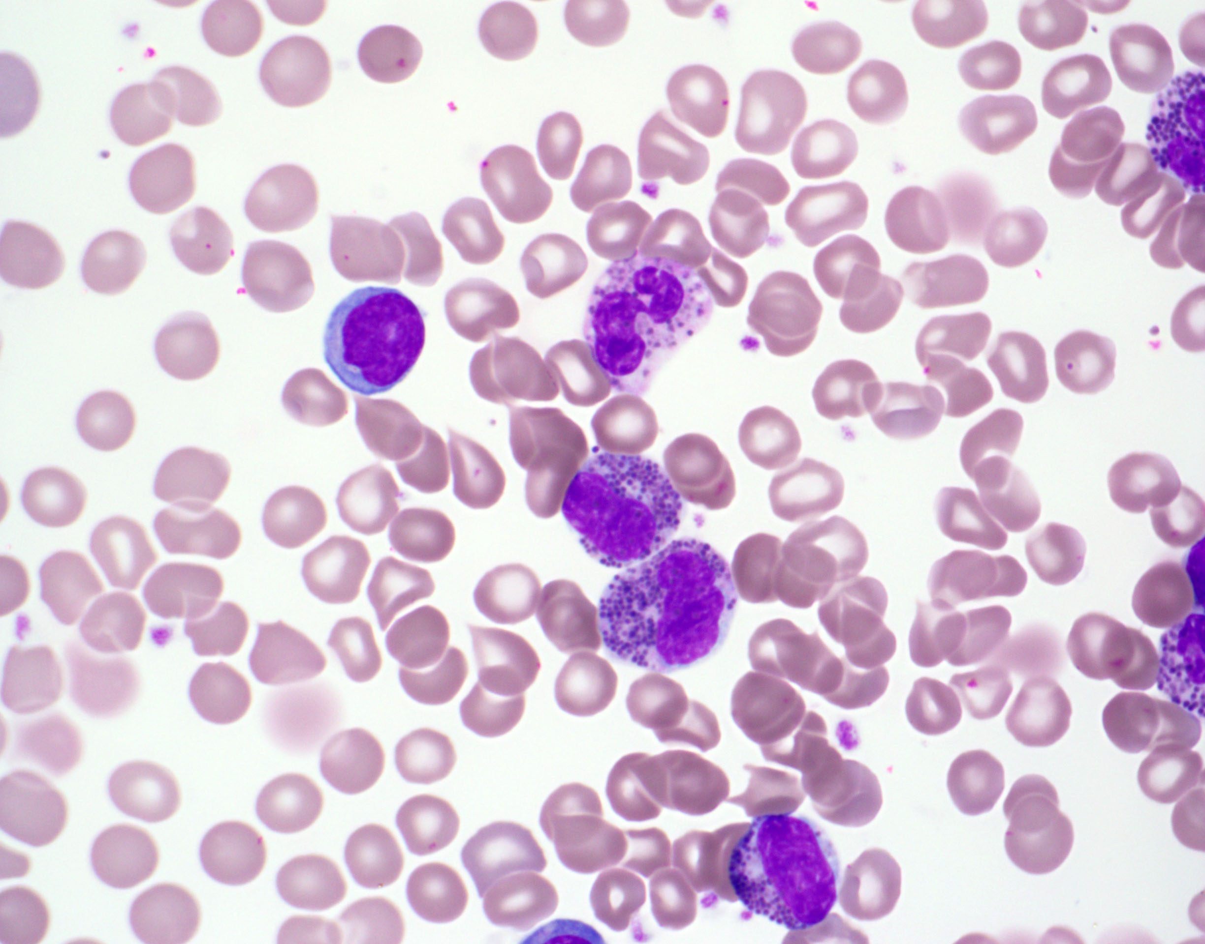
The prominent azurophilic granulation seen in the leukocytes are an example of the Alder-Reilly anomaly.
This finding is seen in patients with mucopolysaccharidoses where there is lysosomal build up of mucopolysaccharide due to impaired catabolism.

Slide 13
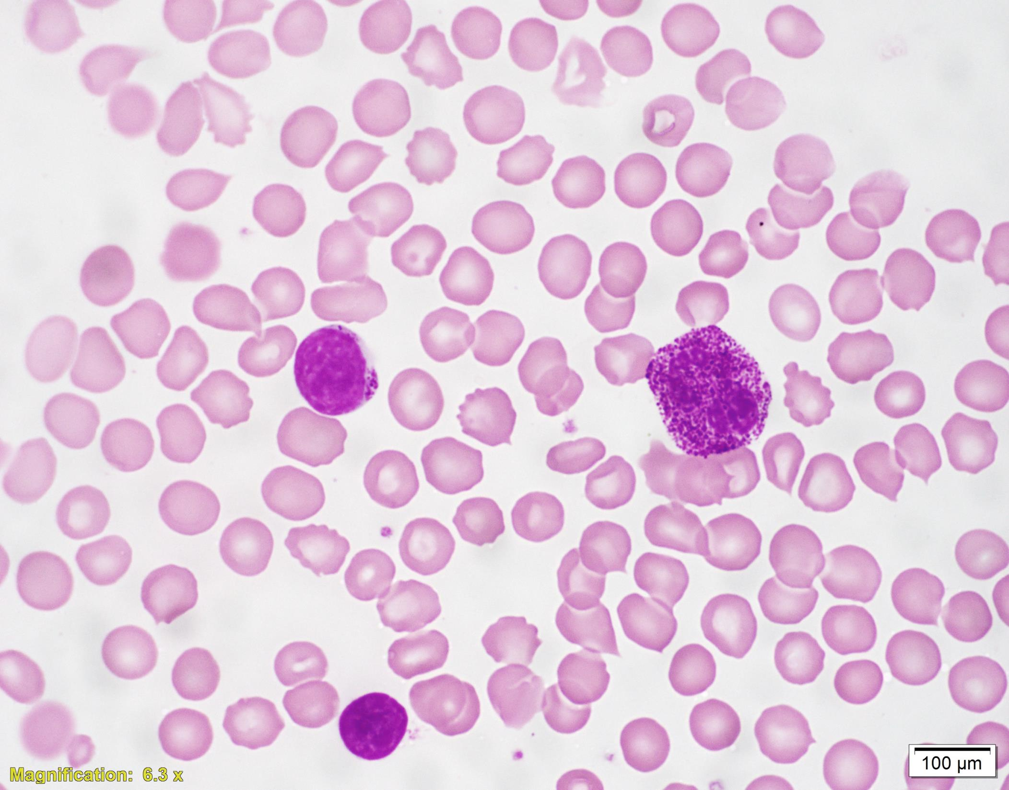
The prominent azurophilic granulation seen in the leukocytes are an example of the Alder-Reilly anomaly.
This finding is seen in patients with mucopolysaccharidoses where there is lysosomal build up of mucopolysaccharide due to impaired catabolism.
Abnormal granulation can also be seen in lymphocytes…

Slide 14
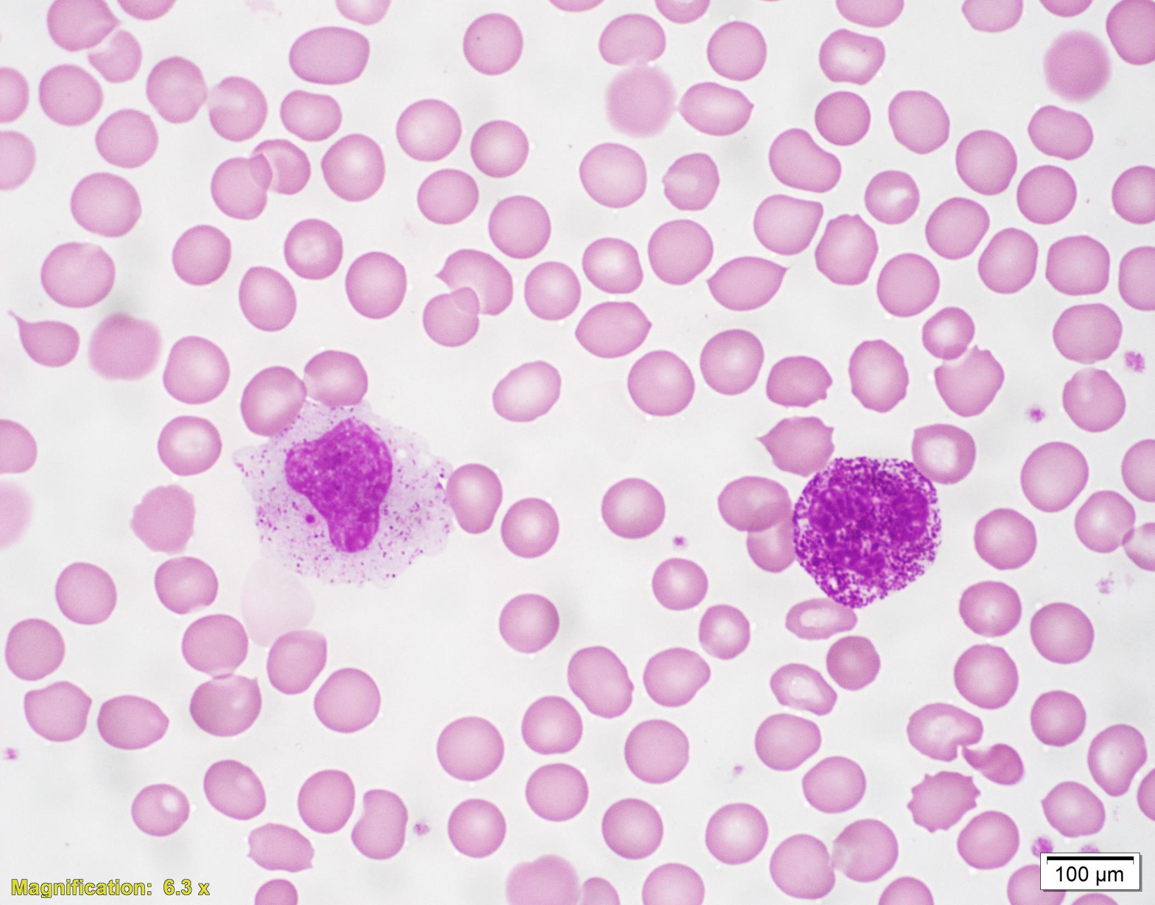
The prominent azurophilic granulation seen in the leukocytes are an example of the Alder-Reilly anomaly.
This finding is seen in patients with mucopolysaccharidoses where there is lysosomal build up of mucopolysaccharide due to impaired catabolism.
Abnormal granulation can also be seen in lymphocytes…
And monocytes

Slide 15
Bone marrow – Immature lymphocytes
Hematogones – Immature B cells
Mature lymphs

Slide 16
Reactive changes: Lymphocyte activation
Can be prominent with viral infections
Sometimes referred to as ‘atypical lymphocytes’

Slide 17
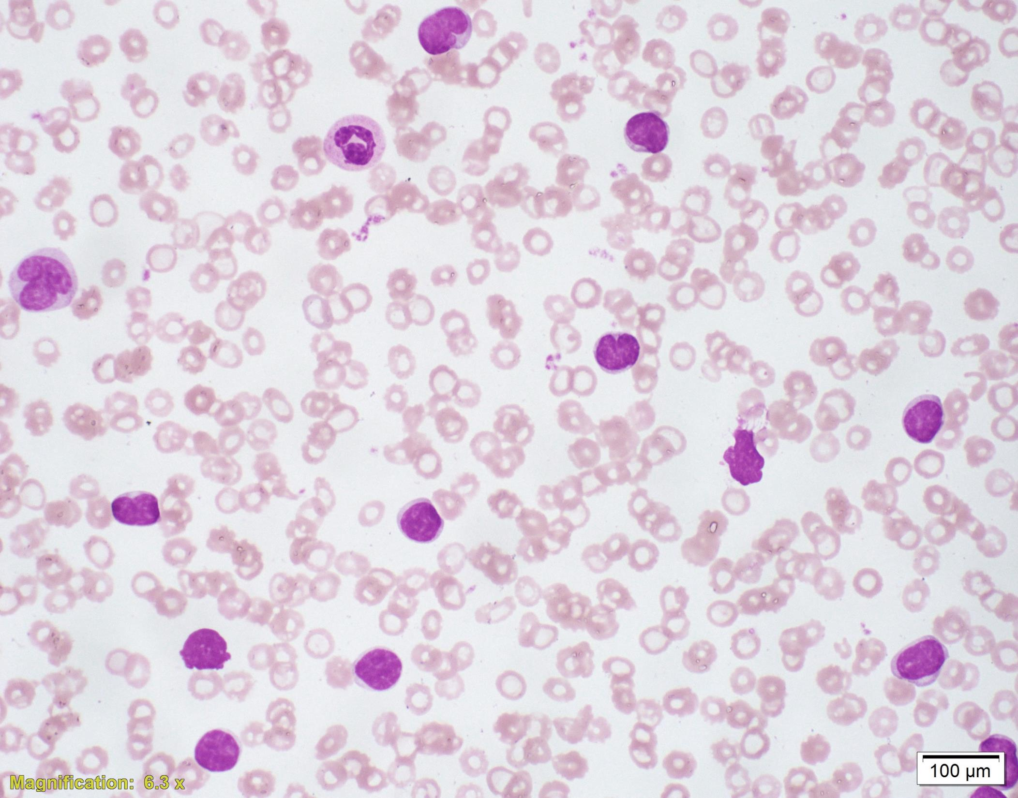
4 year old child with paroxysmal cough
WBC of 47,000/uL
65% lymphocytes

Slide 18
The lymphocytosis consists of small mature lymphocytes
Some lymphocytes have prominent nuclear clefting
Bordetella pertussis causes notable lymphocytosis through release of pertussis toxin

Slide 19
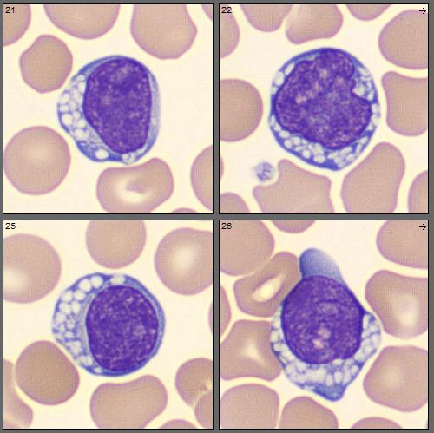
Vacuolated Lymphocytes
The cells shown are lymphocytes with cytoplasmic vacuoles which should make you think of lysosomal storage disorders.
Specific disorders reported to have vacuolated lymphocytes include:
Mucopolysaccharidosis
Galactosialidosis
Mucolipidosis
Juvenile neuronal ceroid lipofuscinosis
GM₁ gangliosidoses

Slide 20
RBC – Normal red cell maturation
Proerythroblast
Basophilic
Erythroblast
Polychromatic
Erythroblast (early)
Polychromatic
Erythroblast (late)
Orthochromatic
Erythroblast
Reticulocyte
Mature
Erythrocyte

Slide 21
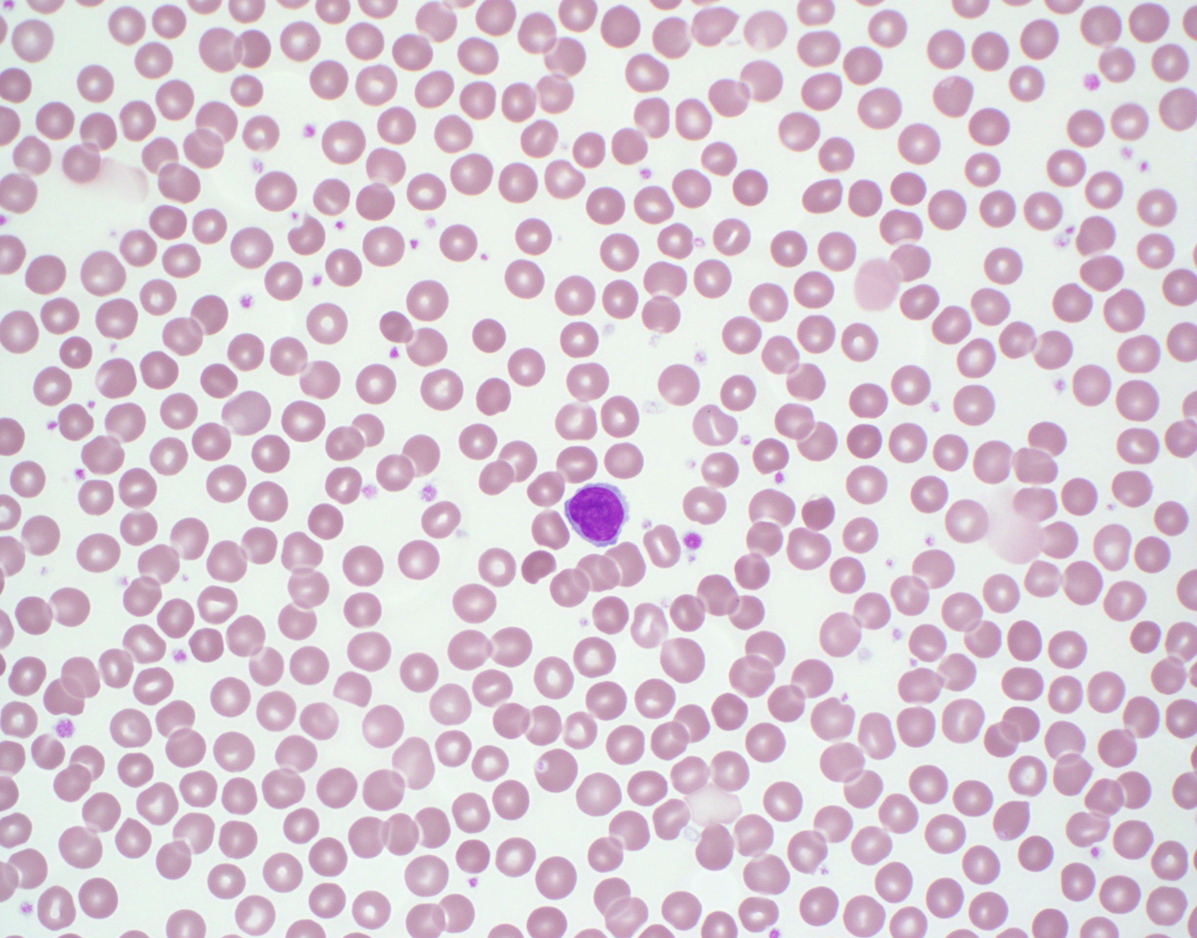
The peripheral blood smear is normal and the patient Hgb level is normal for age.
Various red cell morphologic findings (spherocytosis, stomatocytosis, schistocytes, etc.) at levels of 1% or less are commonly seen on normal peripheral blood smears.

Slide 22
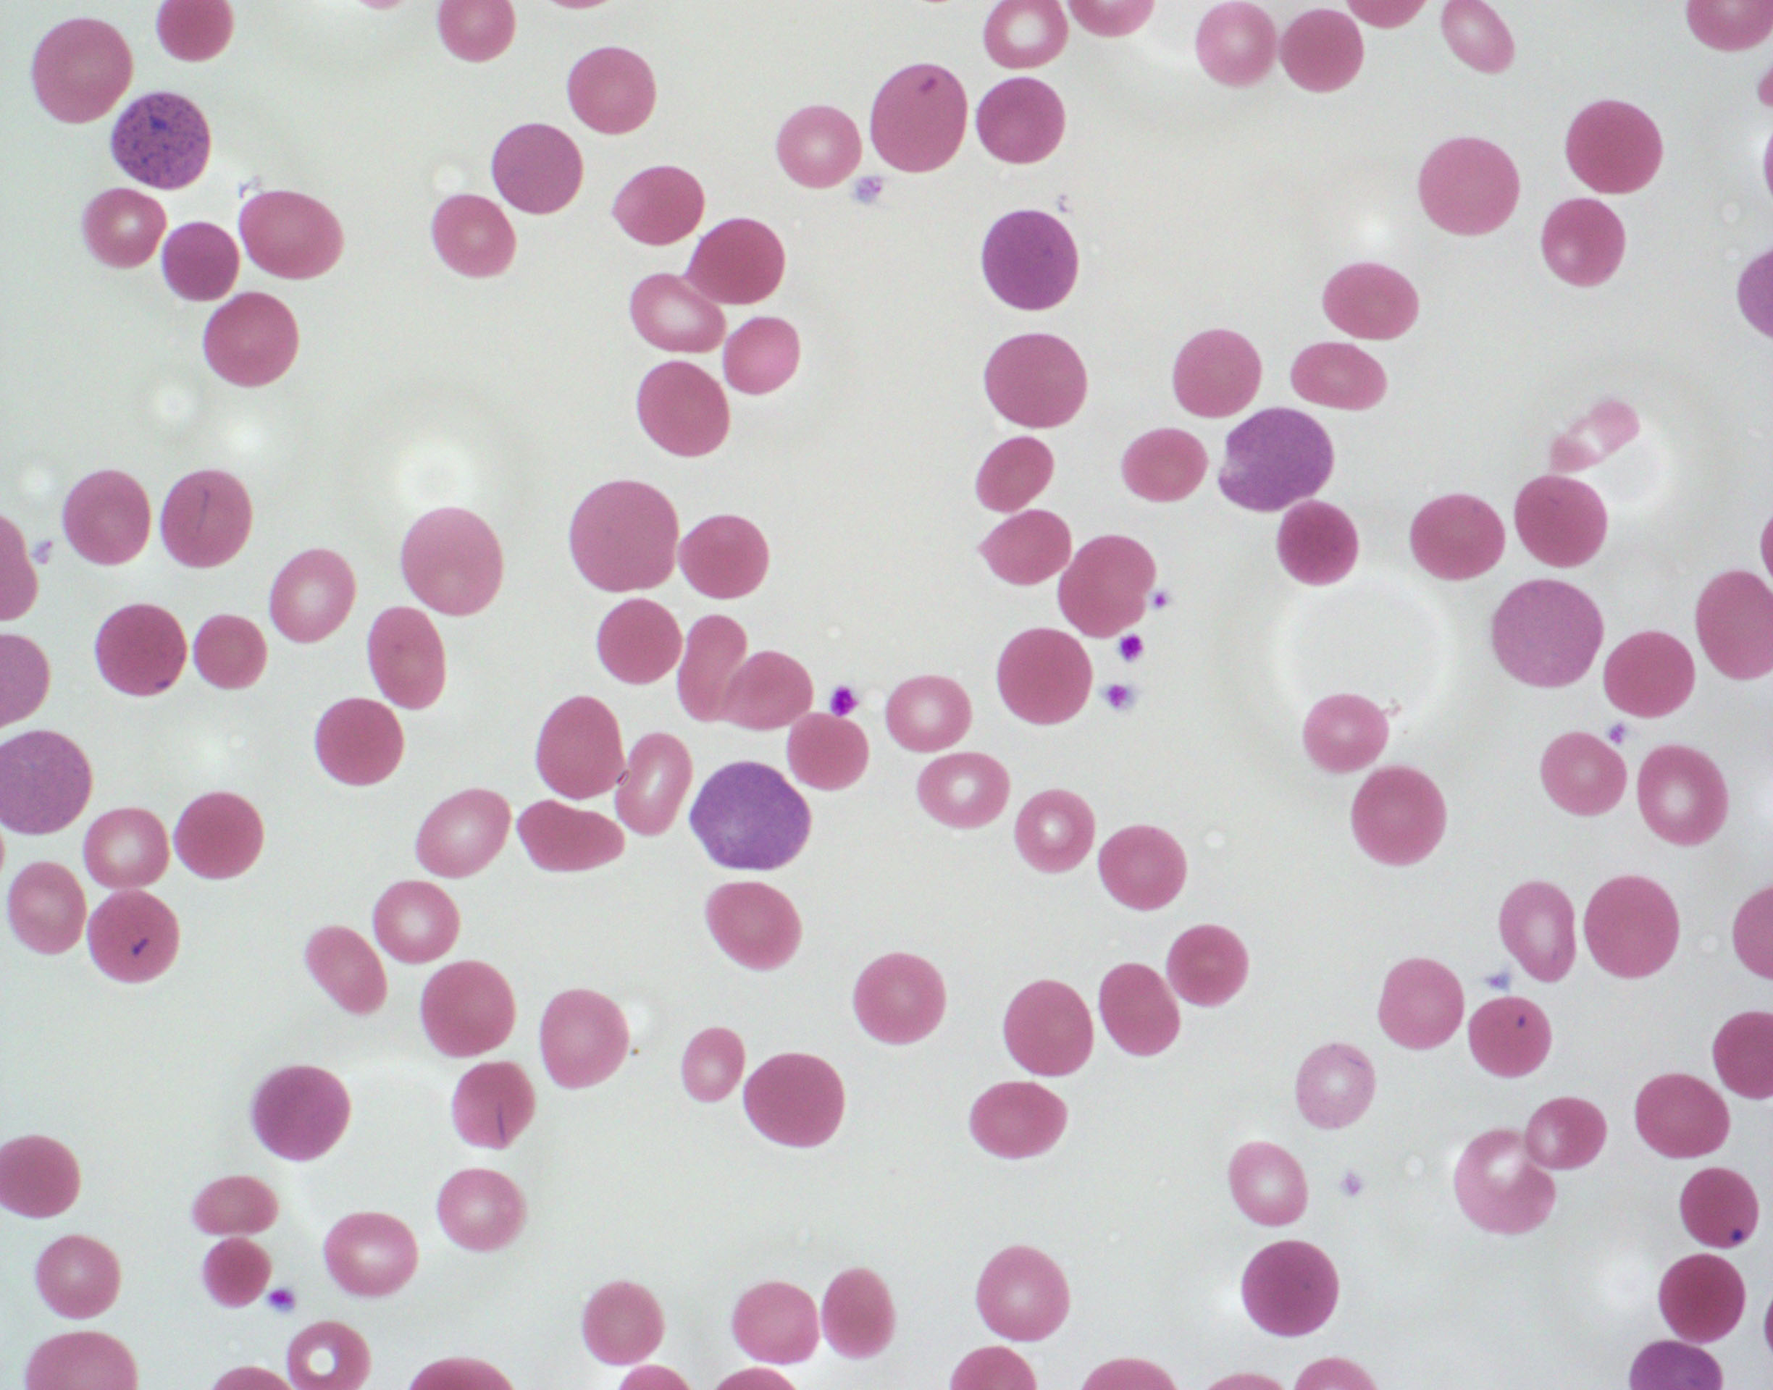
The findings on the peripheral blood smear include small dense round microspherocytes (black arrow)
Polychromasia (blue arrow)
Red cells with central pallor which is often smaller than normal (red arrow)
Typically normocytic hemolytic anemia
Elevated MCHC
Elevated RDW

Slide 23
Hereditary spherocytosis
Hereditary spherocytosis is caused by mutations in membrane skeletal proteins: ankyrin, α-spectrin, β-spectrin, band 3, or protein 4.2
Hereditary elliptocytosis is typically caused by heterozygous mutations in α-spectrin, β-spectrin, or protein 4.1
Hereditary pyropoikilocytosis is typically caused by homozygous mutations in α-spectrin, β-spectrin, or protein 4.1
The peripheral smear findings of hemolytic anemia with spherocytes can also be seen with autoimmune hemolytic anemia, ABO hemolytic disease of the newborn, and rarely with thermal injuries

Slide 24
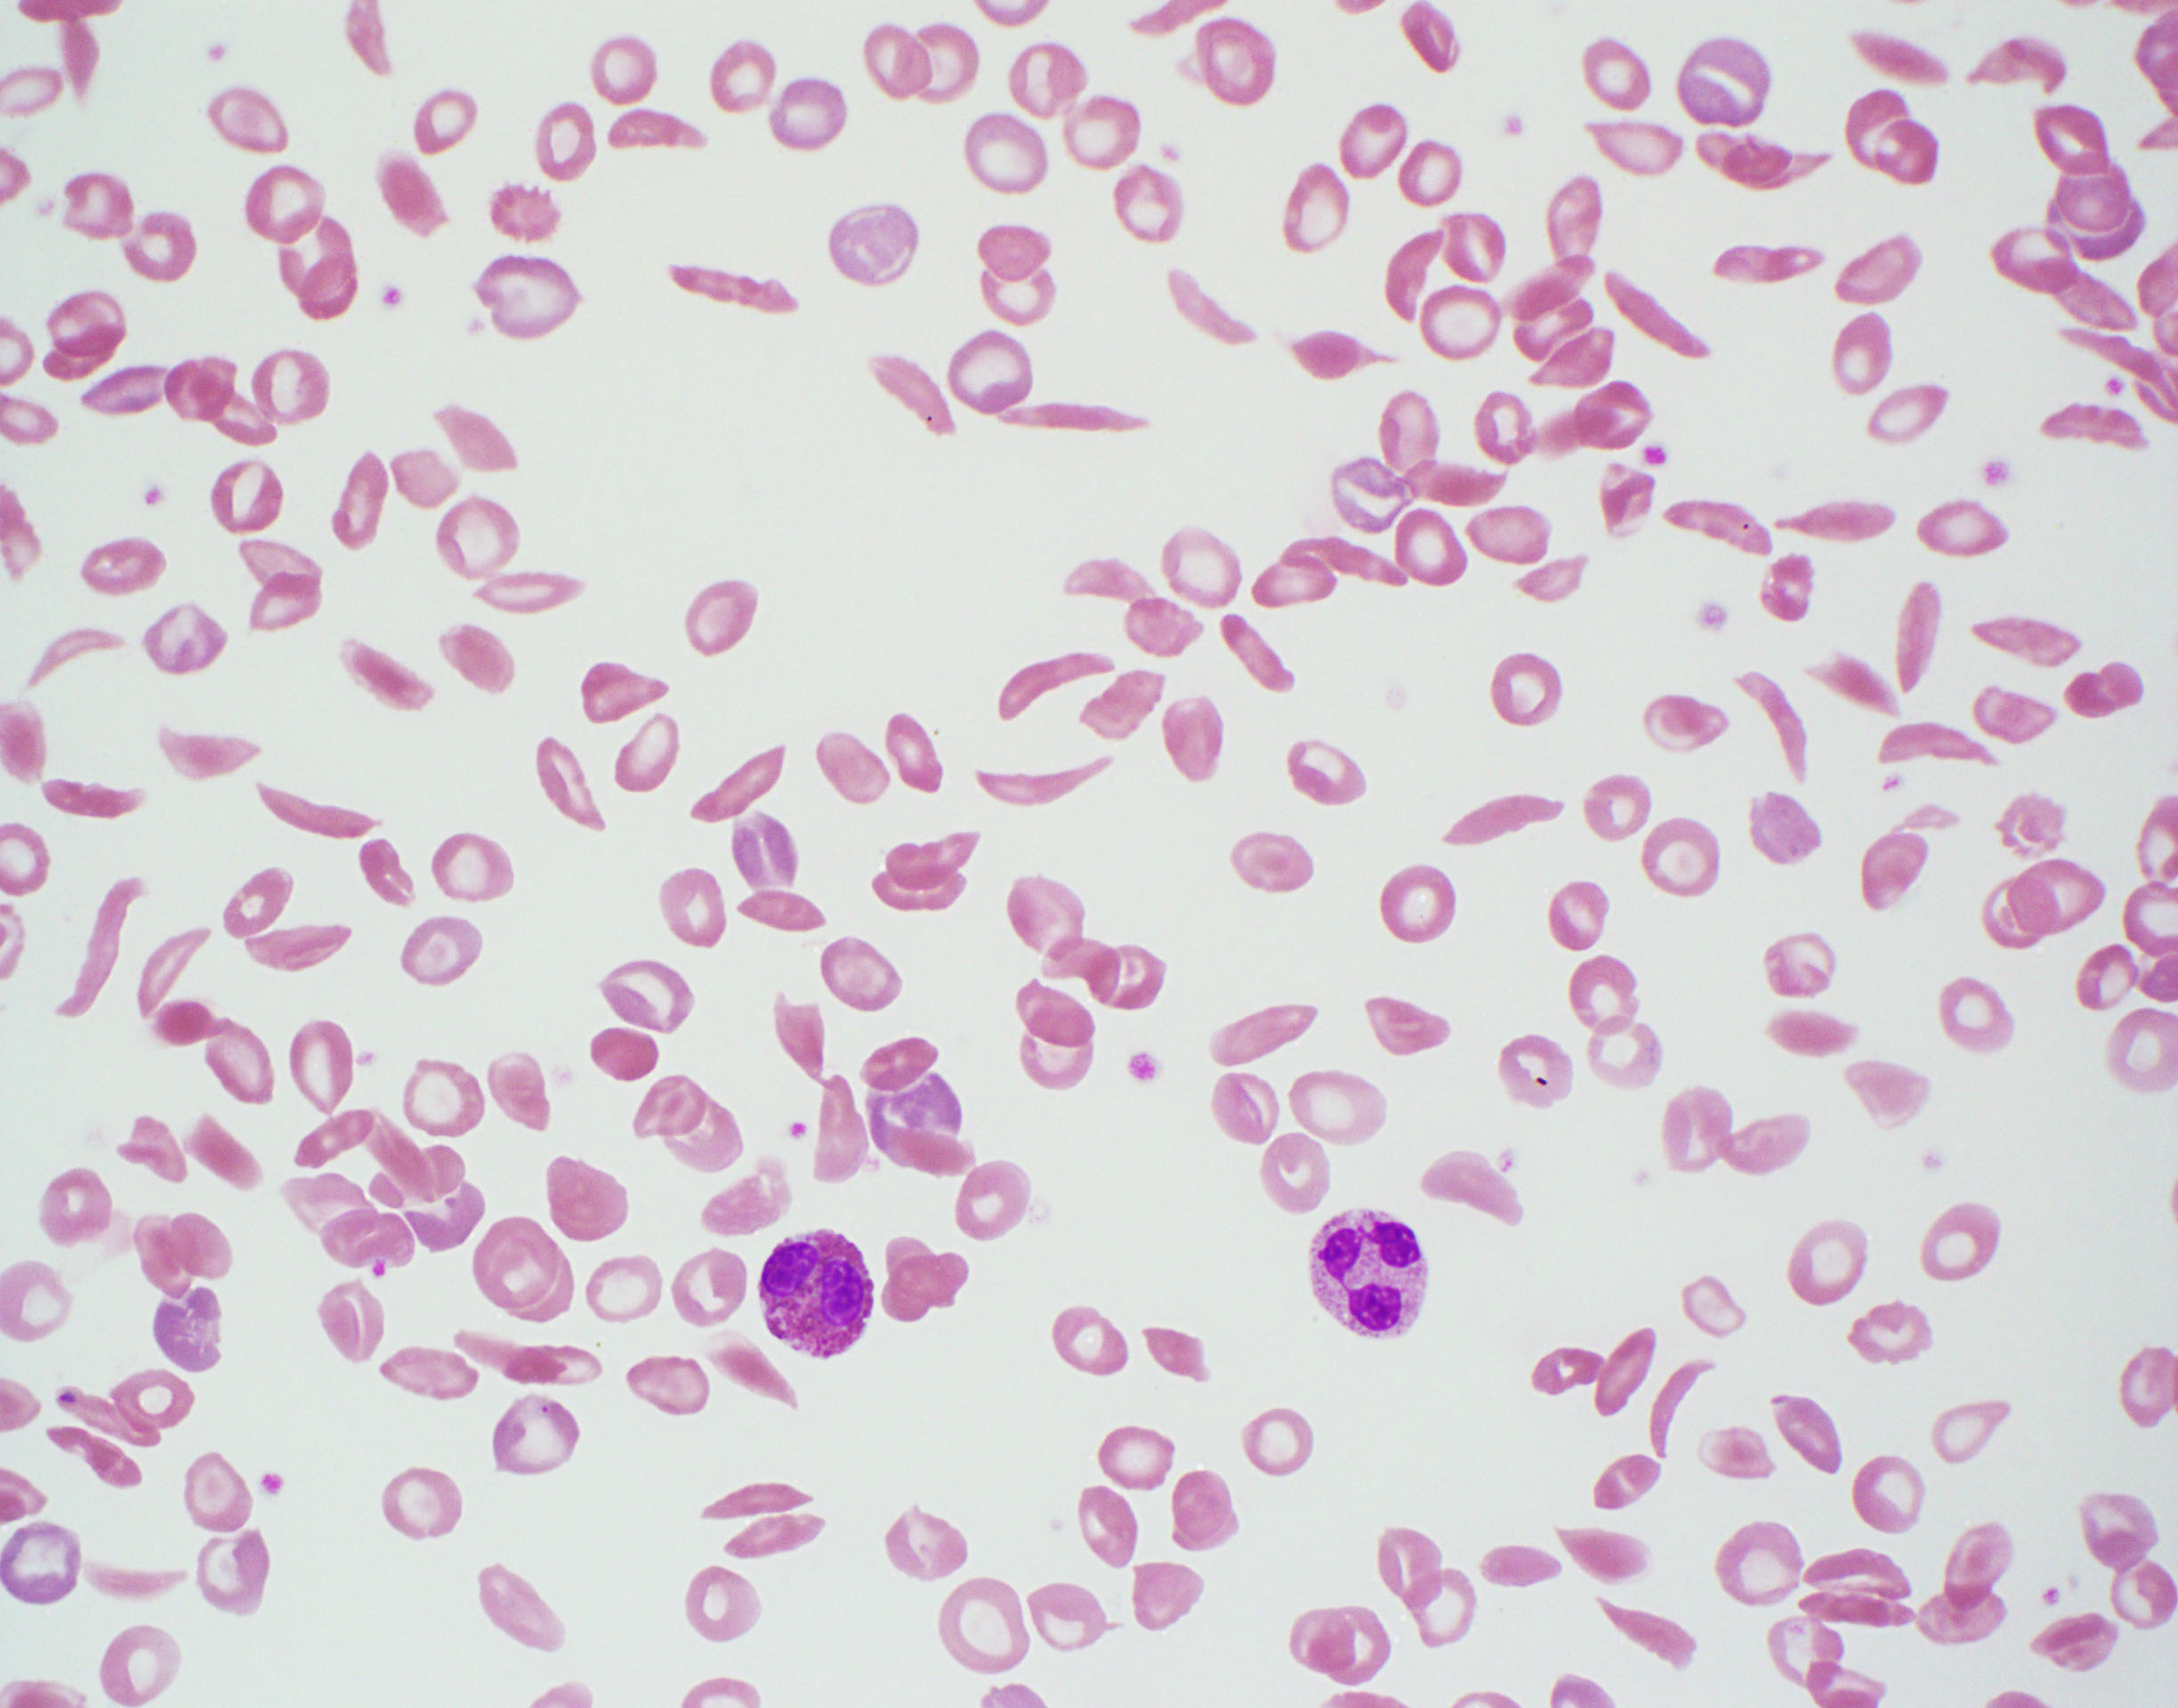
The peripheral blood smear shows a severe sickling crisis seen in patients with S/S or S/β⁰ genotypes.
Substitution of the normal hydrophilic glutamic acid residue for the hydrophobic valine residue leads to pathologic polymerization when deoxygenated.
Patients with sickle cell trait do not typically show any sickling on a peripheral blood smear

Slide 25
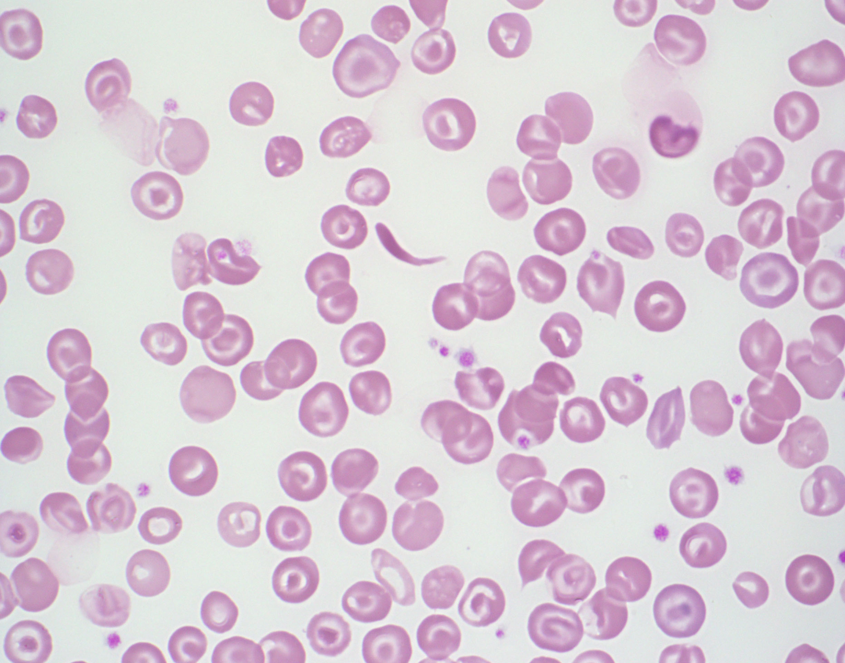
The peripheral smear shows normocytic normochromic anemia with many target cells and rare sickled cells. The smear is consistent with Hemoglobin SC and confirmation would be made with hemoglobin electrophoresis.

Slide 26
Sickled cells on the Peripheral smear
S trait | SS | S-β⁰ | S-β⁺ | SC | SD
- | +→++++ | +→+++ | +→++ | +→++ | +→++

Slide 27
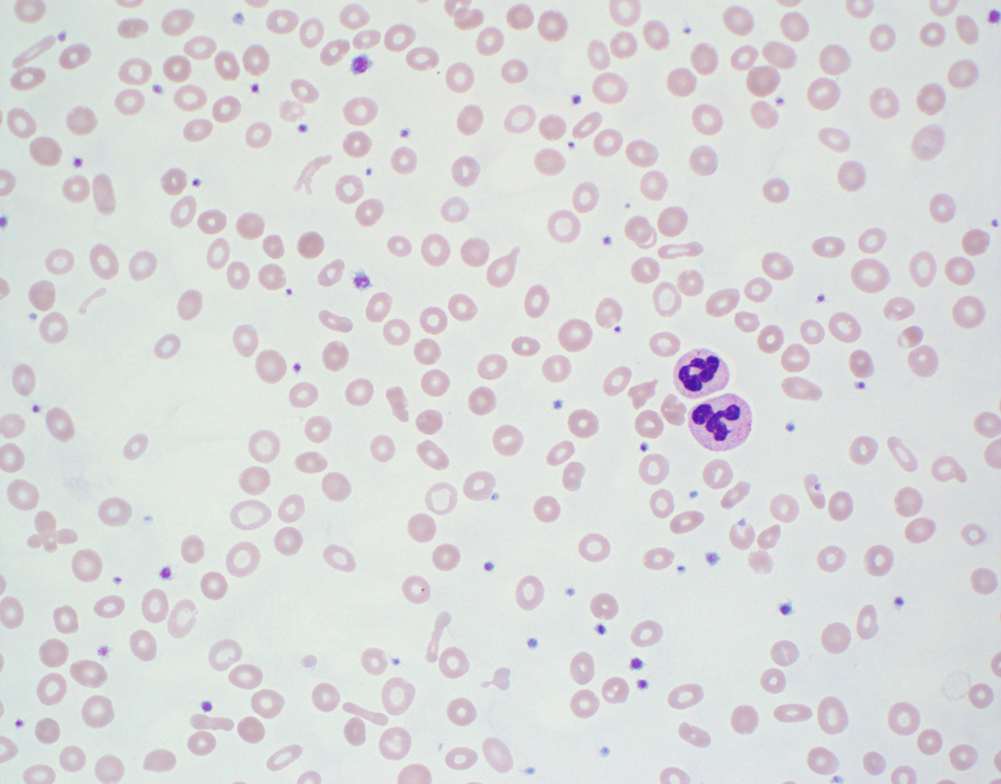
The peripheral smears shows hypochromic microcytic anemia with anisopoikilocytosis
Elliptical (pencil) cells are present (red arrow).
There is mild thrombocytosis.
These findings are consistent with iron deficiency anemia.

Slide 28
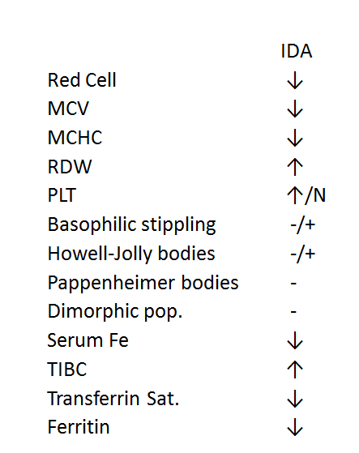
Iron deficiency anemia
IDA
Red Cell ↓
MCV ↓
MCHC ↓
RDW ↑
PLT ↑/N
Basophilic stippling -/+
Howell-Jolly bodies -/+
Pappenheimer bodies -
Dimorphic pop. -
Serum Fe ↓
TIBC ↑
Transferrin Sat. ↓
Ferritin ↓

Slide 29
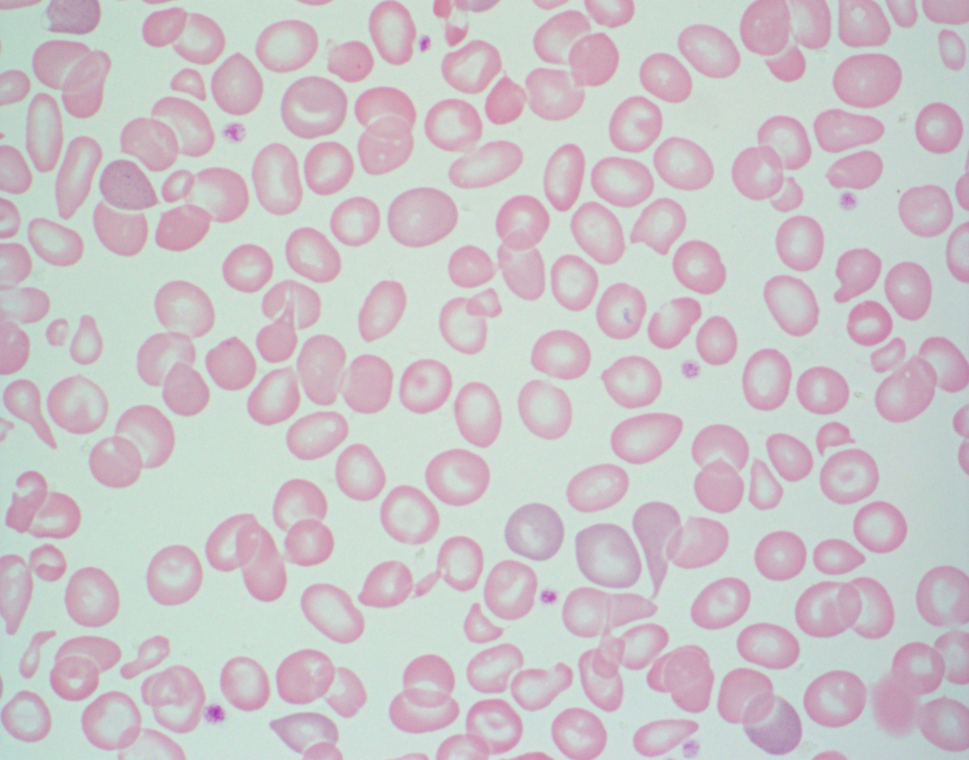
The findings on the peripheral smear include hypochromic microcytic anemia with anisopoikilocytosis, target cells, and basophillic stippling.

Slide 30
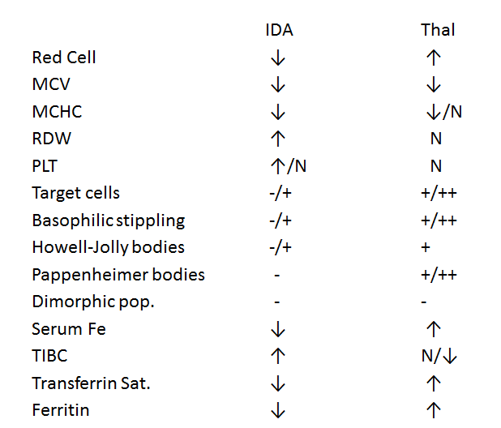
Thalassemia Major
IDA Thal
Red Cell ↓ ↑
MCV ↓ ↓
MCHC ↓ ↓/N
RDW ↑ N
PLT ↑/N N
Target cells -/+ +/++
Basophilic stippling -/+ +/++
Howell-Jolly bodies -/+ +
Pappenheimer bodies - +/++
Dimorphic pop. - -
Serum Fe ↓ ↑
TIBC ↑ N/↓
Transferrin Sat. ↓ ↑
Ferritin ↓ ↑

Slide 31
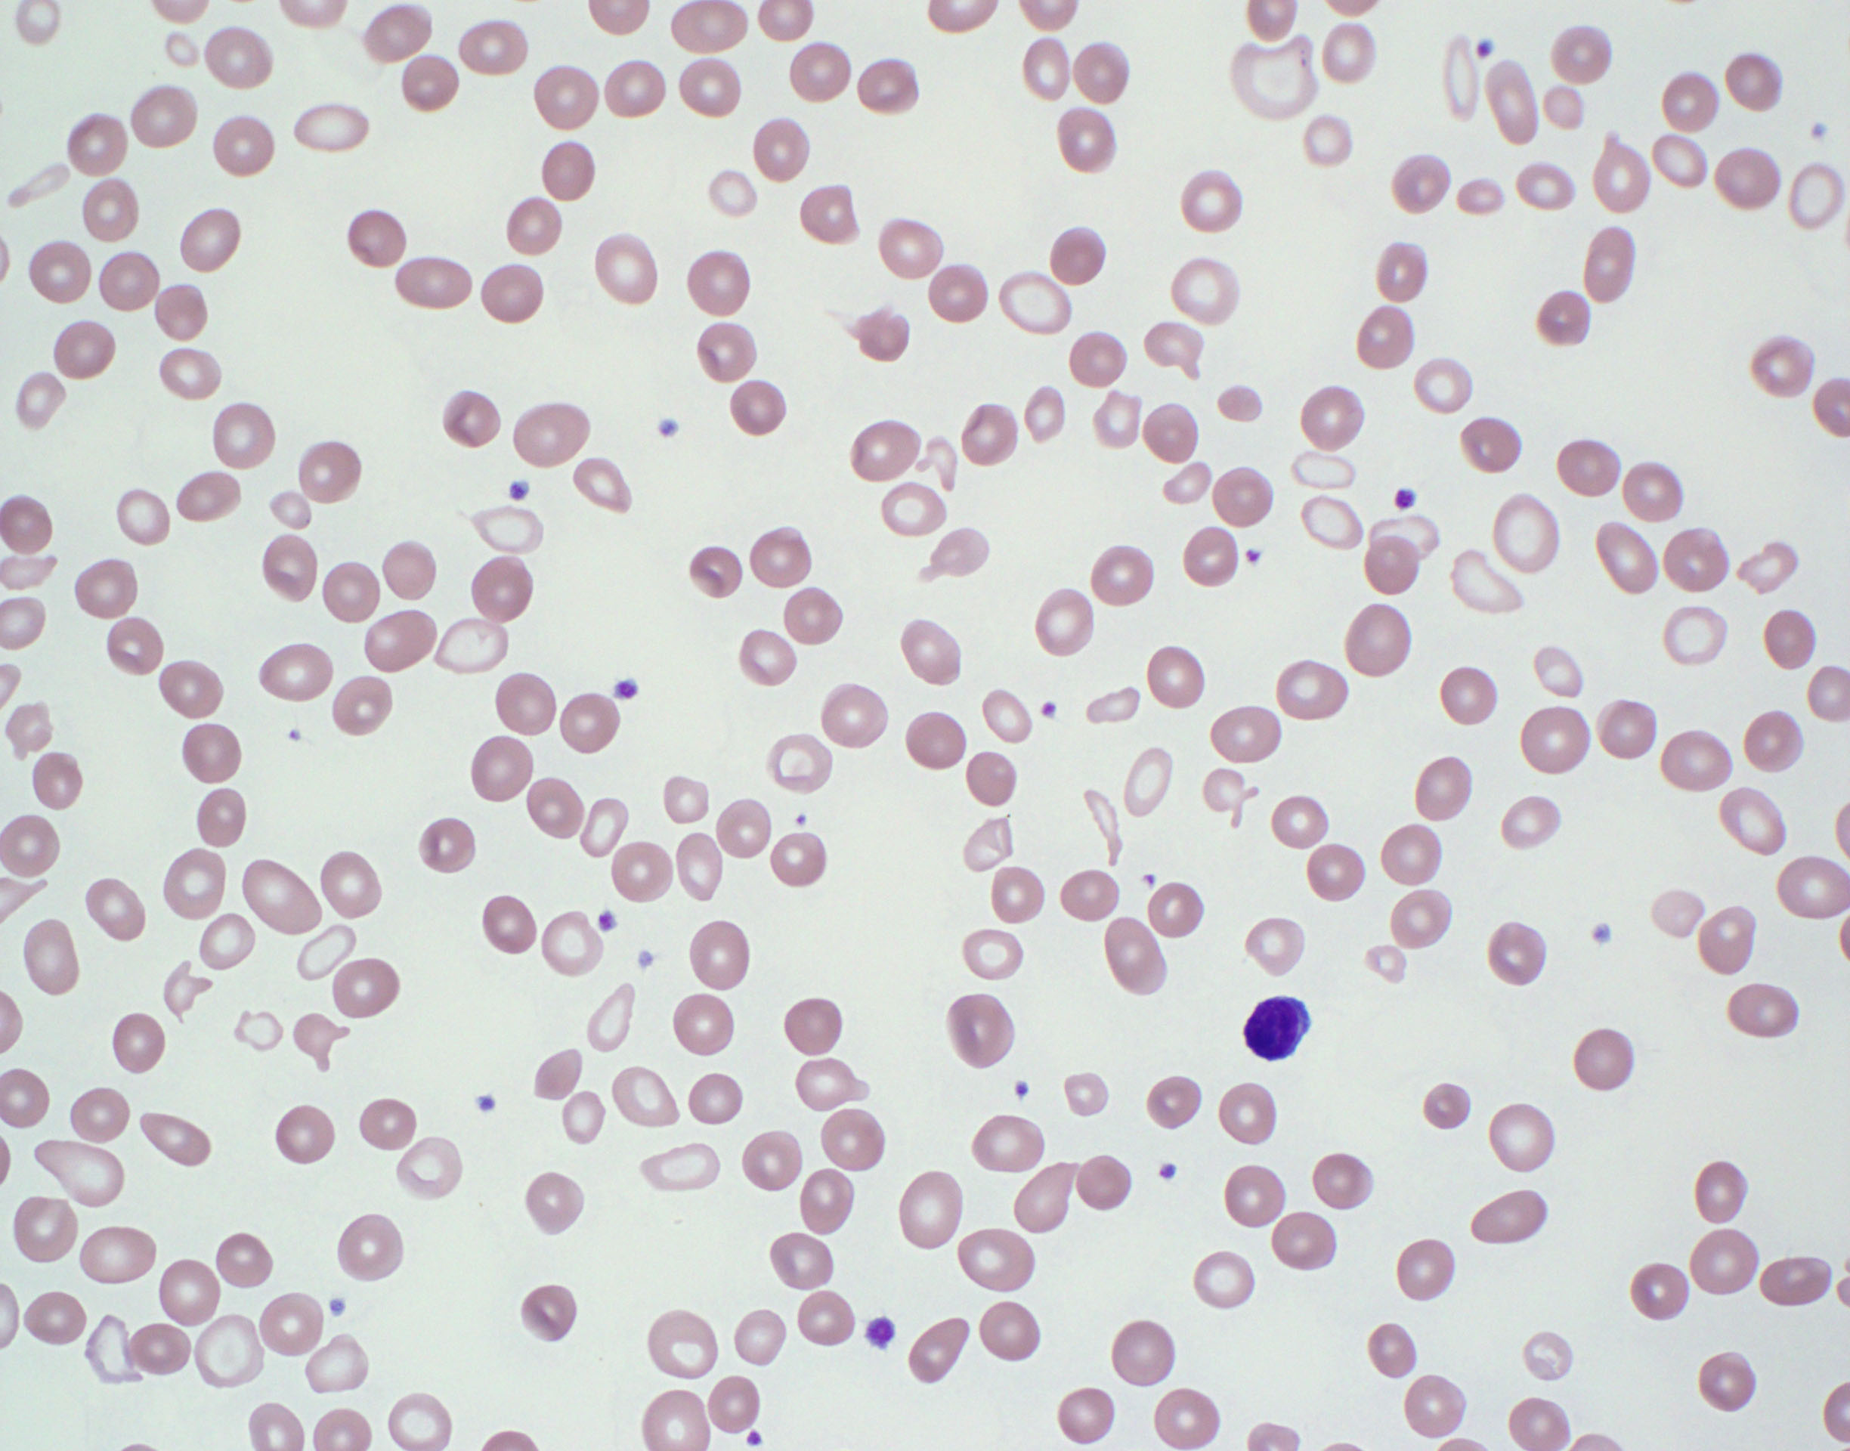
Review of the peripheral smear reveals a dimorphic red cell population. One is pale and microcytic with poikilocytosis. The other is normochromic.
Pappenheimer bodies (P) and occasional basophilic stippling are noted.

Slide 32
Sideroblastic Anemia
R
Prussian blue staining of the bone marrow aspirate in such patients will reveal ringed sideroblasts (R) which are required for diagnosis. A red cell with Pappenheimer bodies is also present (P)
Genetic analysis of the current case revealed mutations in the δ-aminolevulinic acid synthase gene (ALAS2), consistent with X-linked sideroblastic anemia.
P

Slide 33
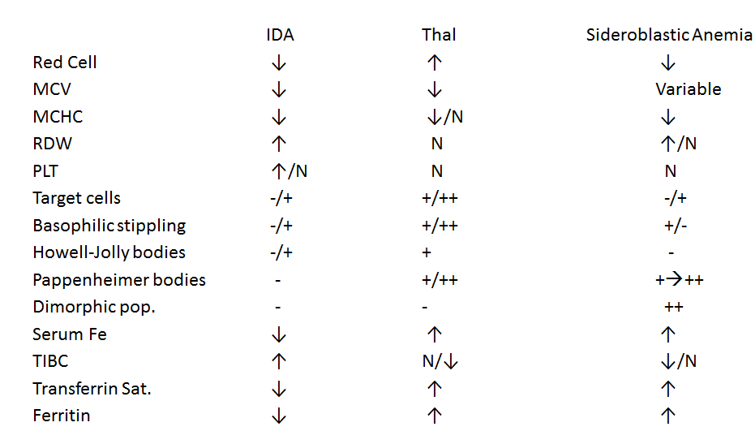
Sideroblastic Anemia
IDA Thal Sideroblastic Anemia
Red Cell ↓ ↑ ↓
MCV ↓ ↓ Variable
MCHC ↓ ↓/N ↓
RDW ↑ N ↑/N
PLT ↑/N N N
Target cells -/+ +/++ -/+
Basophilic stippling -/+ +/++ +/-
Howell-Jolly bodies -/+ + -
Pappenheimer bodies - +/++ +→++
Dimorphic pop. - - ++
Serum Fe ↓ ↑ ↑
TIBC ↑ N/↓ ↓/N
Transferrin Sat. ↓ ↑ ↑
Ferritin ↓ ↑ ↑

Slide 34
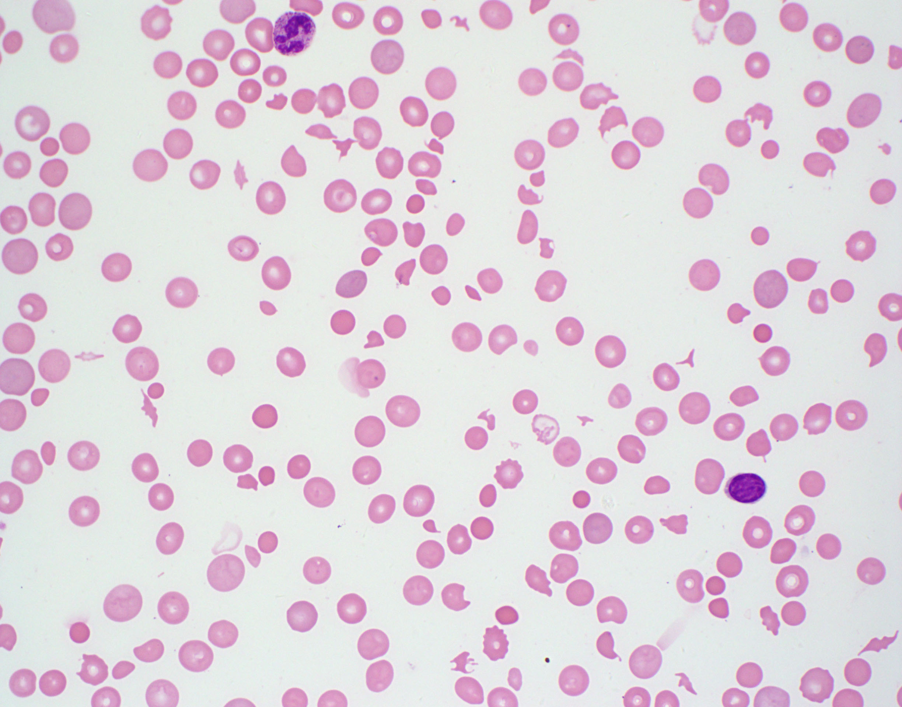
The peripheral blood smear showed polychromasia (red arrow), thrombocytopenia, numerous schistocytes (blue arrow), spherocytes and occasional helmet cells (green arrow).
This smear is consistent with microangiopathic hemolytic anemia (MAHA).

Slide 35
Microangiopathic Hemolytic Anemia
MAHA is associated with several causes of thrombotic microangiopathy syndromes such as TTP, HUS, and aHUS
Other causes of MAHA include DIC, infection, malignancy, preeclampsia, HELLP, and systemic rheumatic diseases

Slide 36
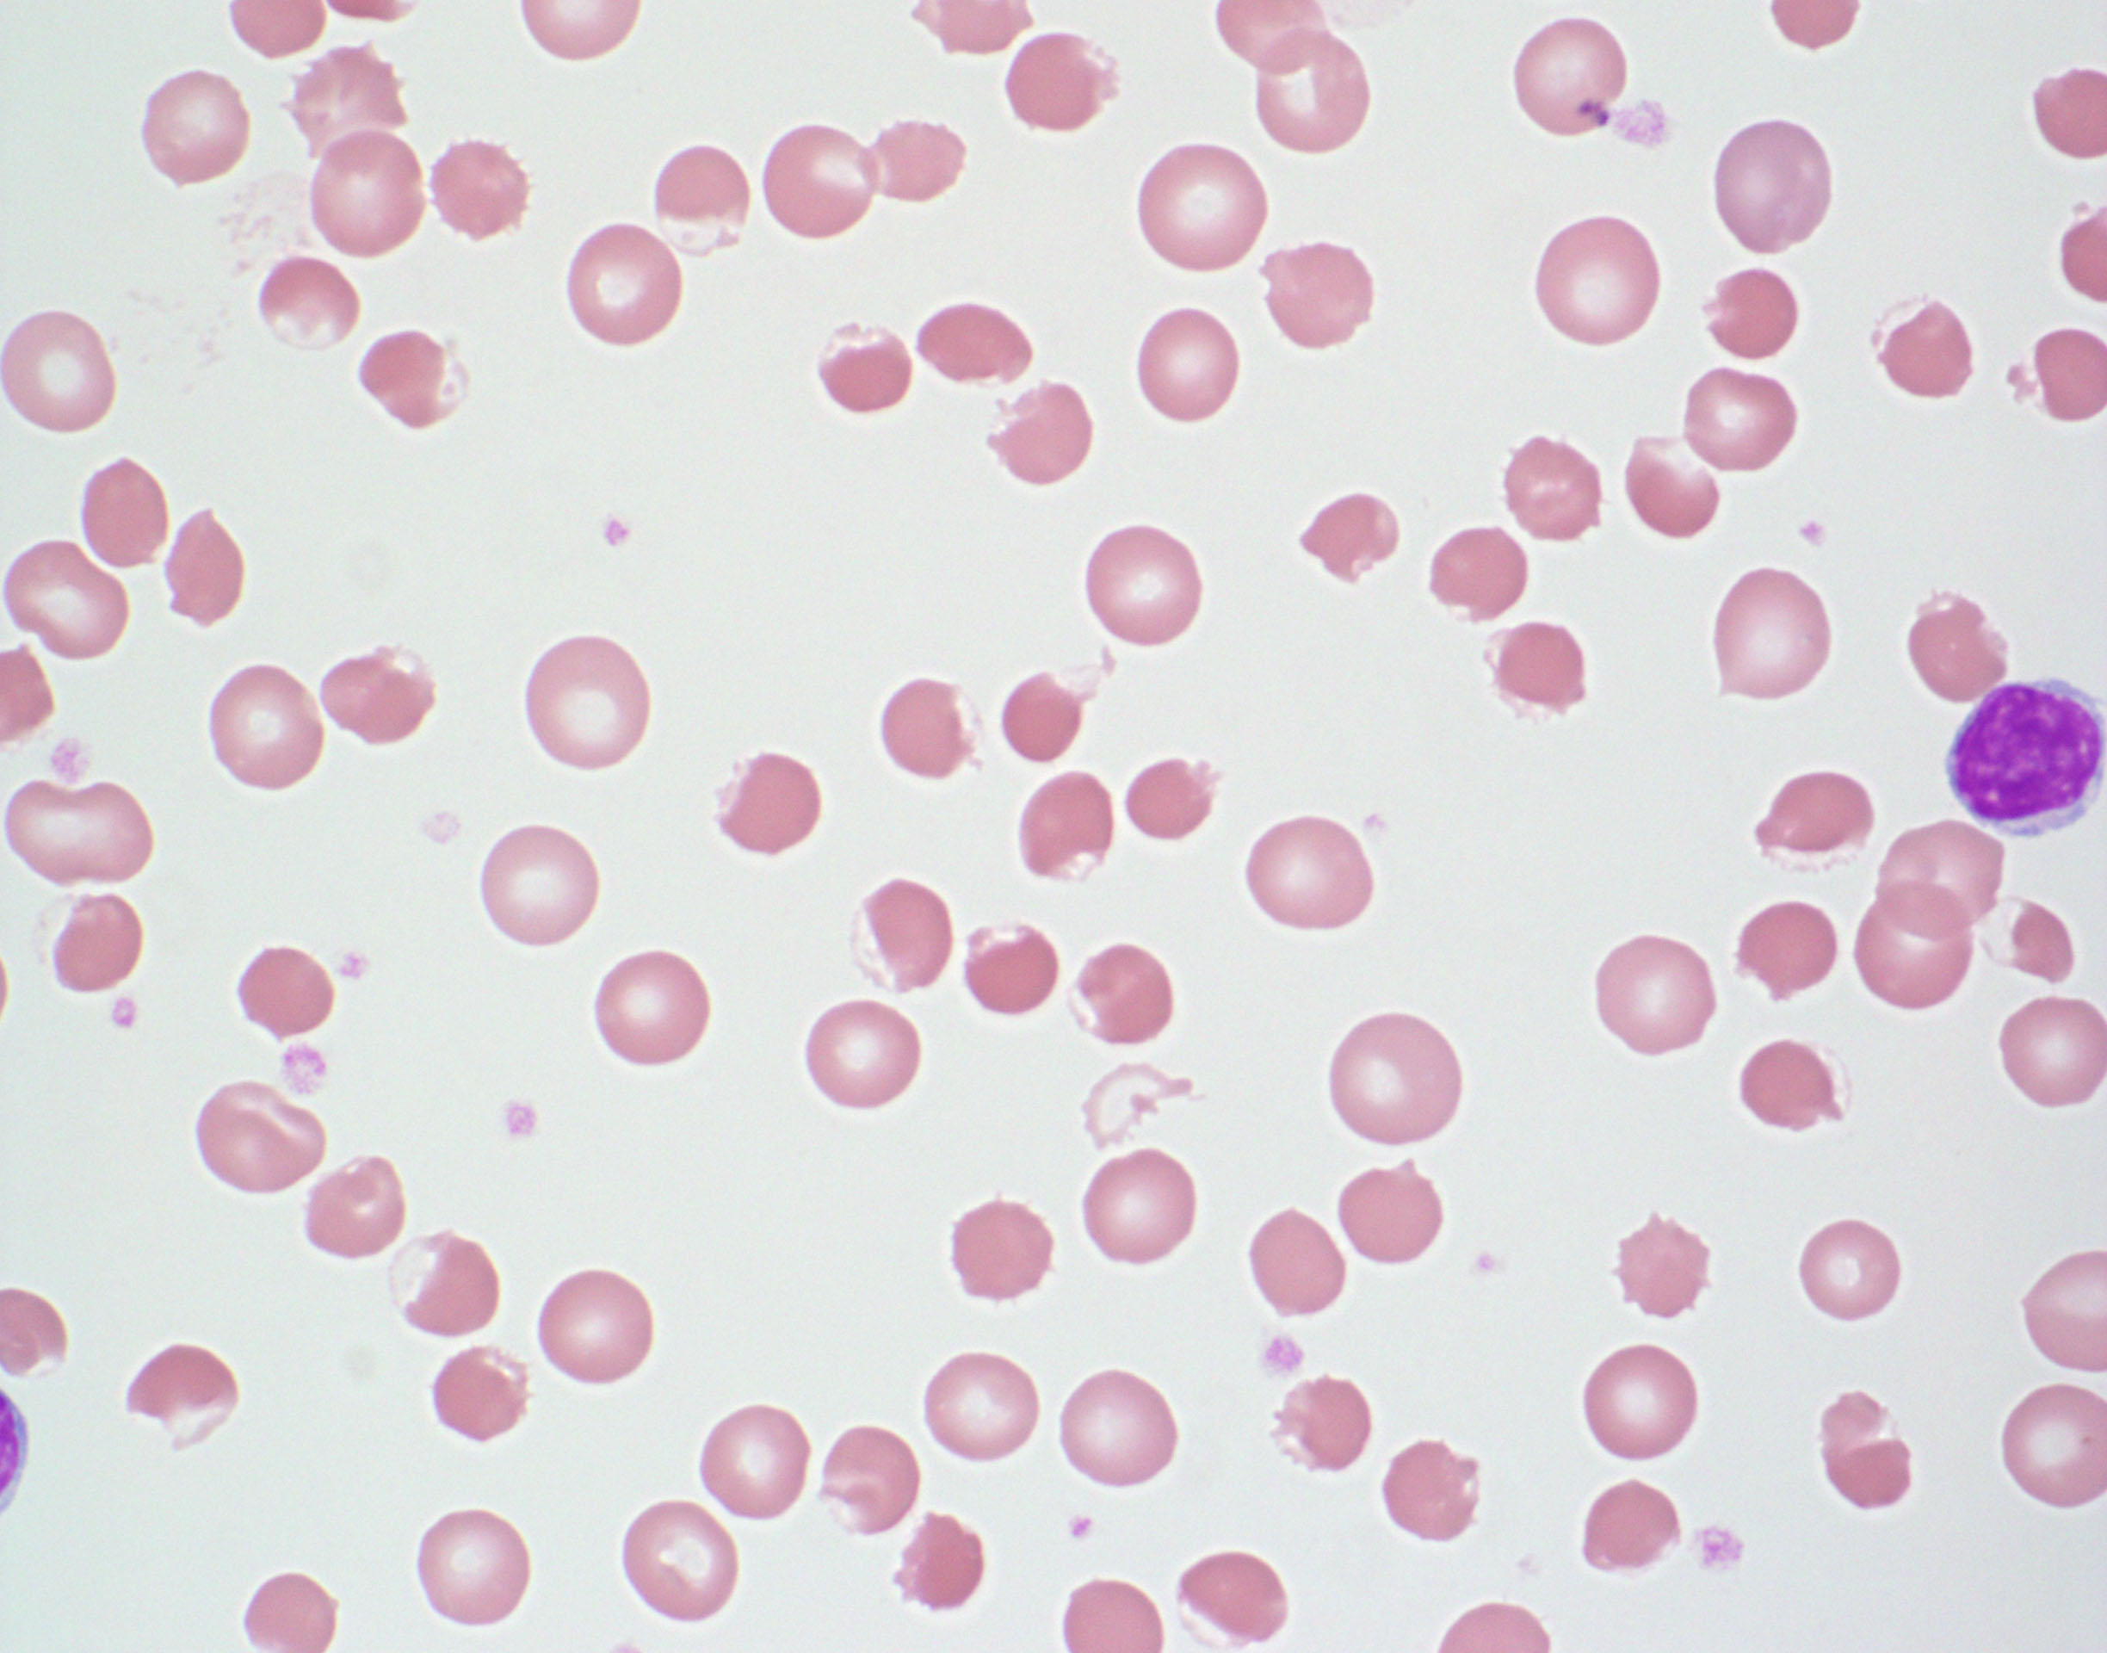
The findings on the peripheral smear are consistent with G6PDH deficiency. There are numerous blister cells on the smear (aka eccentrocytes)
Blister cells are formed by disruption of the cell membrane during removal of precipitated oxidized hemoglobin (Heinz bodies) followed by reattachment of the two ends of the membrane with vacuole formation.
Bite cells are also seen in G6PDH deficiency through removal of oxidized precipitated hemoglobin without vacuole formation

Slide 37
The peripheral smear is consistent with Hemoglobin C disease. There are target cells, microcytosis, and reticulocytosis. There is a hemoglobin C crystal present in the center of the field (blue arrow).
Hemoglobin C is due to mutation of the hemoglobin beta chain which is less soluble than the normal beta chain and leads to crystallization. The crystals lead to red cell rigidity and decreased survival time. Hgb C, by itself, does not polymerize or cause sickling.
Both heterozygous and homozygous Hemoglobin C variants can lead to dehydration of the red cells and consequent increase of the MCHC. Hemoglobin C trait usually does not cause anemia.

Slide 38
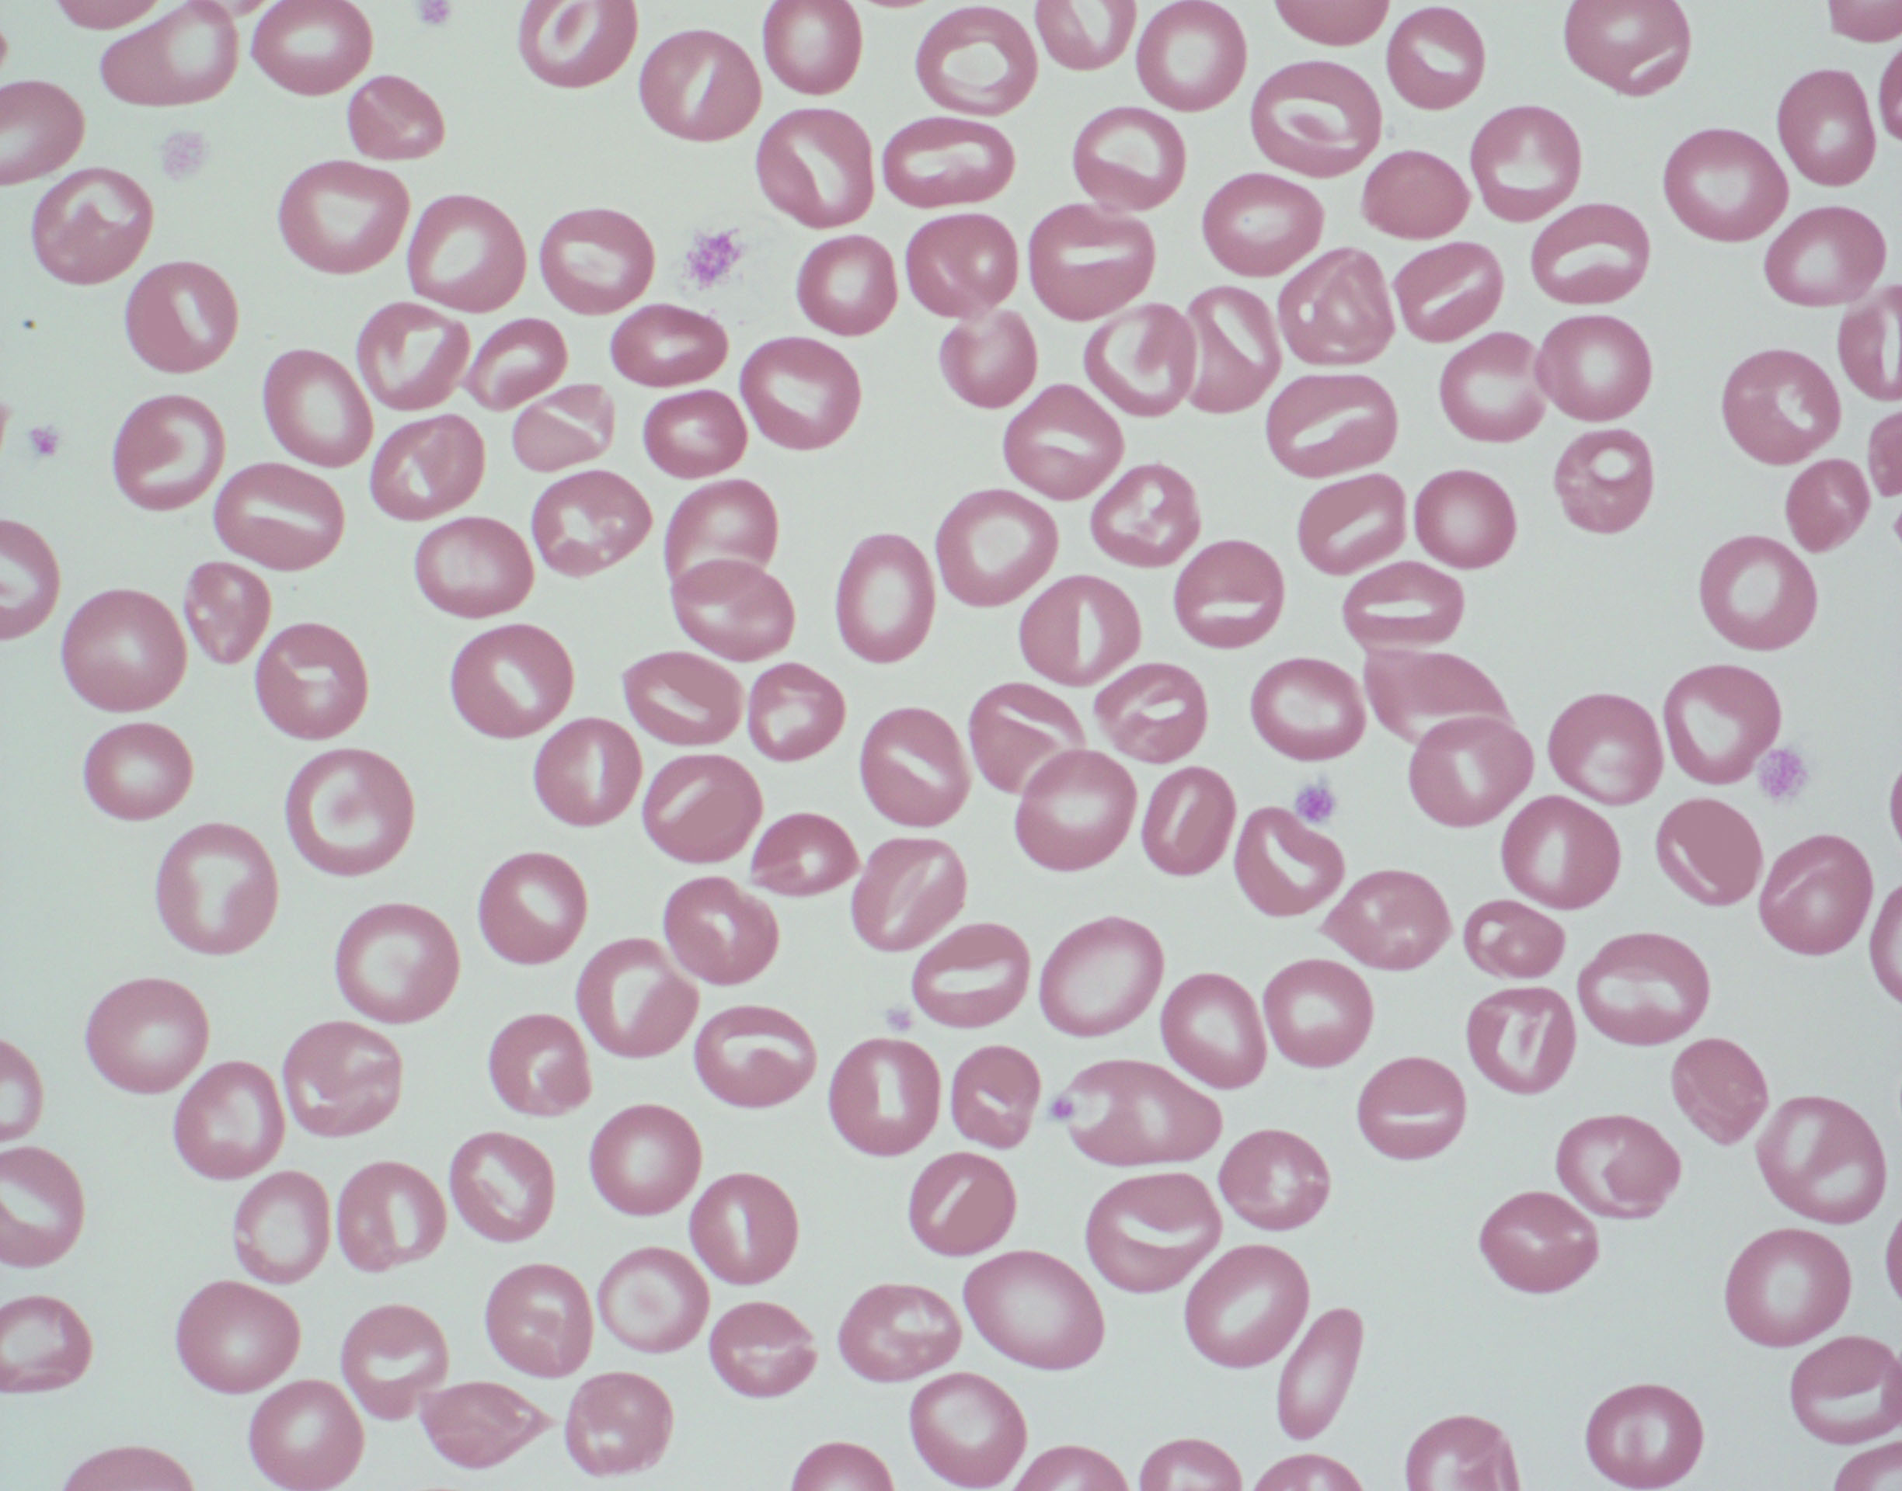
Review of the peripheral smear shows many stomatocytes. A stomatocyte is a uniconcaved red cell which results in central pallor that looks like a slit or a slightly curved rod.
Hereditary stomatocytosis is due mutations in Rh associated glycoprotein (RhAG) which leads to cation permeable red cells with resultant overhydration of the cell. These cells have greatly increased intracellular Na+.
The diagnostic laboratory features include peripheral smear stomatocytes (5-50%), hemolysis, macrocytosis, low MCHC, and positive osmotic fragility test.

Slide 39
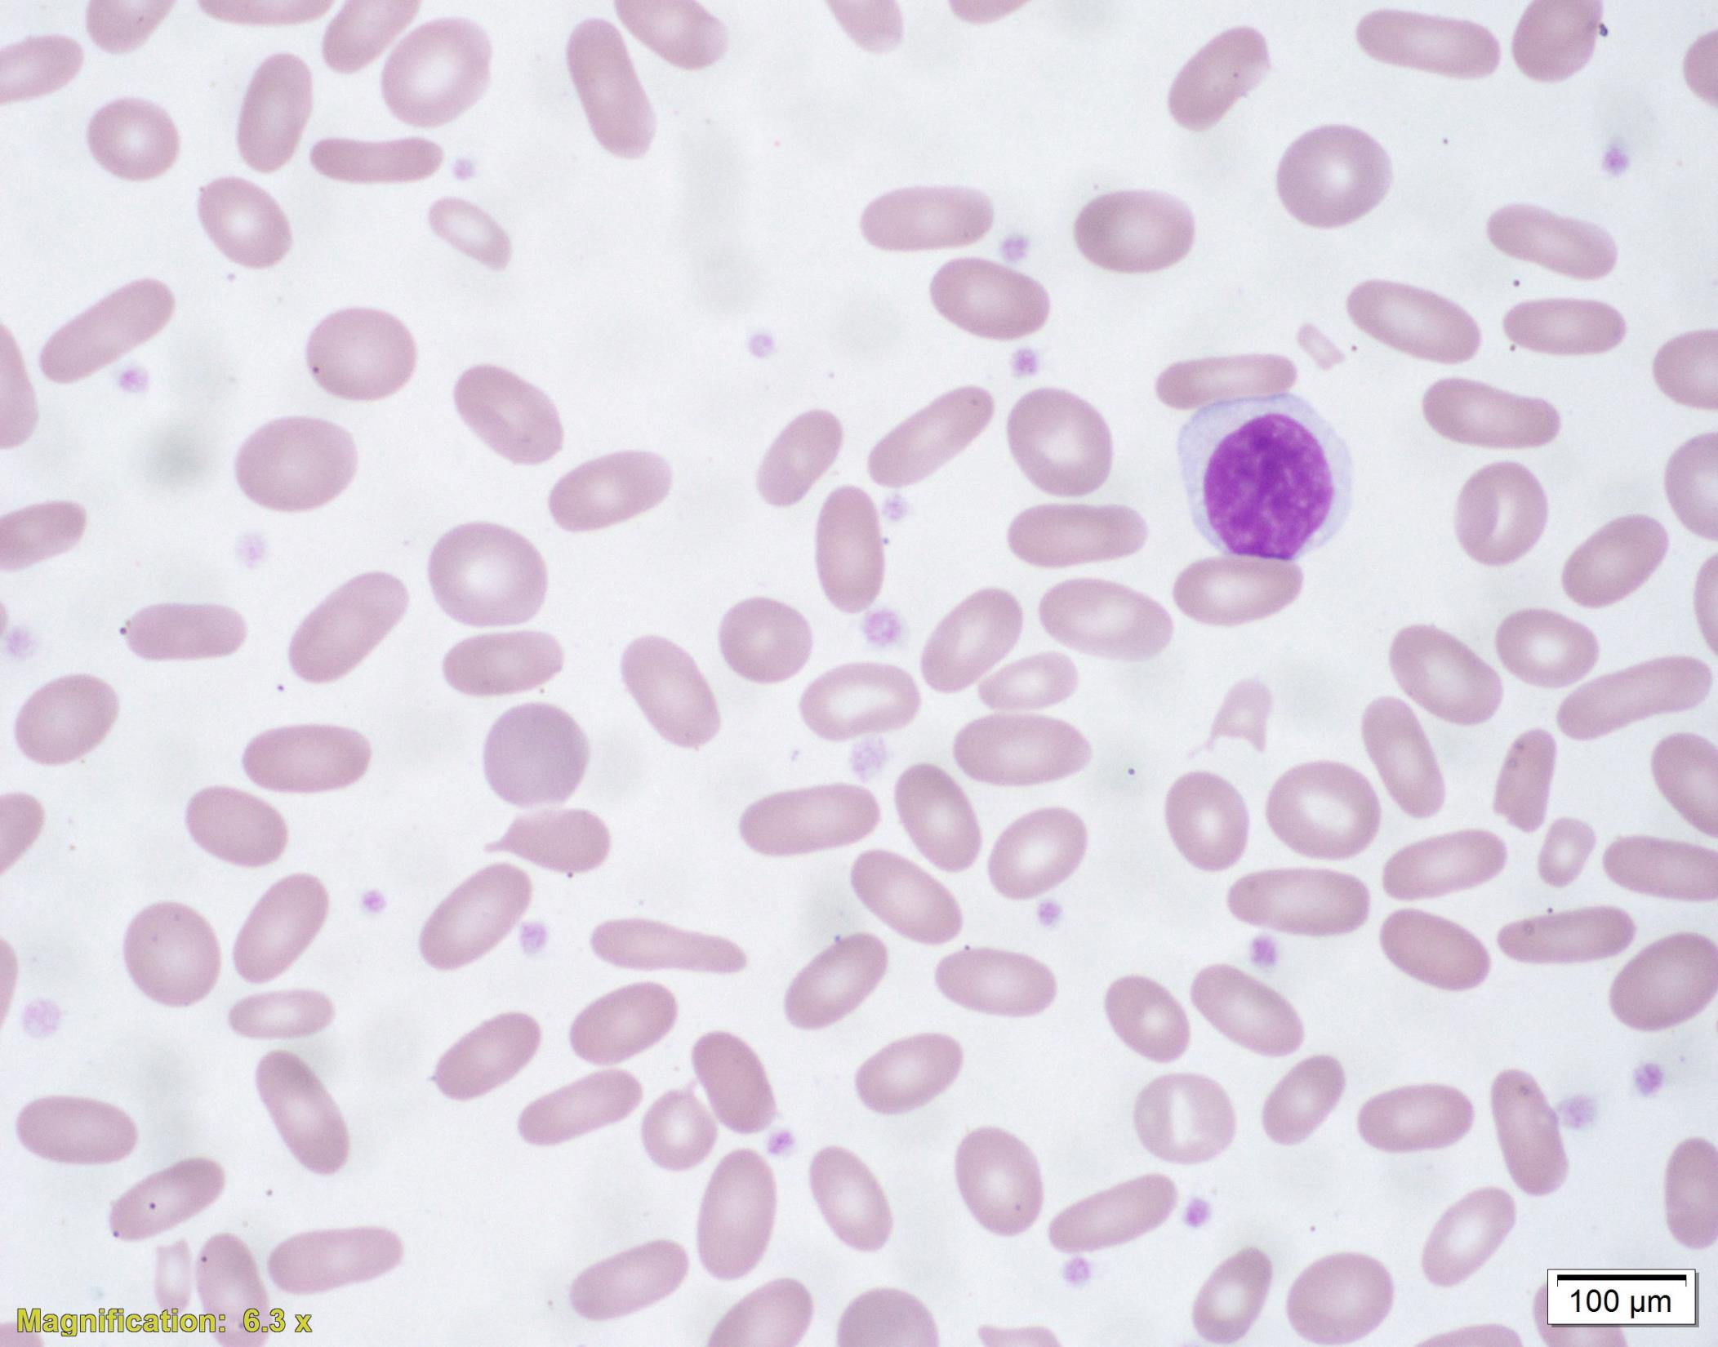
The findings on the peripheral smear include many elliptocytes (ovalocytes). These are rod shaped cells with two parallel sides of equal lengths and two rounded ends. Central pallor is usually preserved.
Normal blood smears can contain a few ovalocytes/elliptocytes (<1%). When seen in large numbers, it is consistent with hereditary elliptocytosis (HE).
Typical heterozygous HE patients are usually asymptomatic. An osmotic fragility test is usually normal. Mutations in α–spectrin, β-spectrin, or protein 4.1 are responsible.

Slide 40
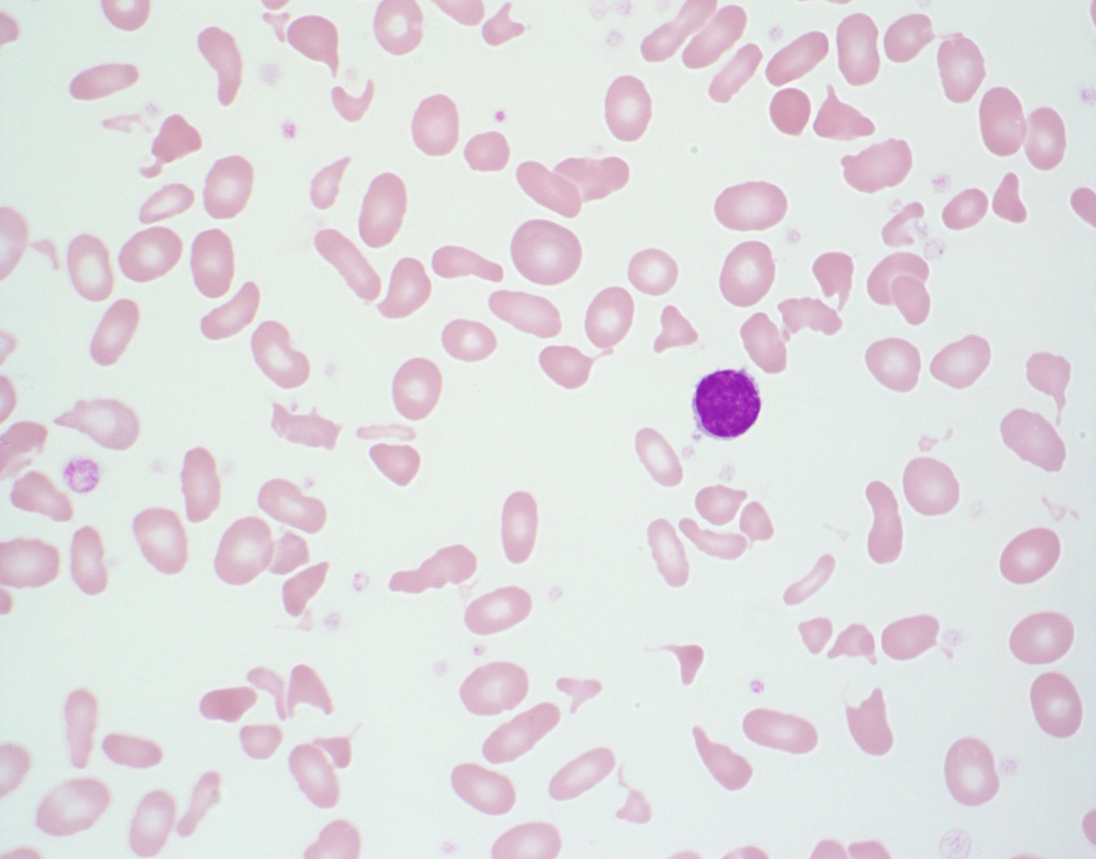
The smear shows anemia with marked poikilocytosis including schistocytes and elliptocytes. It is consistent with hereditary pyropoikilocytosis (HPP).
Essentially HPP is a more severe form of hereditary elliptocytosis when both parents have hereditary elliptocytosis and each passes on abnormal allele to offspring.

Slide 41
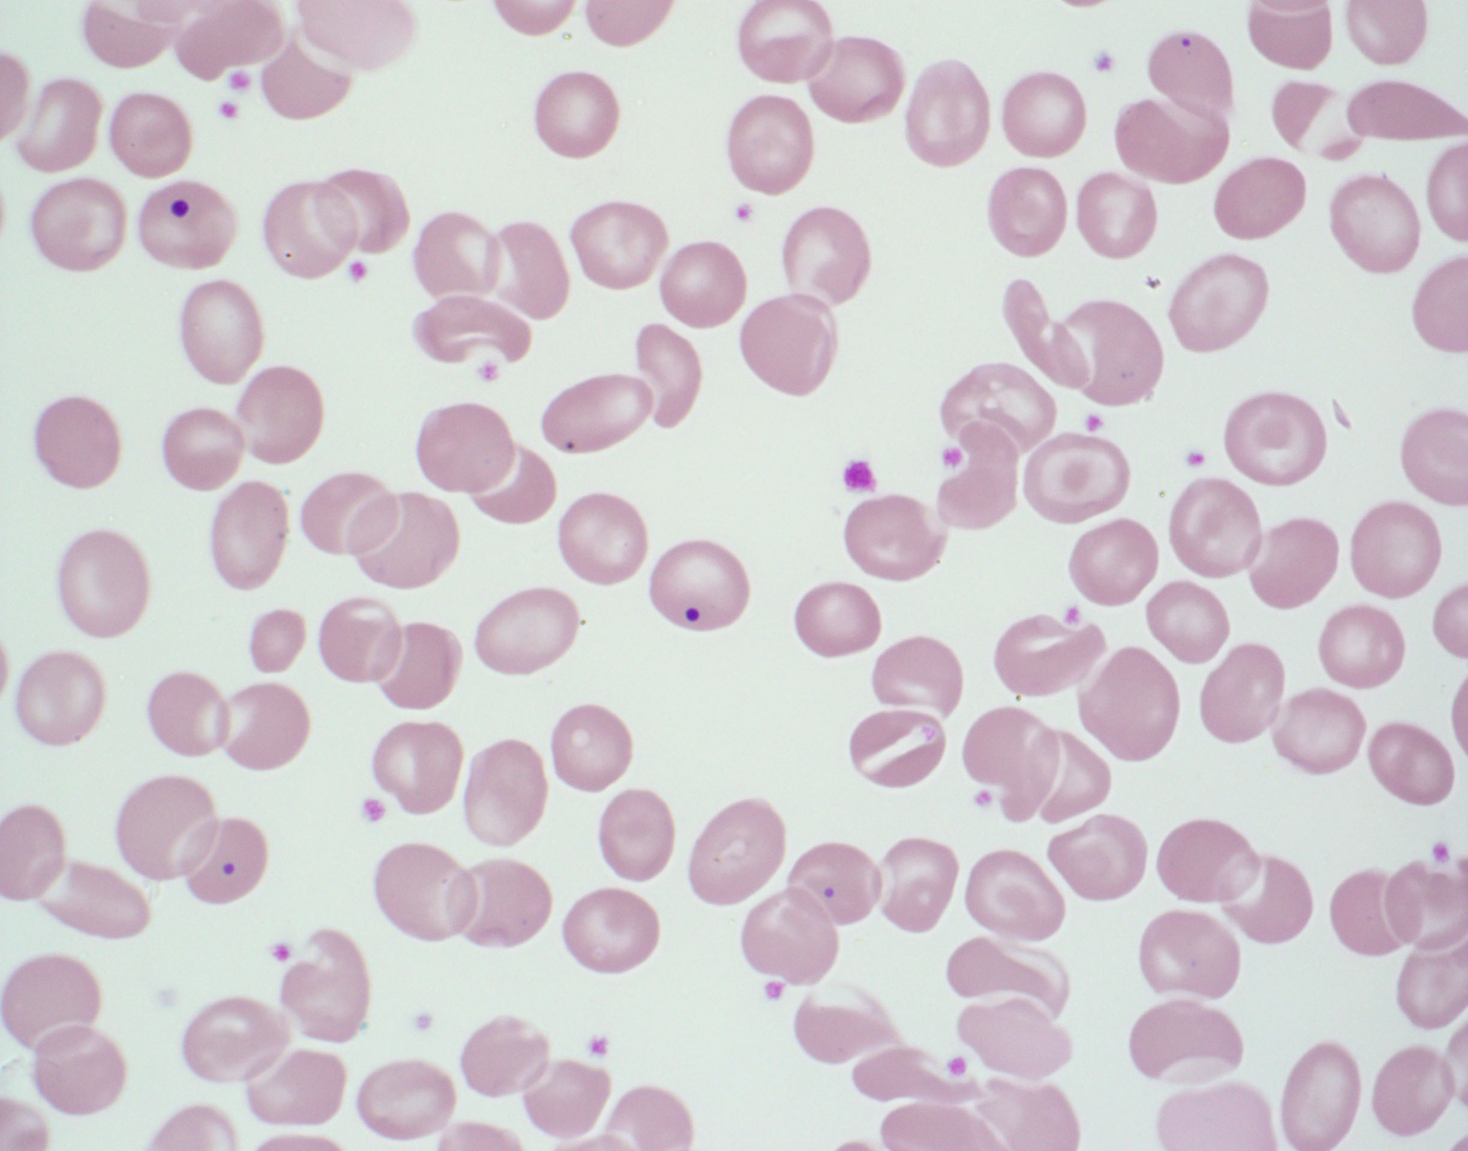
These inclusions are Howell-Jolly bodies which are nuclear fragments left behind in the cytoplasm after extrusion of the nucleus.

Slide 42
RBC Inclusion Review

Slide 43
Basophilic Stippling
Coase stippling consists of aggregated ribosomes with incompletely degraded RNA
Visualized with Wright staining
Consists of numerous small deep blue or grey blue granules which are distributed evenly throughout the red cell
Clinical conditions associated with basophilic stippling:
Lead poisoning
Pyrimidine 5’-nucleotidase deficiency
Thalassemias
Hemoglobinopathies
Sideroblastic anemia
MDS
Congenital dyserythropoietic anemia

Slide 44
Howell-Jolly Body
H-J bodies consist of retained nuclear material
Visualized with Wright staining
Small purple or purple-blue staining round objects of variable size. Usually one per cell, but can sometimes see two or more per cell.
Clinical conditions associated with H-J bodies:
Postsplenectomy
Functional asplenia (eg sickle cell disease)
Severe hemolytic anemia
Megaloblastic anemia
Congenital dyserythropoietic anemia
Occasionally in newborns especially in those born prematurely

Slide 45
Pappenheimer Bodies
Consists of lysosomes containing iron-protein complexes
Visualized with Wright staining; Prussian blue staining (stains iron)
Small irregular single or cluster of dark staining inclusions within red cells. They stain dark blue or black with Wright-Giemsa and blue with Prussian blue staining
Clinical conditions associated with Pappenheimer bodies:
Functional or anatomic asplenia
Iron overloading:
Hemolytic anemias
Thalassemias
Hemoglobinopathies
Megaloblastic anemia
Congenital dyserythropoietic anemia
Sideroblastic anemia

Slide 46
Heinz Bodies
Heinz bodies are aggregates of denatured hemoglobin which is usually attached to the inner red cell membrane
Not visible with Wright staining; must use supravital dyes such as brilliant cresyl blue
Variably sized and numbered depending on rate of hemoglobin oxidation
Clinical conditions associated with Heinz bodies:
G6PDH deficiency
Hereditary Heinz body hemolytic anemia
Oxidant drug or chemical poisoning
Rare homozygous hemoglobinopathies

Slide 47
Hemoglobin H inclusions
Hemoglobin H inclusions are precipitates of excess β tetramer chains
Not visible with Wright staining; must use supravital dyes such as brilliant cresyl blue
Inclusions appear as numerous small bluish granules distributed evenly throughout the cell
Clinical conditions associated with HGB H inclusions:
Alpha thalassemia with deletion of 3 of the 4 genes.

Slide 48
RBC – Normal red cell maturation
Proerythroblast (Pronormoblast)
Basophilic
Erythroblast
Polychromatic
Erythroblast (early)
Polychromatic
Erythroblast (late)
Orthochromatic
Erythroblast
Reticulocyte
Mature
Erythrocyte

Slide 49
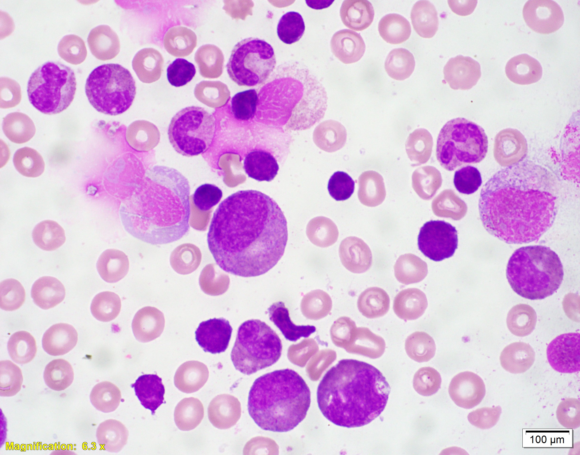
Diamond Blackfan
Bone marrow aspirate with complete absence of erythroid precursors
DDx:
DBA
Transient erythoblastopenia of childhood
Parvovirus

Slide 50
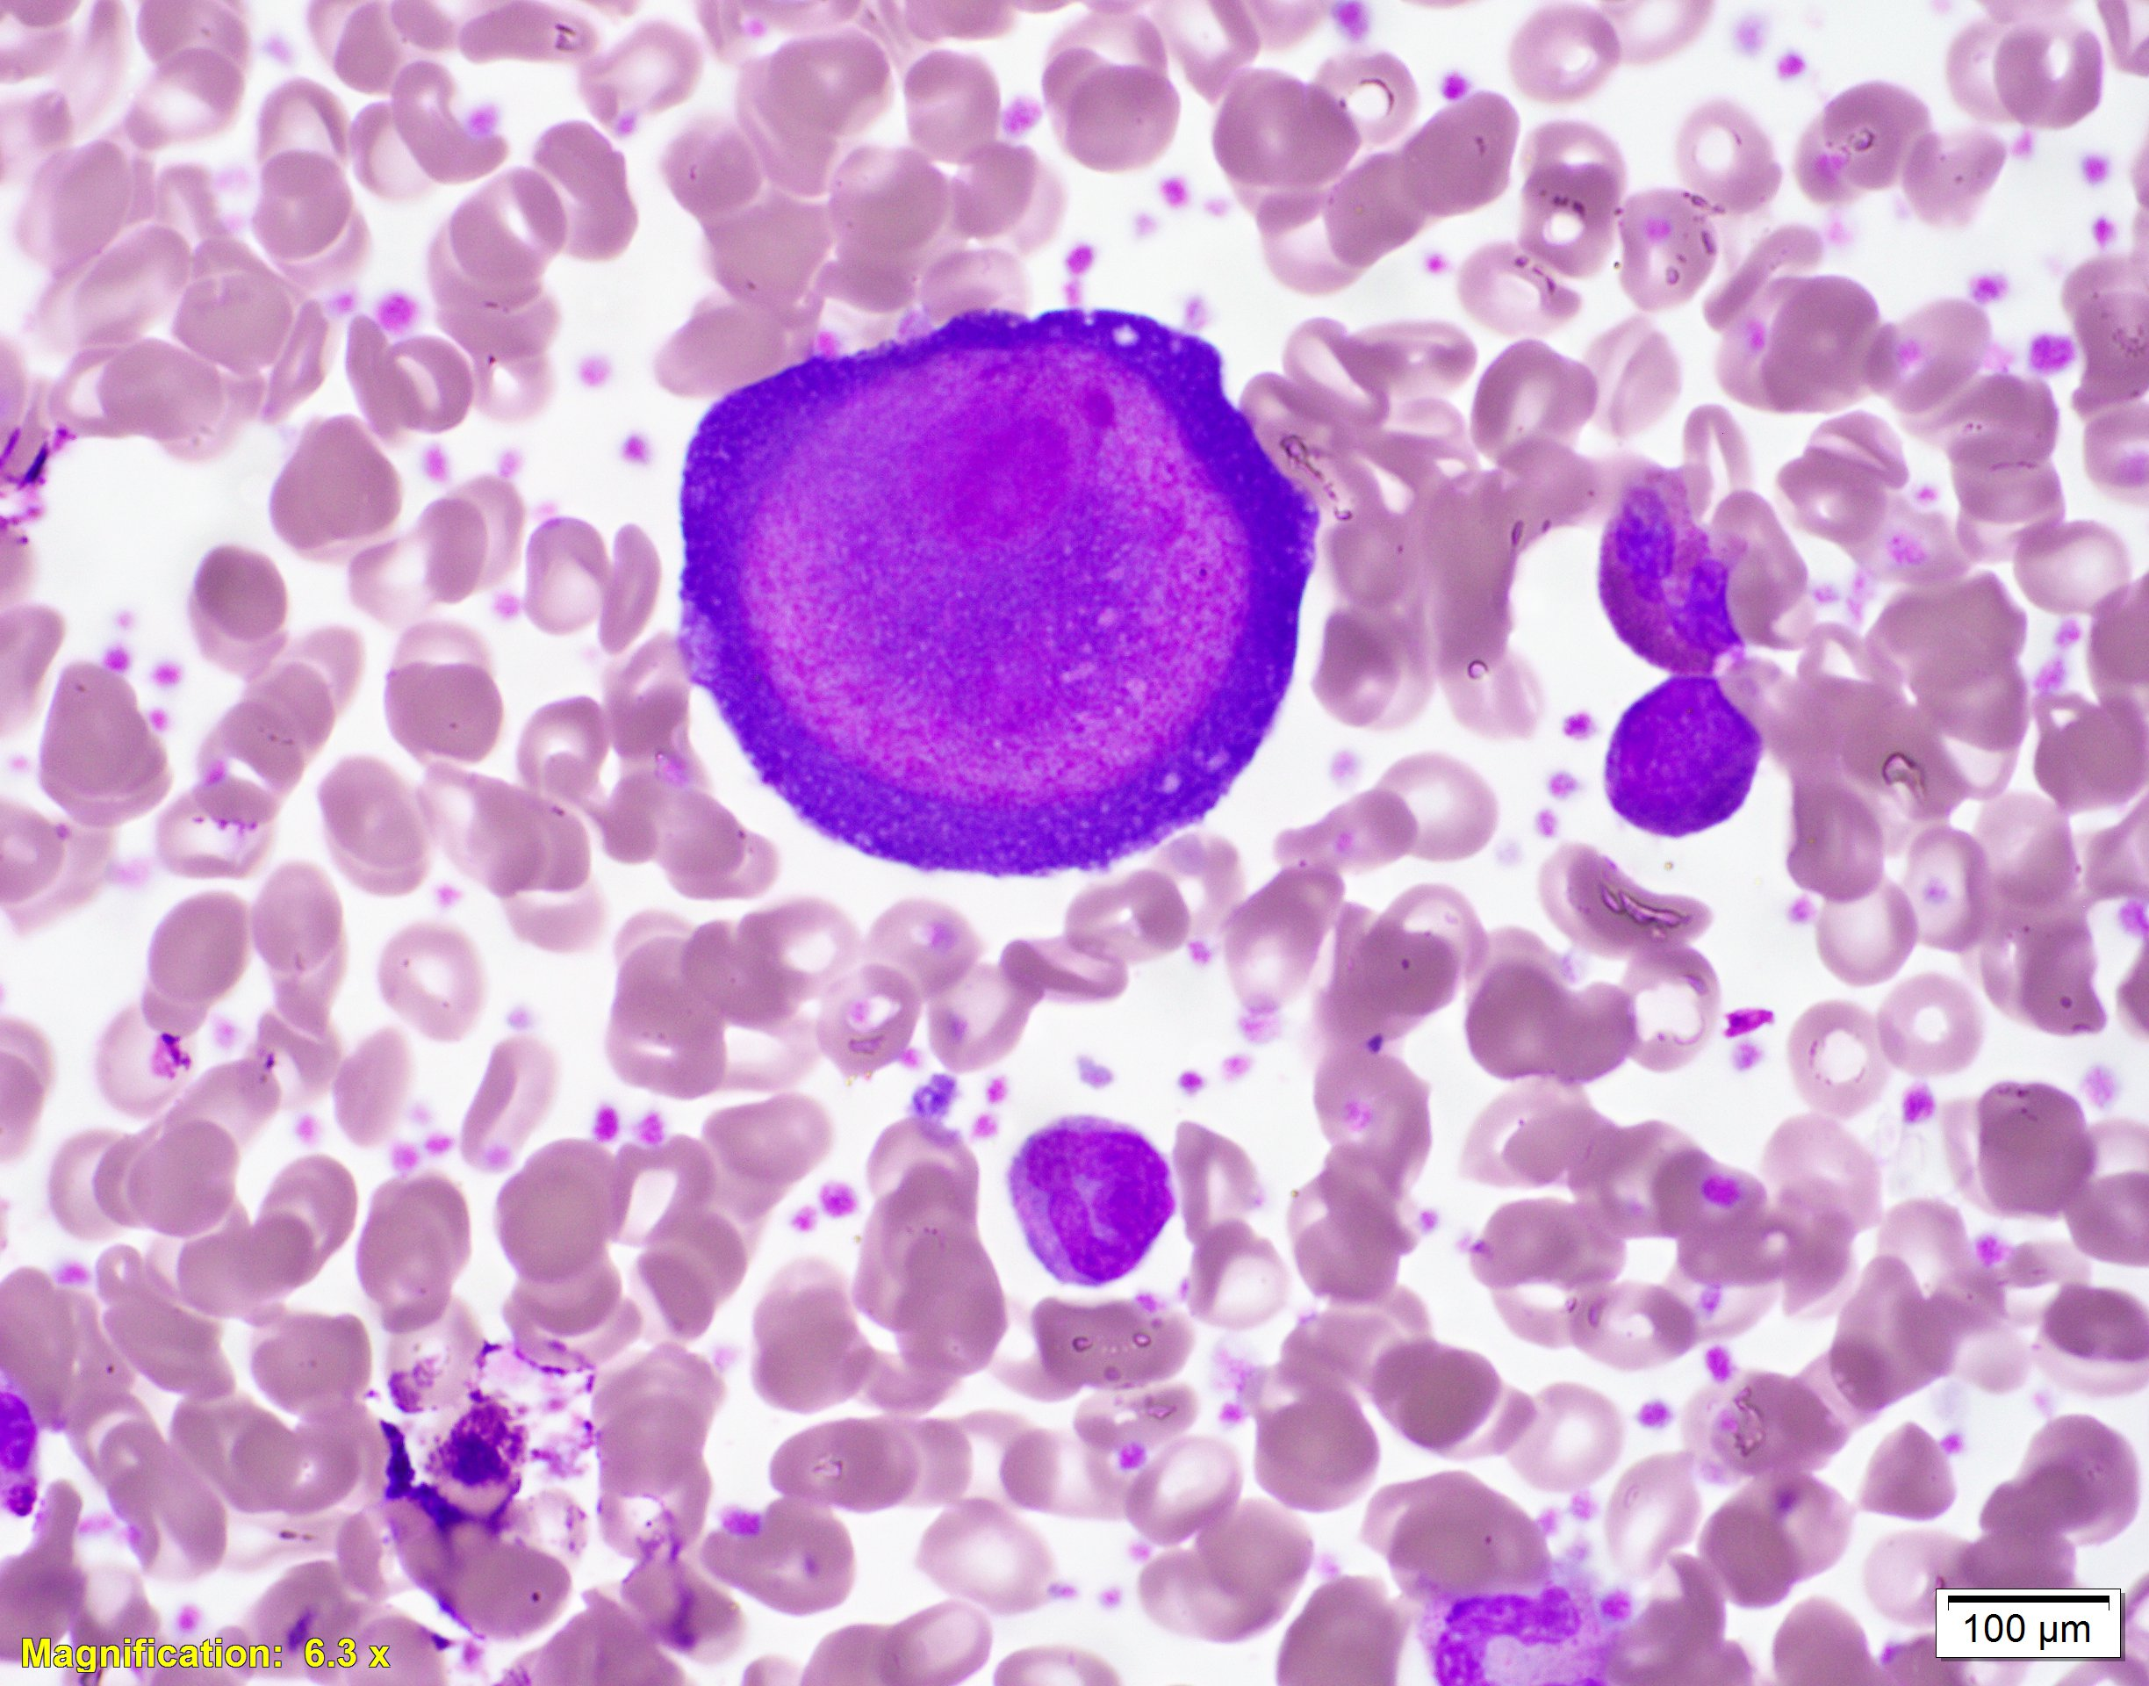

Slide 51
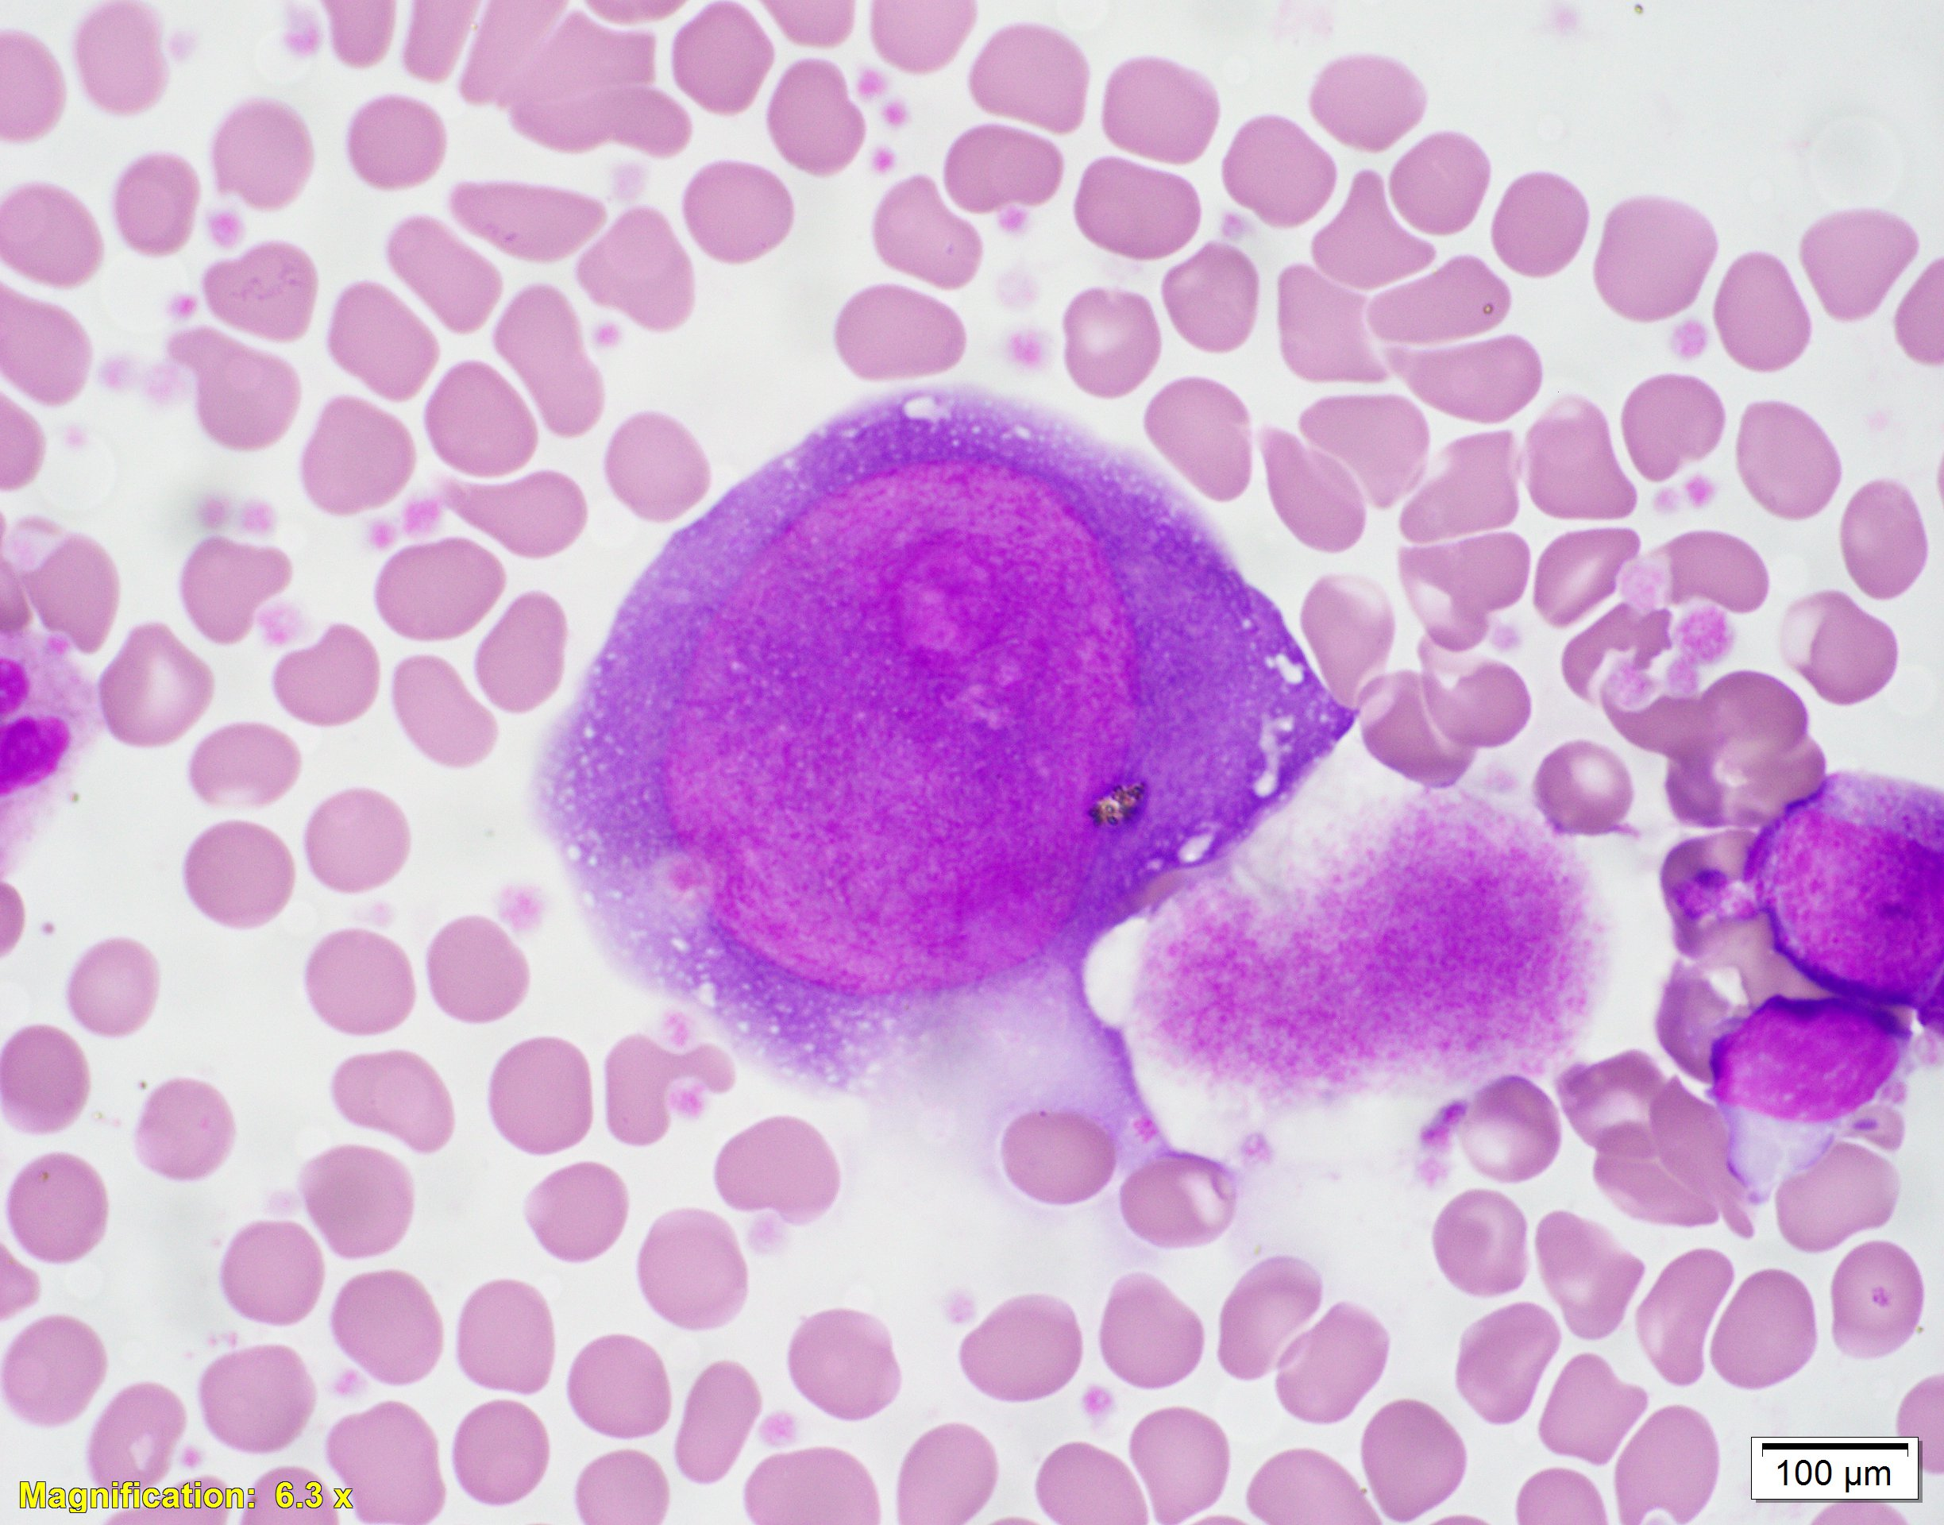
Parvovirus
Giant erythroid precursors with nuclear viral inclusions
Infection causes reticulocytopenia

Slide 52
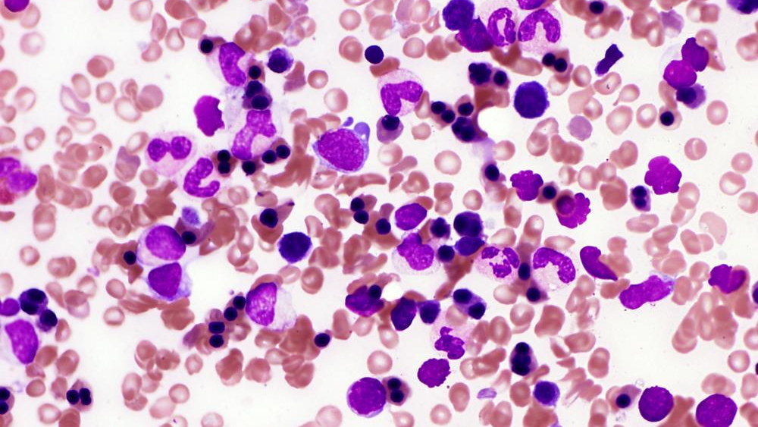

Slide 53
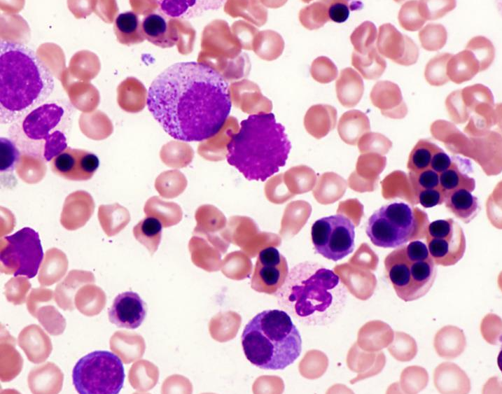
Congenital Dyserythropoeitic Anemia Type II
Normocytic anemia with ineffective hematopoiesis
Numerous normoblastic red cell precursors with frequent bi-nucleation
Pathogenic germline variant in CDAN2
Hereditary erythroblastic multinuclearity with positive acidified serum lysis test
Slide 52 & 53: These images were originally published in ASH Image Bank. Kristian T. Schafernak, M.D. Congenital Dyserythropoietic Anemia (CDA) type II 1 & 2. ASH Image Bank. 2016; 60891-60892. © the American Society of Hematology. Used with permission.

Slide 54
 | CDA Type I | CDA Type II | CDA Type III
Red cell size | Macrocytic | Normo- to Macrocytic | Macrocytic
Morphology | Megaloblastic with a smaller number of binucleated red cell precursor with nuclear bridges | Normoblastic with frequent number of binucleated red cell precursors | Gigantoblasts (large erythroid precursors with multinucleation)
Acid serum hemolysis (Ham’s test) | Negative | Positive | Negative
Gene | CDAN1 | CDAN2 | CDAN3

Slide 55
Megaloblastic anemia
Acquired
Cobalamin deficiency
↓ Cobalamin ↑ Homecysteine ↑ Methyl malonic acid
Folate deficiency
Medications
Genetic
Inborn errors of folate transport and metabolism
Ex: DHFR deficiency
Inborn errors of cobalamin transport and metabolism
Thiamine responsive megaloblastic anemia syndrome (SLC19A2)
Hereditary Orotic Aciduria

Slide 56
Megaloblastic Anemia
Peripheral cytopenias
Macrocytosis
Hypersegmentation of mature neutrophils
Hypercellular bone marrow
Giant metamyelocytes and bands in BM
Large erythroid precursor nuclei with moth-eaten appearance
Nuclear-cytoplasmic dyssynchrony in erythroid precursors

Slide 57
Megaloblastic Anemia
Peripheral smear showing hypersegmentation of mature neutrophils
Normal neutrophils are polylobated with 2-5 lobes
Rare genetic disorder that causes hypersegmentation without abnormal B12 and folate:
Hereditary hypersegmentation of neutrophils

Slide 58
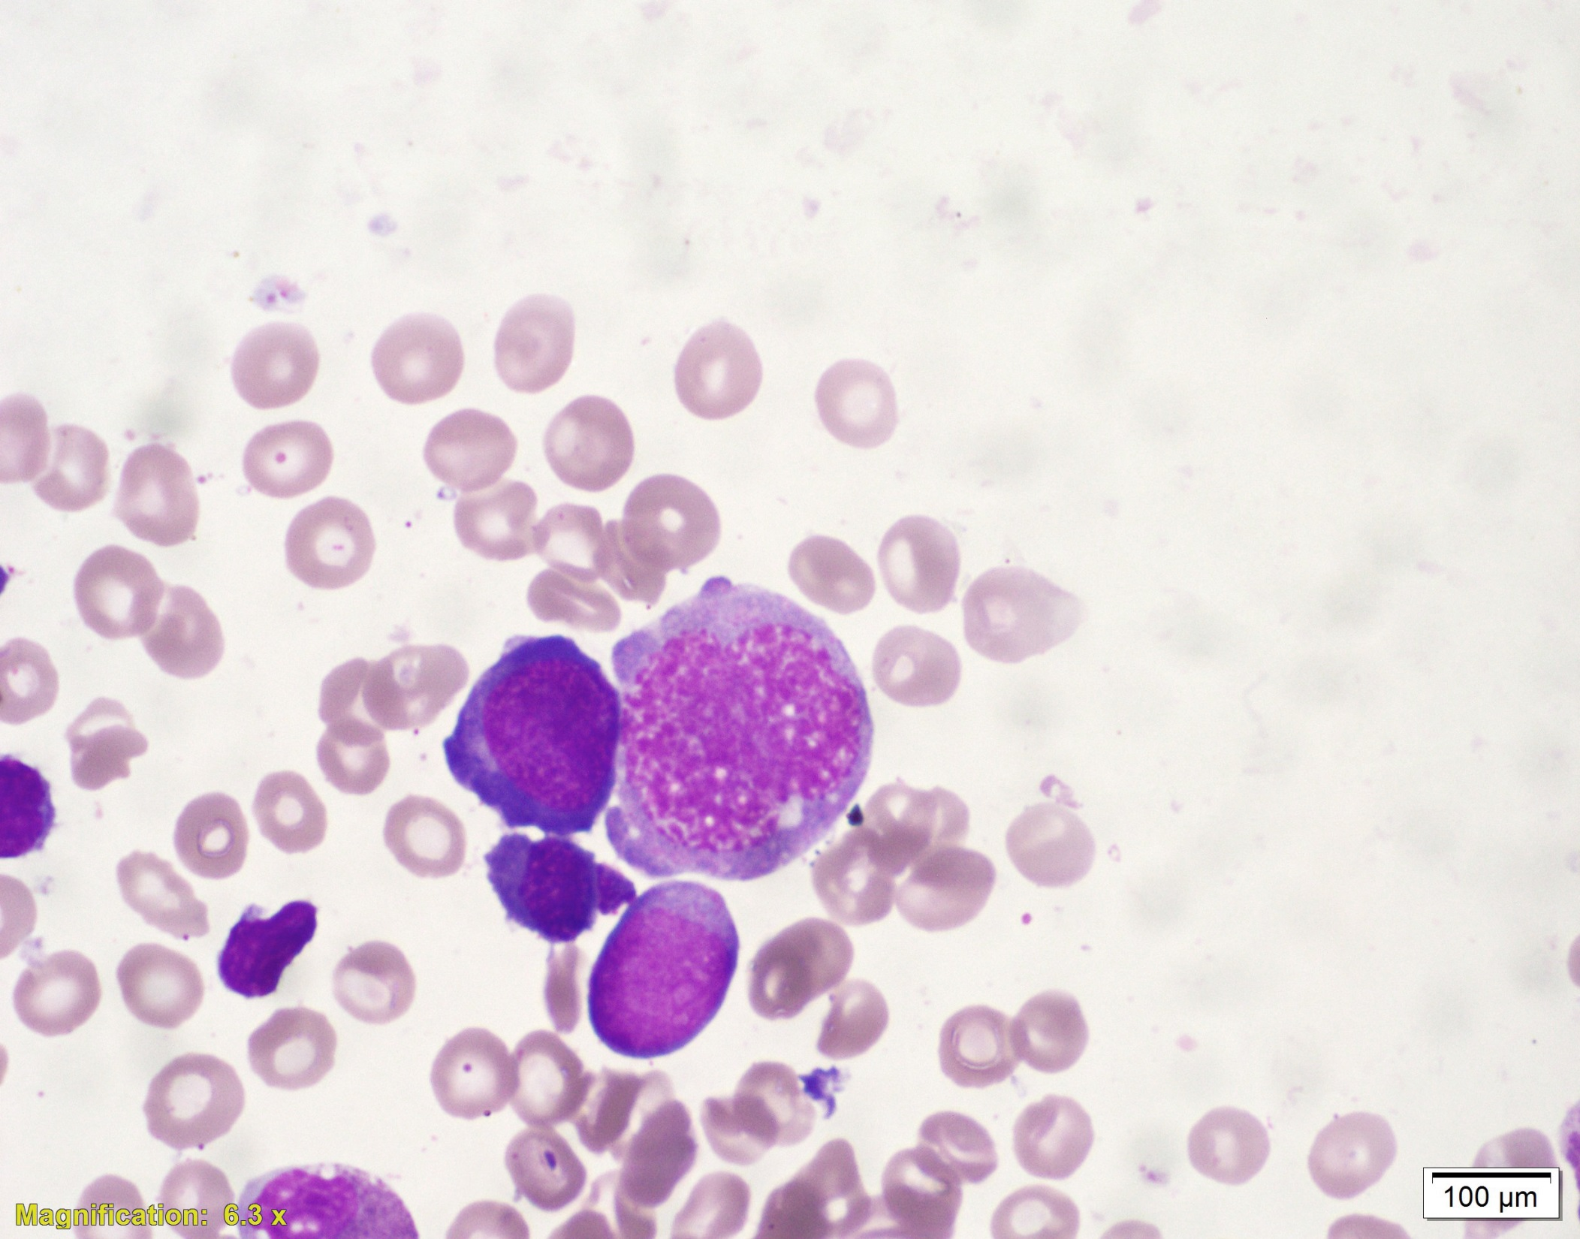
Megaloblastic Anemia
Bone marrow aspirate
Large erythroid precursor nuclei with finely reticulated appearance

Slide 59
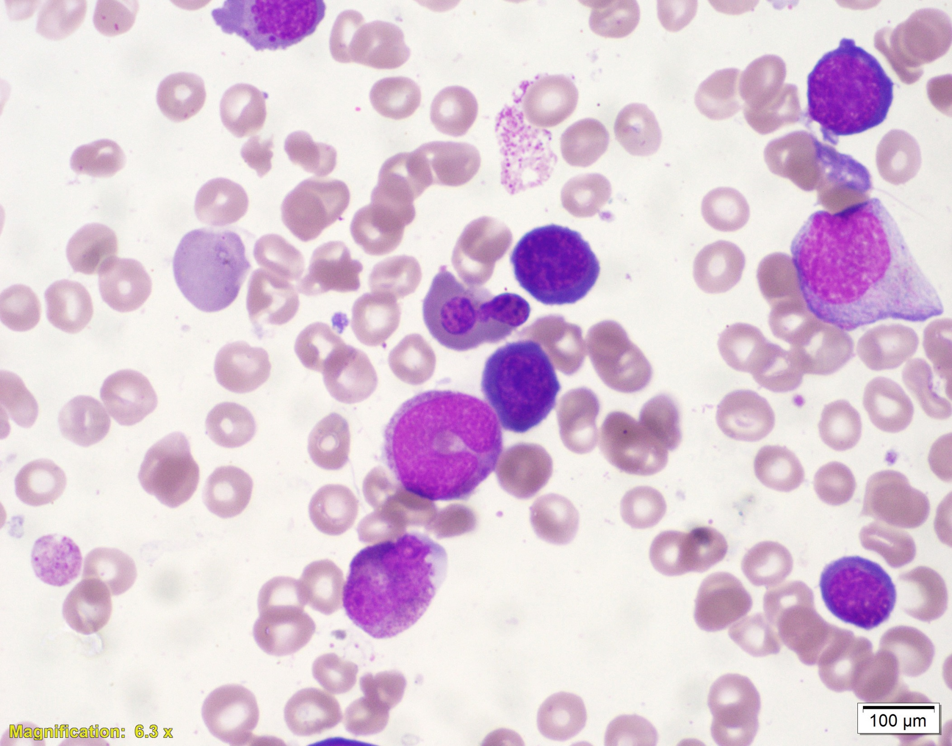
Megaloblastic Anemia
Bone marrow aspirate
Large erythroid precursor nuclei with finely reticulated appearance
Giant metamyelocytes and bands

Slide 60
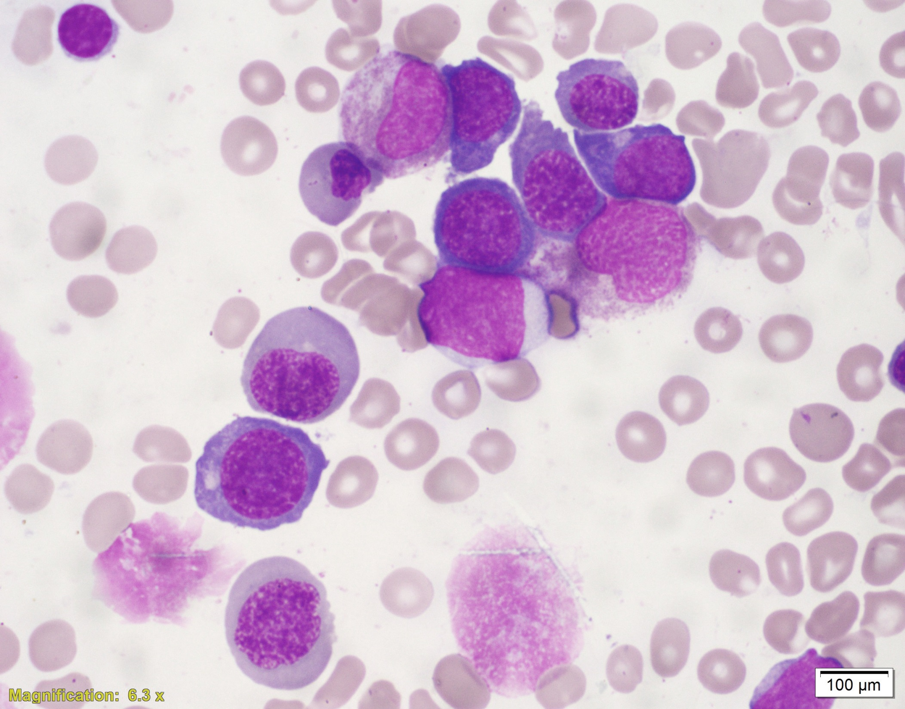
Megaloblastic Anemia
Bone marrow aspirate
Large erythroid precursor nuclei with finely reticulated appearance
Giant metamyelocytes and bands
Nuclear-cytoplasmic dyssynchrony in erythroid precursors

Slide 61
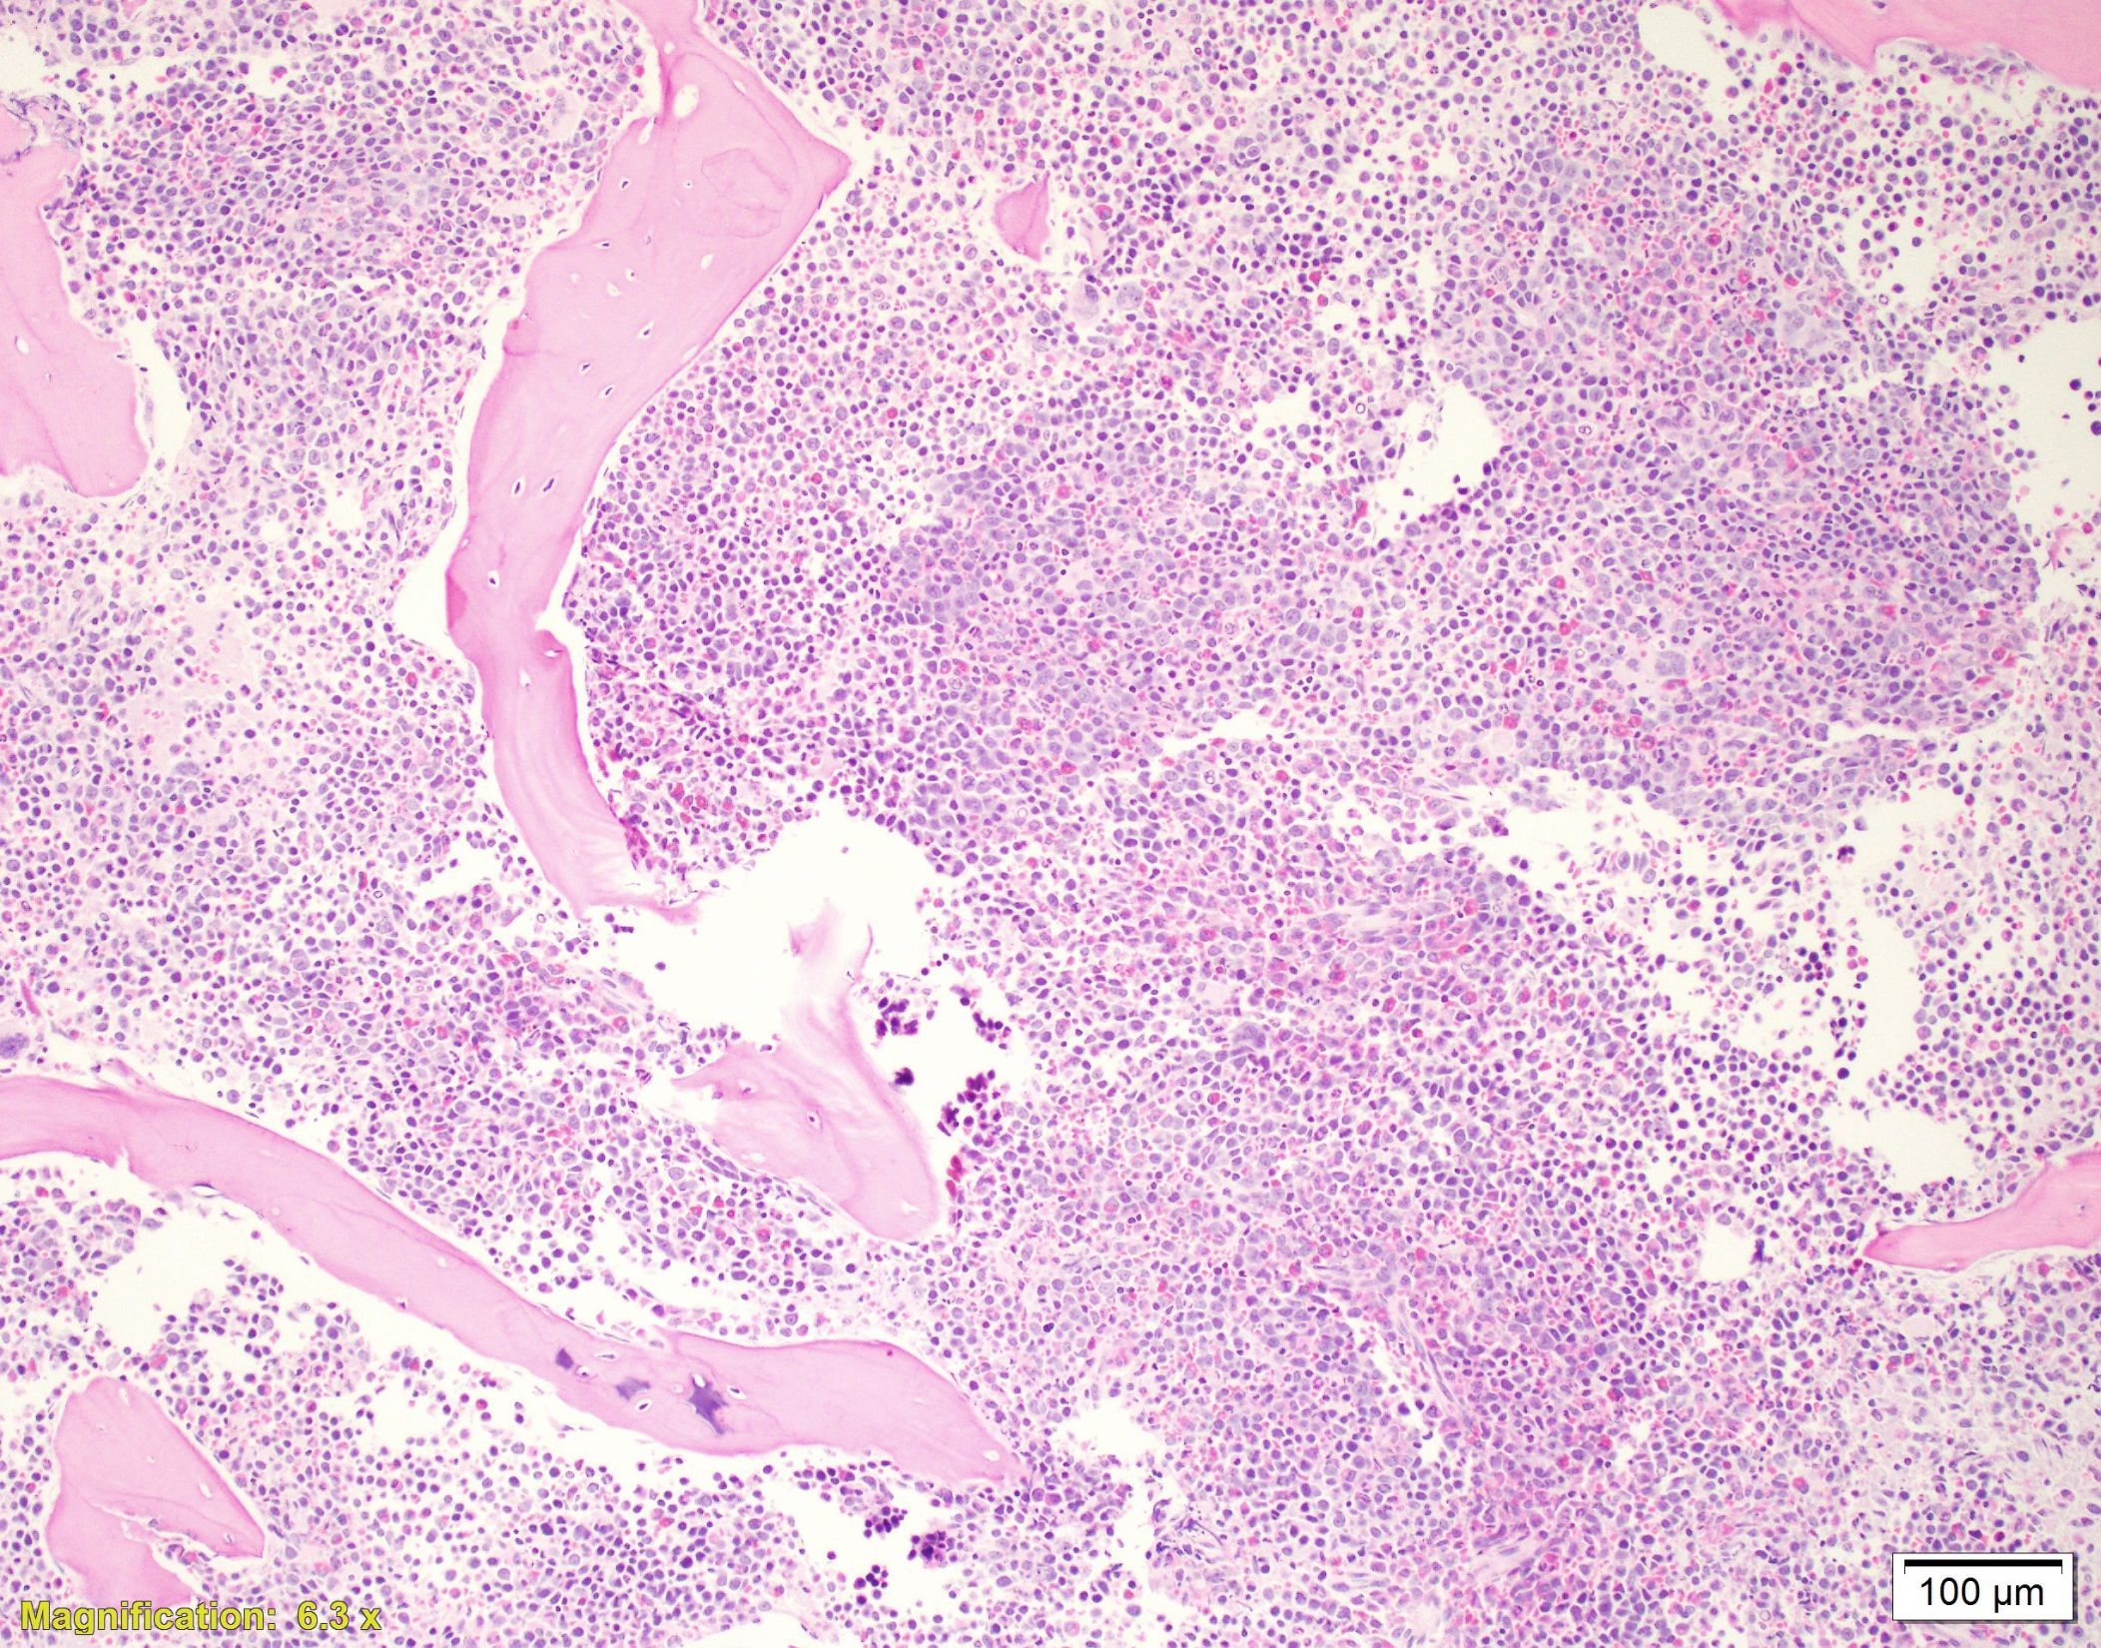
Megaloblastic Anemia
Bone marrow biopsy
Hypercellular bone marrow due to ineffective hematopoiesis
Summary of findings:
Hypercellular bone marrow
Peripheral cytopenias
Morphologic dysplasia
Must rule out nutritional deficiencies before considering MDS

Slide 62
Mimics of myelodysplastic syndrome
A small percentage of dysplastic cells can be found in healthy patient bone marrow of all age groups
Disorders associated with erythroid hyperplasia can cause significant morphologic dysplasia of red cell precursors (stress erythropoiesis)
Nutritional deficiencies
B12/Folate
Copper deficiency
Zinc toxicity
Alcohol use
Medication/Toxins
Infection

Slide 63
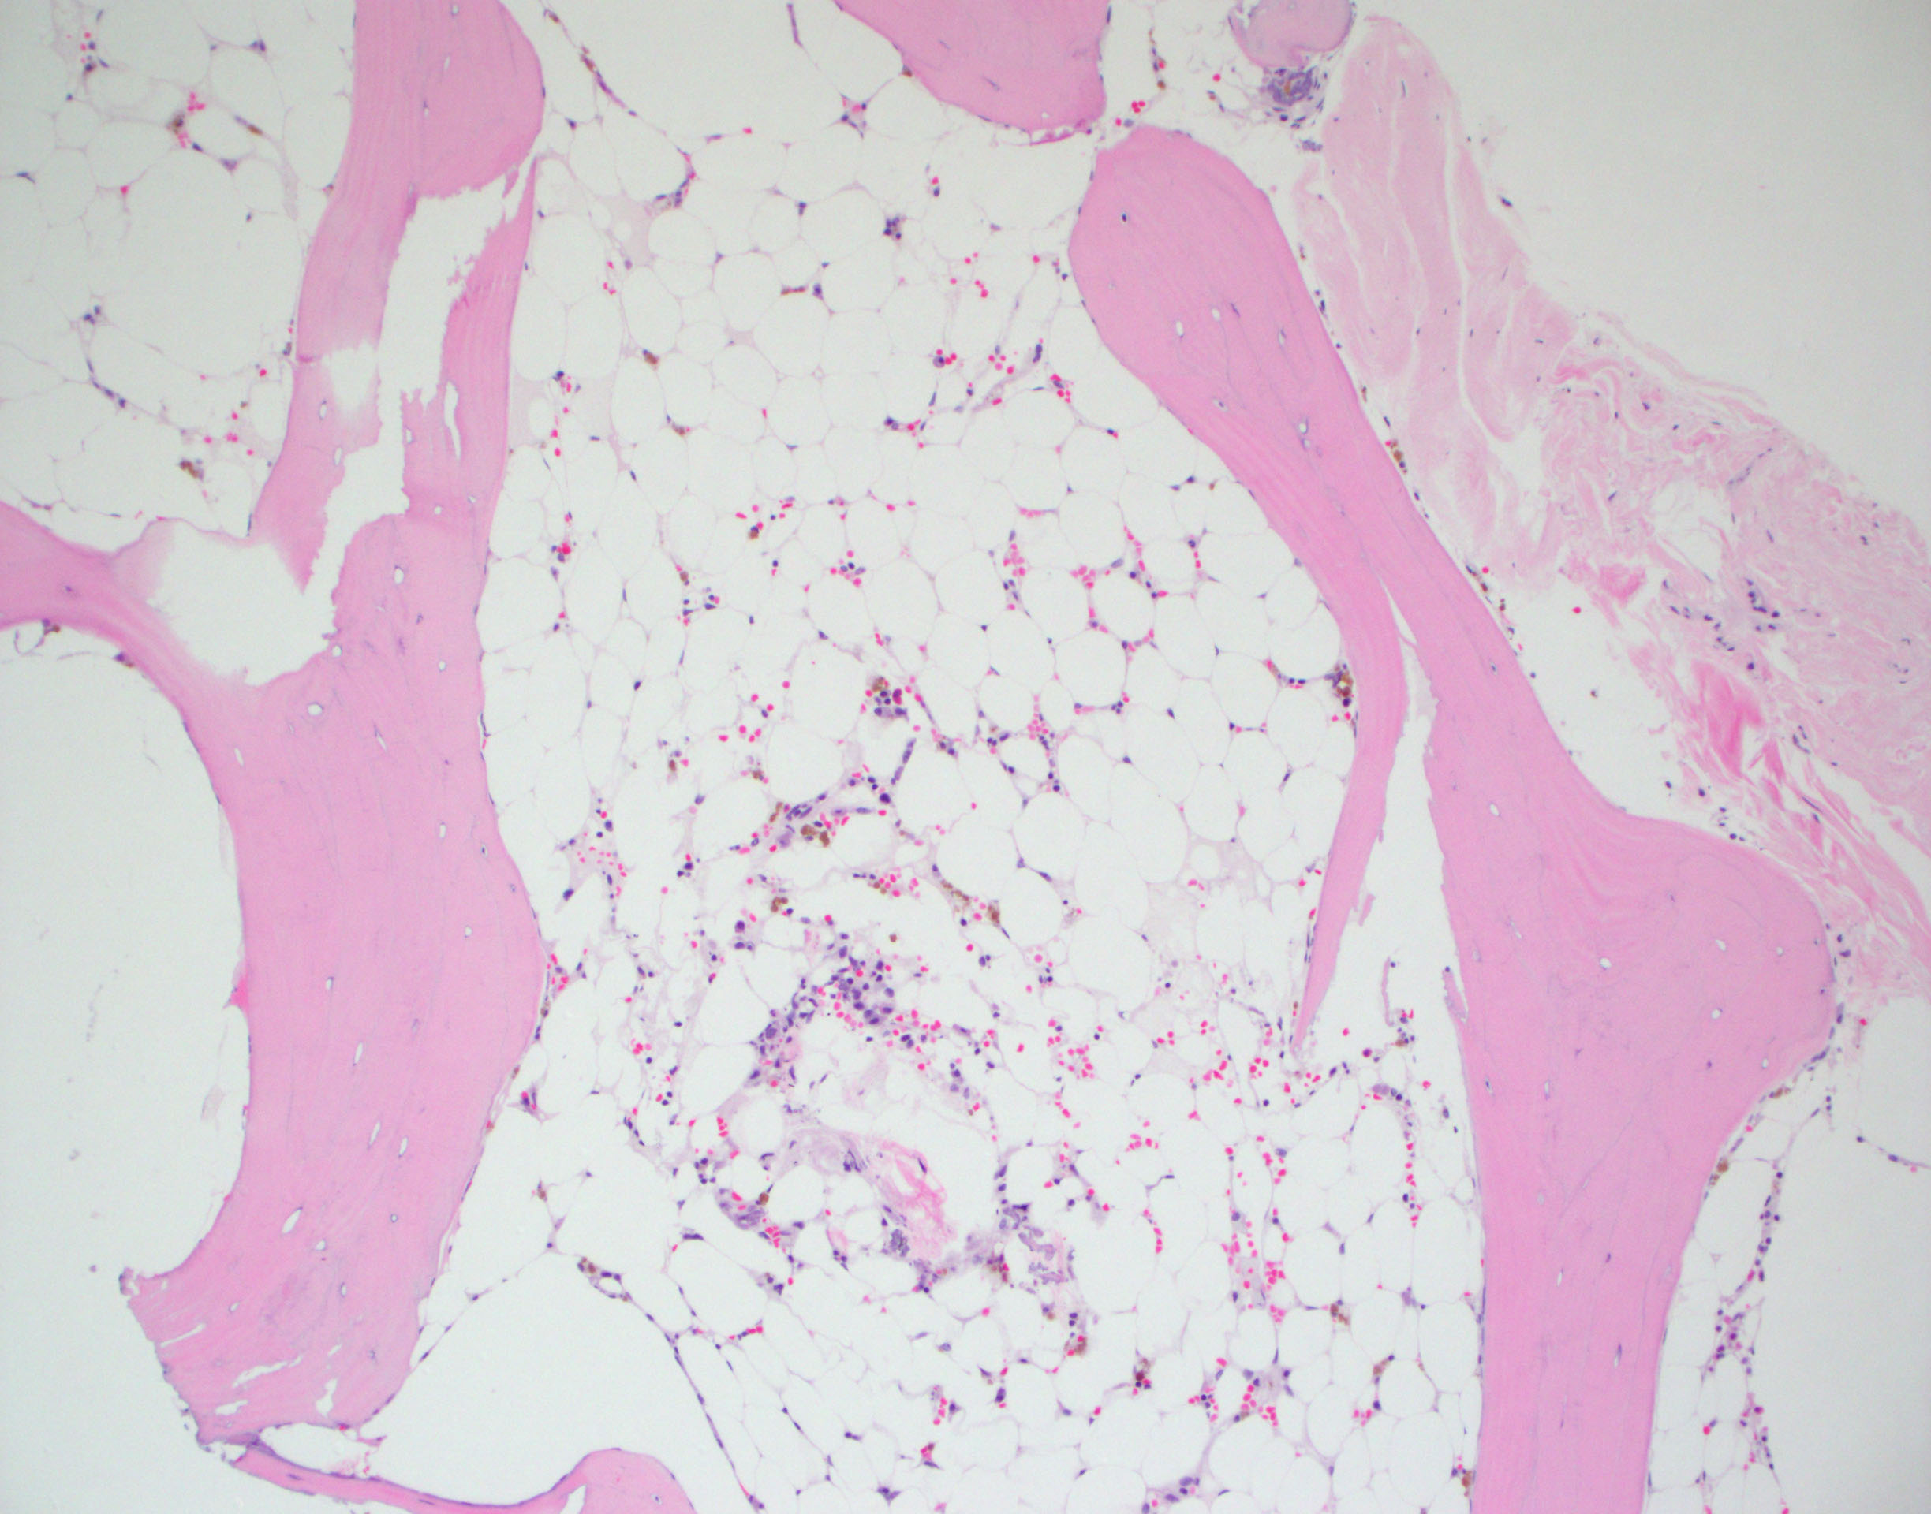
The bone marrow biopsy is severely hypocellular (5%). With no evidence of specific cytogenetic abnormalities or dysplasia the biopsy is consistent with aplastic anemia
Workup of aplastic anemia includes evaluation for Fanconi (DEB breakage studies), Dyskeratosis Congenita (Telomere length studies), PNH clones, and Hepatitis A/B/C serologies
Severe AA requires bone marrow cellularity to be less than 25%

Slide 64
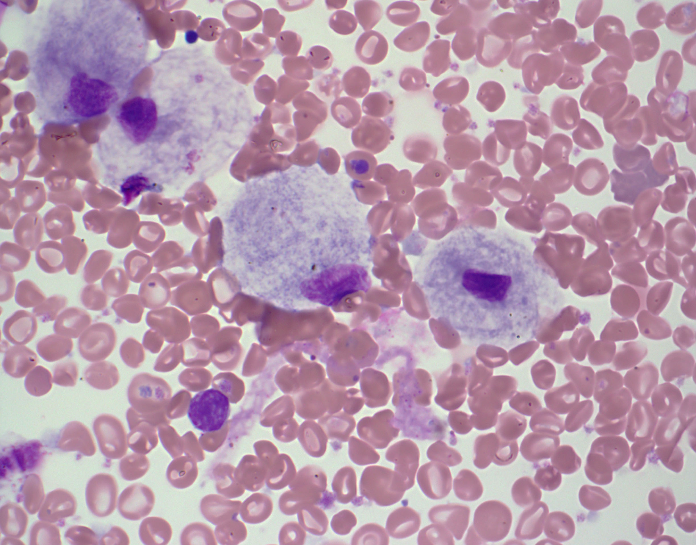
The cells on the bone marrow aspirate direct smear are Gaucher cells. Gaucher cells are macrophages with lysosomes stuffed with glycosphingolipids.
The cytoplasm of the cells have the characteristic ‘wrinkled tissue paper’ appearance. This appearance is due to the enlarged and misshapen lysosomes

Slide 65
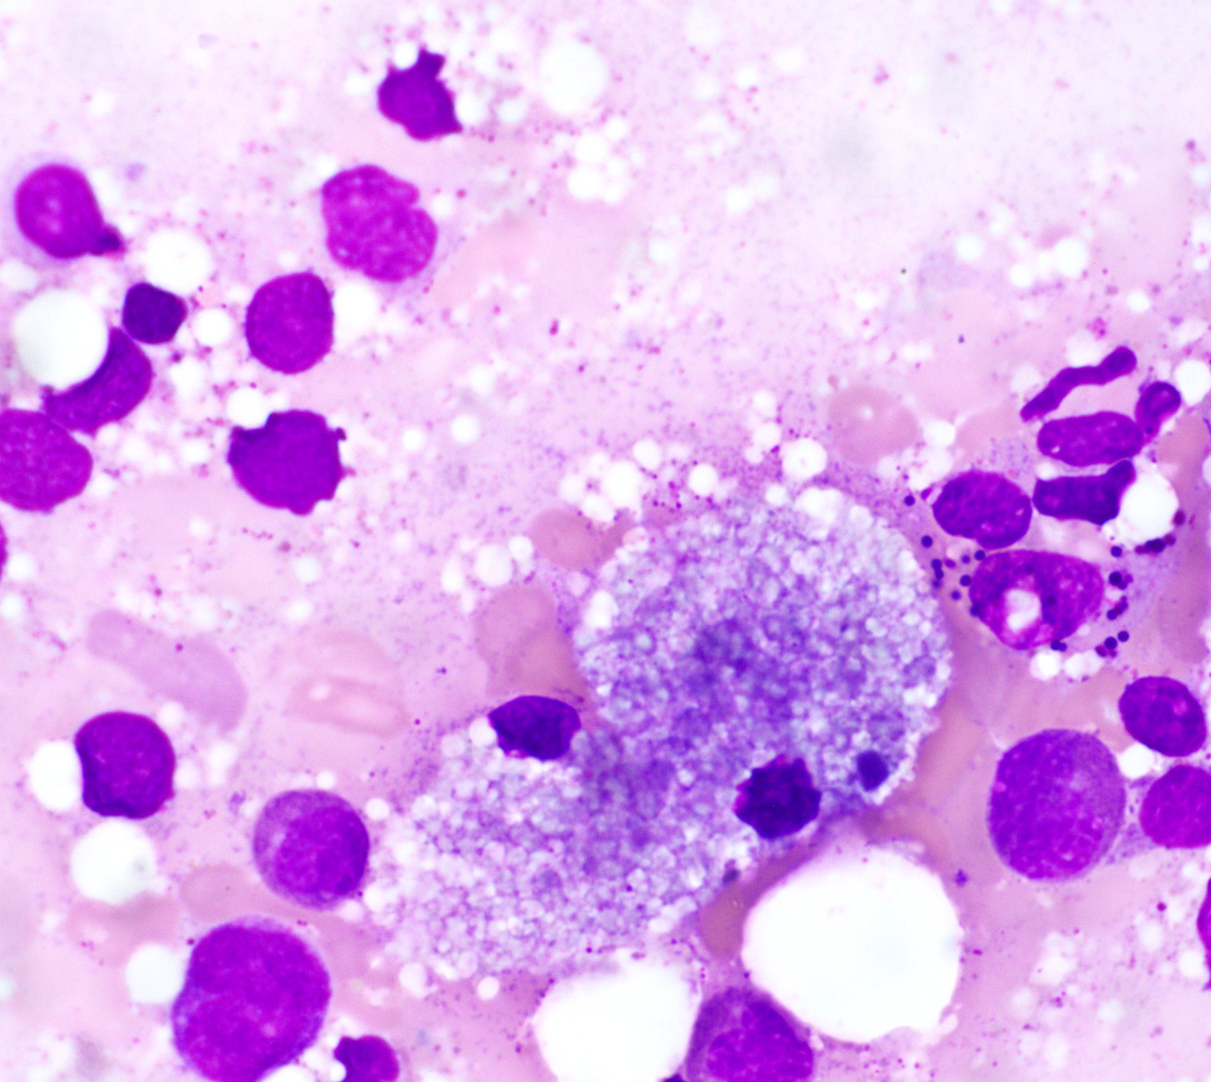
Contrast the Gaucher cell with these histiocytes:
Large macrophages with foamy cytoplasm
This patient has Niemann-Pick which is an acid sphingomyelinase deficiency (SMPD1 gene)

Slide 66
Hemophagocytic lymphohistiocytosis (HLH)
Primary HLH
Hemophagocytosis tends to be more morphologically prominent
Abnormalities in cytolytic granule formation and release
Immunodeficiency syndromes
Secondary HLH
Findings of morphologic hemophagocytosis not required for diagnosis
HLH-2004 study reported hemophagocytosis in 82% of HLH cases

Slide 67
Other Normal Marrow Elements
Mitotic figure
Megakaryocyte
Osteoclast
Plasma Cells
Osteoblasts

Slide 68
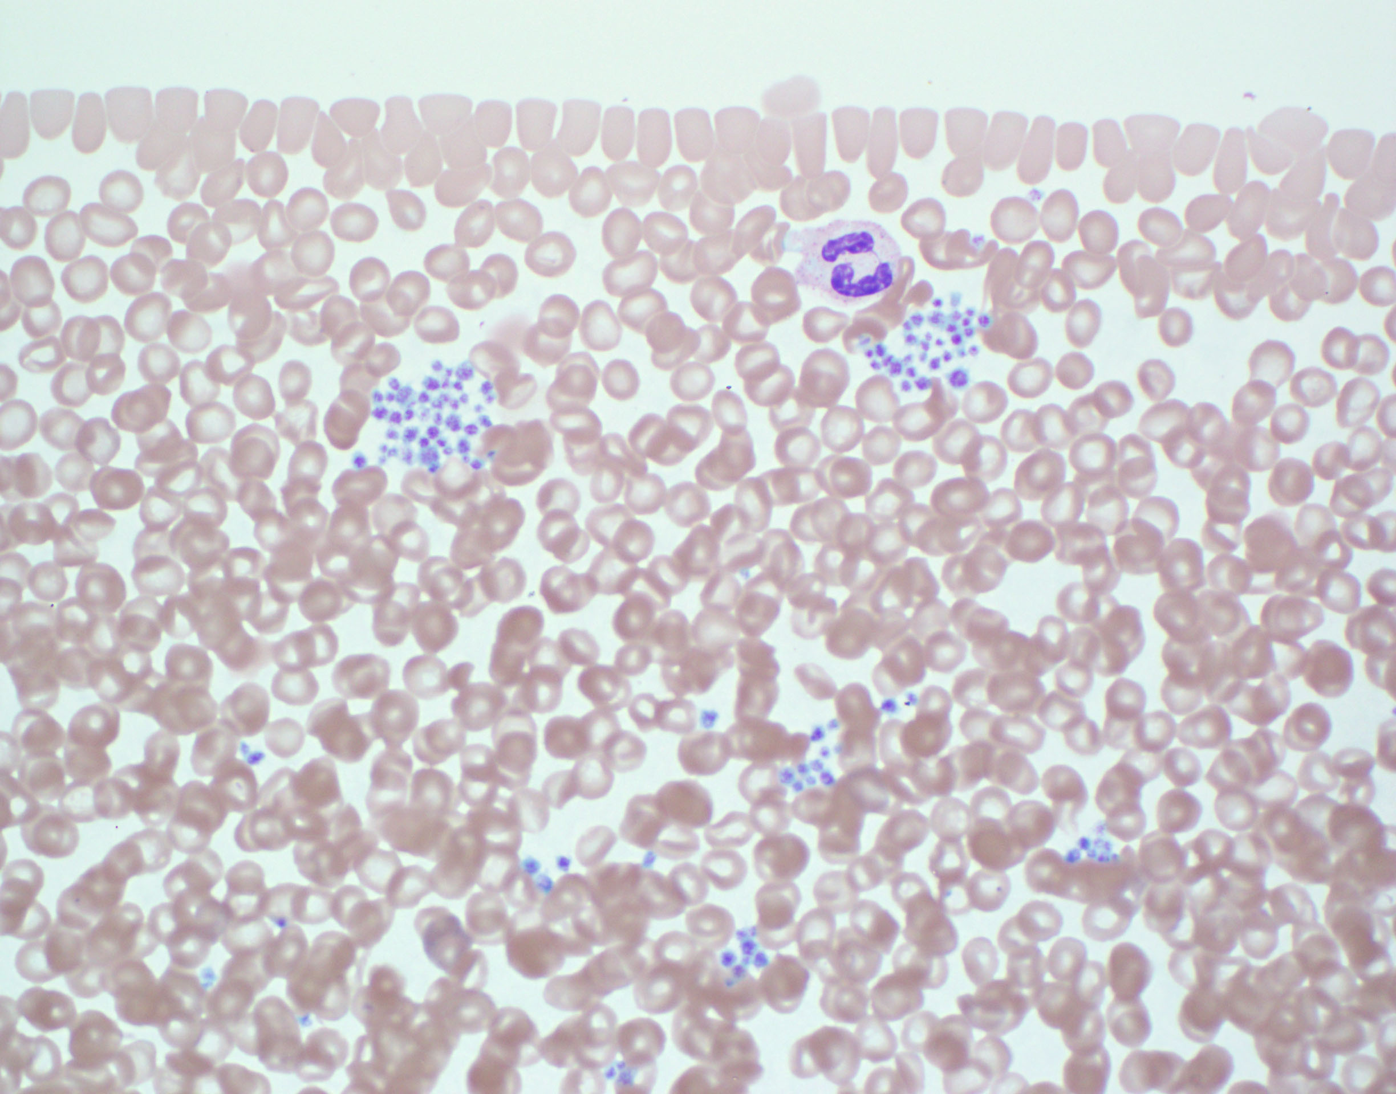
The peripheral blood smear shows significant platelet clumping and is otherwise normal
Platelet clumping occurs occasionally with EDTA anticoagulation and will cause hemocytometer to undercount the number of platelets present
EDTA can also cause platelets to adhere to leukocyte (platelet satellitosis)
Drawing a second sample with citrate anticoagulant should prevent clumping and permit a more accurate platelet count.

Slide 69
Small platelets (MPV<7fL)
Wiskott Aldrich syndrome
X-linked thrombocytopenia
Normal sized platelets (MPV 7-11 fL)
FA
DKC
SDS
Congenital Amegakaryocytic thrombocytopenia
TAR syndrome
Familial platelet disorders with predisposition to malignancy
ANKRD26
ETV6
Large Platelets (MPV>11fL)
MHY9 related disorders
Bernard Soulier syndrome
DiGeorge syndrome
Paris Trousseau syndrome
Gray Platelet syndrome
Sitosterolemia

Slide 70
Good luck!!
Excellent Reference Book:
Blood Cells – Morphology and Clinical Relevance, Gene Gulati and Jaime Caro, ASCP Press

