Slide 1
Supportive Care – Anti-emetics, pain, palliative & end-of-life care
Katharine Brock, MD, MS
Assistant Professor of Pediatrics, Pediatric Oncology & Palliative Care, Emory University School of Medicine
Director, Supportive Care Clinic, Aflac Cancer & Blood Disorders Center
Children’s Healthcare of Atlanta

Slide 2
This talk will follow the topical structure suggested by the ABP (sometimes…):

Slide 3
Basic Science and Pathophysiology
Epidemiology and Risk Assessment
Diagnosis
Management and Treatment

Slide 4
Outline
Anti-emetic Management
Pain Management
Palliative Care

Slide 5
Basic Science and Pathophysiology
Epidemiology and Risk Assessment
Diagnosis
Management and Treatment

Slide 6
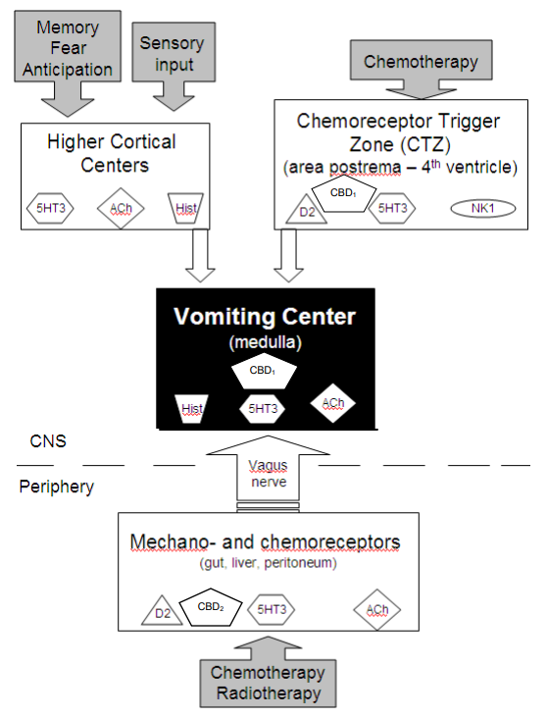
Copyright © 2018, Bridget Fowler Scullion. All right reserved.
Notes:
Ask yourself what receptors are likely involved
CTZ also has some H1 and mu opioid receptors

Slide 7
Basic Science and Pathophysiology
Epidemiology and Risk Assessment
Diagnosis
Management and Treatment

Slide 8
Treat underlying causes of n/v
Common etiologies
Meds: chemo, antibiotics, opioids
GI: mucositis, thrush, GERD, obstruction, ileus, constipation
Psych: Anticipatory n/v, uncontrolled pain, seizure
CNS: ⬆ ICP, Vestibular activation, drug effect
Metabolic: uremia, acidosis, hypercalcemia, hepatic/renal failure
Endocrine: adrenal failure
Cardiac: heart failure

Slide 9
Basic Science and Pathophysiology
Epidemiology and Risk Assessment
Diagnosis
Management and Treatment

Slide 10
Diagnosis
Onset and occurrence of nausea and vomiting
Quality of the symptom
Associations with meals, bowel patterns, activities or interventions, smells
Timing relative to a meal: before, during or after
Whether vomiting provides relief (suggesting partial vs complete SBO)
Medications:
response to anti-emetic medications
complementary medications
prescription medications with expected side effects
Associated symptoms

Slide 11
Basic Science and Pathophysiology
Epidemiology and Risk Assessment
Diagnosis
Management and Treatment

Slide 12
Integrative and Supportive Therapies
Provide small meals, chosen by child
Provide favorite drinks
Hypnosis, breathing techniques, guided imagery
Good oral care
Avoid discomforting smells
Aromatherapy (peppermint, ginger)
Acupressure (P6 point)
https://blog.dana-farber.org/insight/2016/12/how-to-perform-acupressure-for-vomiting-and-nausea/

Slide 13
Pharmacologic therapies
Serotonin (5-HT₃)
Ondansetron, Granisetron, Palonosetron
Dopamine (D₂)
Metoclopramide
Haloperidol
Olanzapine (+ 5HT_{2,} 5HT_{3,} and H₁)
Histamine (H₁)
Diphenhydramine, Dimenhydrinate, Meclizine Cyproheptadine (+ 5HT₂ and Ach)
Promethazine (+ Ach and 5HT₂) - not for <2 y/o
Acetylcholine (Ach)
Scopolamine, Meclizine
Neurokinin₁ (NK) – for age 6+ months
Aprepitant & fosaprepitant (NOT with Cyclophos/Ifos)
Others
IV Fluids
Steroids – for CNS issues, increased ICP, delayed CINV
Dronabinol (THC)
Benzodiazepines (lorazepam) – for anticipatory nausea
Octreotide – for bowel obstruction
Constipation meds – senna, polyethylene glycol, bisacodyl
Notes:
Metoclopramide – co-administer with diphenhydramine to decrease risk for extrapyramidal symptoms
Aprepitant can increase neurotoxicity of some chemo (e.g. ifosfamide)
Schedule meds & pick from different classes

Slide 15
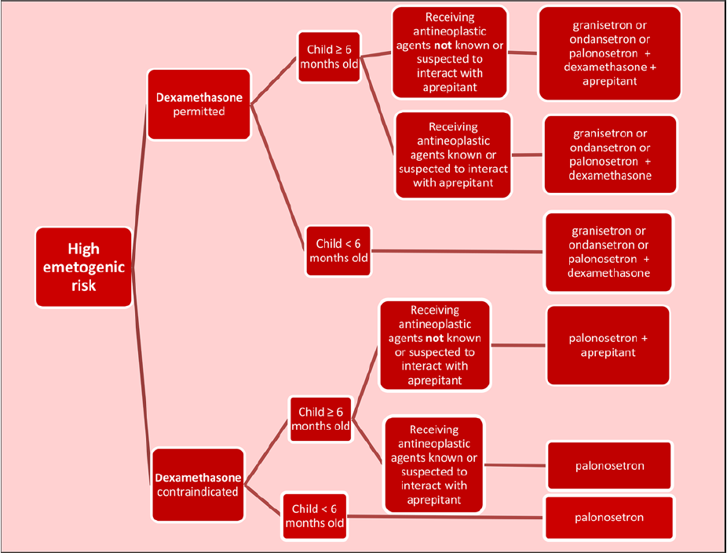
From Patel P, Robinson PD, Thackray J, Flank J, Holdsworth MT, Gibson P, Orsey A, Portwine C, Freedman J, Madden JR, Phillips R, Sung L, Dupuis LL. Guideline for the prevention of acute chemotherapy-induced nausea and vomiting in pediatric cancer patients: A focused update. Pediatr Blood Cancer. 2017 Oct;64(10). doi: 10.1002/pbc.26542. Epub 2017 Apr 28. PMID: 28453189. ©2017 by Wiley. Reproduced with permission.

Slide 16
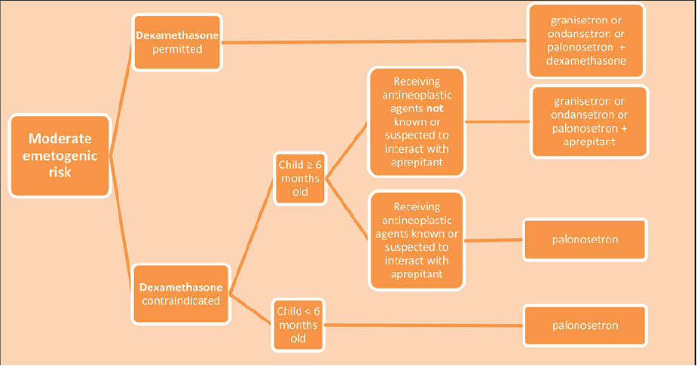
From Patel P, Robinson PD, Thackray J, Flank J, Holdsworth MT, Gibson P, Orsey A, Portwine C, Freedman J, Madden JR, Phillips R, Sung L, Dupuis LL. Guideline for the prevention of acute chemotherapy-induced nausea and vomiting in pediatric cancer patients: A focused update. Pediatr Blood Cancer. 2017 Oct;64(10). doi: 10.1002/pbc.26542. Epub 2017 Apr 28. PMID: 28453189. © 2017 by Wiley. Reproduced with permission.
Patel. Guideline for the prevention of acute CINV in pediatric cancer patients: A focused update. PB&C 2017.

Slide 17
From Dupuis LL, Boodhan S, Holdsworth M, et al. Guideline for the prevention of acute nausea and vomiting due to antineoplastic medication in pediatric cancer patients. Pediatr Blood Cancer . 2013 Jul;60(7):1073-82. doi: 10.1002/pbc.24508. © 2013 by Wiley. Reproduced with permission.

Slide 18
Outline
Anti-emetics
Pain Management
Palliative Care

Slide 19
Pain
The International Association for the Study of Pain (IASP) Definition:
An unpleasant sensory and emotional experience associated with actual or potential tissue damage or described in terms of such damage (e.g., burning/stabbing pain)
Associated neuroelectrical and neurochemical changes
Influenced by emotional and cognitive factors
PAIN IS SUBJECTIVE!
Notes:
Some kids manifest pain by becoming more quiet and moving around less rather than crying/ moaning/ etc. Parent report and child self-report are key.

Slide 20
Physiology of Pain
Nociceptive
Neural transmission activated by mechanical, chemical, or thermal damage to the body tissue
Produces physiologic/endocrine response separate from cognitive/emotional response
Tachycardia
Hypertension
Activation of glucose counter-regulatory hormones (glucagon, epinephrine, cortisone, growth hormone)
Muscle spasms
Increase in metabolic demands
Lack of correlation between tissue injury and intensity of pain

Slide 21
Physiology of Pain
Neuropathic
Results from abnormal nerve function due to nerve invasion or inflammation of nerve root
Etiologies include:
Nerve damage from drug (e.g., vincristine/cisplatin)
Neural compression or invasion by tumors
Physical damage to the nerve
Infectious etiologies (e.g., herpes zoster reactivation)

Slide 22
Duration of Pain
Acute
Usually concordant with degree of tissue damage
Remits with resolution of injury
Chronic
Low levels of underlying pathology that do not explain presence/extent of pain
Perpetuated by factors remote from cause
Environmental and affective factors exacerbate pain

Slide 23
Pain Measurement Tools
Newborns/Infants
Observational behavioral distress scales focused on facial expressions, crying, body movement
Vital signs are nonspecific
Children
Self-report (Faces, Visual Analog Scale)
Verbal numerical ratings- Gold standard
FLACC scale (Face, Leg, Activity, Cry, Consolability), CHEOPS (Children’s Hospital of Eastern Ontario Pain Scale)- Scales of posture, movement, facial expression for use in non-verbal children

Slide 24
Management: Nociceptive Pain
Dosing at regular intervals
“by the clock” - ATC not PRN
Adapting treatment to child
“with the child”
Appropriate route of administration
“by the appropriate route” – oral if possible
2-step strategy
“by the ladder”
WHO Guidelines on Pharmacological Treatment of Persisting Pain in Children w/ Medical Illness, 2012. New update coming in 2020/ 2021.

Slide 25
Management: Nociceptive Pain
WHO Step 2
Moderate to
Severe Pain
Also use adjuvants, integrative medicine
Not recommended
Tramadol (if <12y or has seizures)
Codeine
Meperidine
Hydrocodone
Combination products (Vicodin, Lortab, Percocet)
WHO Step 1
Mild Pain
Morphine
or
Fentanyl, Hydromorphone, Oxycodone, Methadone
Ibuprofen
and/or
Acetaminophen
Other NSAIDs
Cox-2 Inhibitor
Notes:
Morphine- Gold standard
Morphine/Oxycodone not good for renal failure/insufficiency

Slide 26
Opioid Side Effects
Gut hypomotility (constipation)
No tolerance
Needs prophylactic bowel regimen (osmotic laxatives, surfactant laxatives, stimulants)
Methylnaltrexone
Sedation
Wait it out
Hold other sedating drugs
Exercise or methylphenidate if persistent
Pruritis
Treat with Nalbuphine, Antihistamine, NSAIDS, Ondansetron, SSRI
Naloxone 0.2ug/kg/min
Nausea
Due to mu receptors in CTZ
Can treat with D2 antagonist
Urinary retention
Bladder cath, nalbuphine, bethanechol
Opioid Hyperalgesia
Use adjuvants
Treat with dose reduction or rotation
Ketamine
Myoclonus
Reduce dose or rotate opioids
Hydration
Treat with benzodiazepines
Notes:
Methylnaltrexone- peripheral opioid receptor antagonist- reverses constipation but cannot cross BBB- no change in pain
Stool softeners
1) Osmotic laxatives
Lactulose 15-30ml PO BID
Polyethylene glycol (Miralax) 8.5 – 17g PO qday – BID ++
2) Surfactant laxatives
Docusate 0.5 – 1mg/kg PO qday – QID
Stimulants
Senna (< 6 y/o = ½ tab qday, > 6 y/o = 1 tab qday).
Can be given as suppository
Bisacodyl 5-10mg suppository qday prn
Others:
Octreotide (malignant bowel obstruction)
Low-dose naloxone infusion (0.5-2 mcg/kg/hr for OIC)
Methylnaltrexone (opioid-induced constipation)
(sennosides-only superior to combination with docusate in small RCT)
Myoclonus- can lead to seizures

Slide 27
Why to Rotate Opioids
Renal failure
Rotate off morphine/oxycodone to fentanyl or methadone
or less ideal, hydromorphone
Too many side effects with poor pain control
If excellent pain control, try a 20% dose decrease.
Opioid-induced hyperalgesia or myoclonus
Allodynia, myoclonus, neuroexcitability
Consider a switch across classes
Morphine/Oxycodone/Hydromorphone (Phenanthrene derivatives)
Fentanyl (Phenylpiperidine derivatives)
Methadone (Diphenylheptane derivatives)
Notes:
Watch for opioid-induced hyperalgesia in patients who you keep going up and up and they pain gets worse and more diffuse, rather than better.

Slide 28
Opioid Terminology
Tolerance: Need to increase dose of opioids over time
Withdrawal: Symptoms if opioid discontinued/tapered too quickly
Dysphoria, restlessness, anxiety, nausea, diarrhea, abdominal cramps, rhinorrhea, sweating, tachycardia, hypertension, tachypnea
Addiction: A chronic, relapsing condition characterized by persistent, compulsive dependence on a behavior or substance despite adverse consequences
Largely genetically determined
Pseudo-addiction: characteristics similar to addiction that resolve when pain is adequately treated (generally due to inadequate dosing)

Slide 29
Management: Neuropathic Pain
Gabapentinoids
Gabapentin
Pregabalin
Tricyclic antidepressants (TCAs)
Amitriptyline
Nortriptyline
Selective serotonin norepinephrine reuptake inhibitors (SNRIs)
Venlafaxine
Duloxetine
Antiepileptic drugs (AEDs)
Carbamazepine
Topiramate
Local anesthetics
Lidocaine (patch or infusion)
Ketamine
Opioids for pain not effectively treated with other modalities
Methadone
Notes:
AED- sedation- slow titration
Other AED: valproate, carbamazepine, topiramate

Slide 30
Other Approaches to Pain
Mechanical approaches
Physical therapy
Acupuncture, acupressure
Physical approaches
Massage
Positioning
Heat/cold
Cognitive behavioral techniques
Guided imagery
Hypnosis
Biofeedback
Interventional procedures
Regional nerve blocks
Epidural anesthesia
Nerve ablation for refractory pain
Targeted drug therapies
NSAIDs, bisphosphonates for bony metastases
Corticosteroids
Muscle relaxants
Notes:
Steroids: visceral distension, bony destruction, cerebral edema

Slide 31
Outline
Anti-emetics
Pain Management
Palliative Care

Slide 32
What is Palliative Care?
Care that “seeks to prevent, relieve, reduce or soothe the symptoms produced by serious medical conditions or their treatment and to maintain a patient’s quality of life” (Natl Academy of Medicine)
Palliative care, and the medical sub-specialty of palliative medicine, is specialized medical care for people living with serious illness. It focuses on providing relief from the symptoms and stress of a serious illness. The goal is to improve quality of life for both the patient and the family. Palliative care is provided by a team of palliative care doctors, nurses, social workers and others who work together with a patient’s other doctors to provide an extra layer of support. It is appropriate at any age and at any stage in a serious illness and can be provided along with curative treatment.
Center to Advance Palliative Care, https://www.capc.org/about/palliative-care/

Slide 33
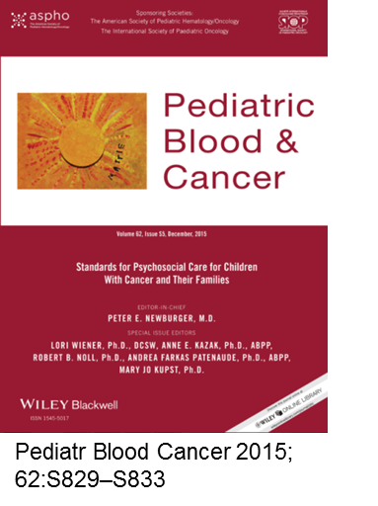
Standard of Care
2015: Palliative Care as Standard of Care in
Pediatric Oncology
2016: Integration of Palliative Care into Standard
Oncology Care: ASCO Clinical Practice Guideline
Update (original in 2012)
Notes:
ASCO standard of care is that early (within 8 weeks of diagnosis) palliative care be provided to all patients with advanced cancer

Slide 34
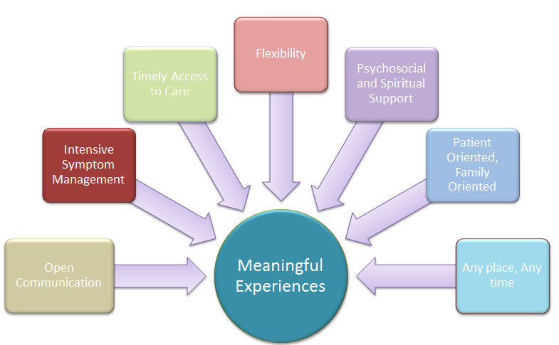
Core Ideals of Palliative Care
Courtesy of Janet Duncan, MSN CPNP, PACT Boston
Notes:
The Core Ideals of palliative care are all a part of helping patients have a meaningful experience while coping with serious illness.
Our core values include:
Open communication
Intensive symptom management
Timely access to care
Flexibility
Psychosocial and Spiritual Support
Patient oriented and family oriented care
Care that can be delivered at any place and any time

Slide 35
Palliative Care Misconceptions
FALSE: Palliative care is end of life care
TRUE: Palliative care should be a priority from diagnosis of a child with a serious disease
FALSE: Palliative care cannot be concurrent with disease-directed therapy
TRUE: Palliative care is an extra layer of support focused on physical, psychological, social and spiritual needs
FALSE: Palliative care is the same as hospice care
TRUE: Hospice care is a distinct service for children with an expected prognosis of ≤6 months, generally focused on comfort and home-based care
Notes:
Abrupt transitions to end of life
The Patient Protection and Affordable Care Act that was passed in 2010 included a provision termed “Concurrent Care for Children” Requirement, which requires state Medicaid programs to pay for both curative and hospice care for children <21 years old if the child is within the last 6 months of life based on the expected disease course.

Slide 36
Timing of Palliative Care
Not Ideal:
Abrupt Transition
From Ullrich C, Sourkes B, and Wolfe J. Palliative Care for the Child Cancer. In: Pizzo PA, Poplack DG, eds., Principles and Practice of Pediatric Oncology. 7th ed. Philadelphia, PA: Wolters Kluwer; 2016: 1404-1427. © 2016 by Wolters Kluwer. Reproduced permission.
Notes:
Patients with high-risk or incurable disease who receive cancer-directed care in synergy with PC demonstrate improved outcomes.
Value of palliative oncology well recognized.
Integration of PC principles and services into routine cancer care for children with high-risk disease has been associated with improved symptom management & EOL outcomes for patients and quality of life for both children and families.

Slide 37
Timing of Palliative Care
Not Ideal:
Abrupt Transition
Ideal:
Part of the Paradigm
From Ullrich C, Sourkes B, and Wolfe J. Palliative Care for the Child Cancer. In: Pizzo PA, Poplack DG, eds., Principles and Practice of Pediatric Oncology. 7th ed. Philadelphia, PA: Wolters Kluwer; 2016: 1404-1427. © 2016 by Wolters Kluwer. Reproduced permission.
Notes:
Patients with high-risk or incurable disease who receive cancer-directed care in synergy with PC demonstrate improved outcomes.
Value of palliative oncology well recognized.
Integration of PC principles and services into routine cancer care for children with high-risk disease has been associated with improved symptom management & EOL outcomes for patients and quality of life for both children and families.

Slide 38
Key Components of Palliative Care
Communication
Understanding of Illness
Goals of Care
Medical Decision Making
Advanced Care Planning
Code status
Care Coordination
Medical team, support services, home agencies
Symptom Management
Notes:
Understanding of disease/treatment
Hopes/Worries
Sources of strength
Open-ended questions are crucial
Honest, straightforward language
Acknowledge emotion
LISTEN
Advanced Care Planning
Cancer-directed therapy at the end of life- increase QOL or burdens
Do Not Attempt Resuscitation (DNAR)-
POLST (Physician Orders for Life-Sustaining Treatment)
Organ donation
Location of Care

Slide 39
Symptoms
System | Symptom
General | Fatigue
Pain | Nociceptive, neuropathic, interventional, radiotherapy
Respiratory | Dyspnea, cough, secretions
FEN/GI | Consideration of IVF, artificial hydration & artificial nutrition N/V, bowel obstruction, constipation, diarrhea, dysmotility, anorexia, dysgeusia
Neuro/Psych | Agitation/irritability, anxiety, depression, delirium, sleep challenges, seizures, spinal cord compression
Dermatology | Pruritus
EOL management | Active dying process Pain, dyspnea, secretions, delirium

Slide 40
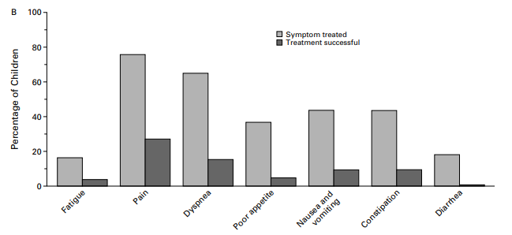
Symptoms at the End of Life
89% suffered from at least 1 symptom
51% suffered from ≥ 3 symptoms
Pain and Dyspnea most-commonly treated
Treatment was successful in <30% of children
Wolfe, J. Symptoms and Suffering at the End of Life in Children with Cancer. NEJM 2000
Notes:
Last month of life

Slide 41
Changes at the End of Life
In the days/weeks prior to death:
Increased somnolence
Less interactivity (walking/speaking)
Decreased appetite
Weight loss/gain
Skin changes (pallor, cool)
Respiratory changes
In hours/days prior to death:
Somnolence → sleeping up to 22 hours per day → comatose
Decreased solids → Decreased liquids → no intake
Decreasing urination → anuria
Waxy appearance, jaw falls back
Labored breathing with apneic pauses
Secretions that cause gurgling sound
Notes:
Most families have NEVER done this! They don’t know what to expect. And most think it will be a quiet, peaceful process with everyone holding hands and singing and they will have warning, etc. It doesn’t always go like this. So don’t promise things you can’t guarantee will occur. You can promise that you will do your best to keep the child as comfortable as possible, and that you will be honest with the family.
** families often want to know when this will occur – while it is hard to prognosticate, you still know more than they do, so give your best hours-days, days-weeks, weeks-months, months-years estimate if the family wants a time. Also, you get more accurate as the time gets closer, so you can let them know that you’ll be able to provide better guidance as time gets close. If at home, hospice can also be the eyes/ears for this. We watch a lot of people die, so they’ll know when things are close.
-- For example, when the breathing is the apneic/ slow breathing – death is likely to occur in the next ~ 24 hrs.

Slide 42
End-of-life management
Nearly all problems can be managed with ~4 medications:
For pain, dyspnea, and cough = Opioid (morphine)
For seizures, anxiety, agitation, nausea = Benzodiazepine (lorazepam)
For nausea/vomiting, delirium = Anti-psychotic (haloperidol)
For secretions at EOL = Anti-cholinergic (atropine or hyoscyamine)

Slide 43
Pain Management at End of Life
Increases for moderate pain 30-50% (continuous and PRN)
Severe pain at EOL often requires dose increases of 50-100%
Rescue dose should be 10% of daily requirement
50-100% of continuous dose if using PCA
When switching drugs, decrease dose 25-50% (cross-tolerance)
Fentanyl patches only for stable, chronic pain- NOT acute/EOL titration
Methadone is long-acting, no rapid titration. Increases only every 3-4 days
Do NOT use combination products (Percocet, Vicodin) – acetaminophen
NO data that pain medication hastens death- may prolong life
NO ceiling dose
Notes:
Acetaminophen combination products (e.g. Tylenol #3, Vicodin [hydrocodone], Percocet [oxycodone]) are not recommended as dosing cannot be increased with increasing pain without risking associated liver toxicity of high doses of acetaminophen.

Slide 44
Dyspnea
Subjective!
Do not use oxygen saturations, RR, retractions
Ask or look at face (scared/ startled look), expressions, breathing pattern
Management:
Opioids!!
Generally 1/3 - 1/2 the pain dose is sufficient (if isolated problem)
When already on opioids, use same dose as pain dose
Fan to the face
Increase head of bed/reposition
Oxygen by nasal cannula if hypoxic
Benzodiazepines may be helpful if significant anxiety component
Discussing stopping IVF, as likely making dyspnea worse
Brant J. Breathlessness with Pulmonary Metastases: A Multimodal Approach. J Adv Pract Oncol. 2013
Qian Y et al. Fan Therapy for the Treatment of Dyspnea in Adults: A Systematic Review. JPSM 2019.
Barnes H et al. Opioids for the palliation of refractory breathlessness in adults with advanced disease and terminal illness. Cochrane Review. 2016.
Notes:
Ask the patient if they’re short of breath.
If the look startled/ scared/ eyes wide open → that’s a sign of dyspnea.
Dyspnea algorithm: (1) opioids, (2) fan, (3) o2 if hypoxic, (4) opioids, (5) benzos,

Slide 45
“Terminal” delirium
More common problem than is commonly recognized
May be hyperactive or hypoactive or mixed
Agitated/confused/decreased attention, altered cognition, a change from baseline, fluctuating/intermittent, +/- hallucinations
Management:
Treat underlying cause if possible and in line with goals of care
Day/night and re-orientation
Monitor
If distressing/interfering with care:
Consider using anti-psychotics (haloperidol)
Avoid treating with benzos and anti-cholinergics
Agar. Efficacy of Oral Risperidone, Haloperidol, or Placebo for symptoms of Delirium… JAMA Internal medicine. 2017
Notes:
This is standard of care for now. This may change over time as new studies come out. All data extrapolated from adult care.
- Other anti-psychotics such as risperidone (risperdal), olanzapine (zyprexa), quietapine (seroquel), and chlorpromazine (thorazine) would all be second to third line agents.

Slide 46
Secretions
Gurgling sound (aka, death rattle) caused by pooling of saliva in back of throat due to the body relaxing
Not distressing to patient
Management:
Provide anticipatory guidance and reassurance
Stop unnecessary volume (IVF, extra feeds/liquids, medications)
Atropine 1% eye drops given sublingually
Hyoscyamine (0.125mg/1ml solution)
Glycopyrrolate
Notes:
Hospice will often use hyoscyamine (levsin) or atropine drops depending on the company.
- Hyoscyamine comes in two concentrations (0.125mg/1ml soln) and a 0.125mg/5ml elixir. The latter is much more volume. i.e. for a 50kg patient, would have to give 5ml which is often too difficult to tolerate unless there is a g-tube in place.

Slide 47
Focus on what families CAN do
Provide your child with the familiar voices, sounds, and touch that will comfort your daughter/son the most (read favorite books, psalms, listen to music, soothing smells)
Child life assistance
Continue to bathe, change the position of his/her body, and watch for signs of discomfort
Practice prayer, rituals and other cultural expressions of importance
Chaplain, home spiritual advisor assistance
Complementary therapies such as massage and Reiki are often welcomed by families as hands on healing of the child.
Notes:
Hospice will often use hyoscyamine (levsin) or atropine drops depending on the company.
- Hyoscyamine comes in two concentrations (0.125mg/1ml soln) and a 0.125mg/5ml elixir. The latter is much more volume. i.e. for a 50kg patient, would have to give 5ml which is often too difficult to tolerate unless there is a g-tube in place.

