Slide 2
Pharmacology of Emerging Therapies to Treat Pediatric Cancers
Differentiating Agents
Targeted Therapies
Epigenetic Modifiers
Immune checkpoint Inhibitors
Anti-angiogenic Agents
Copyright © 2019 by ASPHO

Slide 3
Objectives
To understand general mechanism of action and pharmacology of each emerging therapy medication class
To understand the theory behind the proposed use for the pediatric cancers they may be used to treat
To understand the potential side effects associated with each medication
Copyright © 2019 by ASPHO

Slide 4
Categories of Medications
Differentiating Agents
Medications that affect cancer cells and transform them into normal cells
Targeted Therapies
Medications that interfere with specific molecular targets to stop the growth, progression or spread of cancer cells
Epigenome-targeted Therapies
Medications that affect two areas of differentiation early in cell line to produce cancer cells and are presumed to affect either DNA modification or histone modification.
Immune checkpoint Inhibitors
Medications that prevent the patient’s immune system cells from being turned off by cancer cells and as a result, help the patient’s own immune system attack the cancer cells.
Anti-angiogenic Agents
Medications that inhibit the growth of new blood vessels which helps to slow or stop the growth of cancer cells.
Copyright © 2019 by ASPHO

Slide 5
The Future of Cancer Treatment: Overlap of Novel Medications with Chemotherapy and Radiation
Targeted Therapies
Differentiating Agents
Epigenetic Reprogramming
Immune Checkpoint Inhibitors
Anti-Angiogenic Therapy
Chemotherapy and Radiation
Copyright © 2019 by ASPHO

Slide 6
Differentiating Agents^{11,17}
Research about differentiation agents began with the early study of leukemia in 1970’s
It was discovered that leukemia cell’s development stopped early in the disease process at the time of cell production and differentiation into normal, mature cells failed
In theory, if a medication could be given that would promote the differentiation to mature cells, then the disease could be stopped
Copyright © 2019 by ASPHO

Slide 7
Differentiating Therapies¹⁷ All-trans-retinoic Acid(ATRA) Example
Copyright © 2019 by ASPHO

Slide 8
Differentiating Agents: All-Trans Retinoic Acid and Arsenic Trioxide^{11,17}
All-trans retinoic acid (ATRA) was found to produce terminal differentiation of Acute Promyelocytic Leukemia Cells(APL) during in vitro experiments
ATRA induced remission in all patients in it’s first clinical trial by differentiation of the leukemic cells to normal cells
After initiation of combination regimens of cytotoxic chemotherapy and ATRA, leukemia cells developed resistance to ATRA
Arsenic Trioxide (ATO) was discovered to produce remission in relapsed patients through partial differentiation and apoptosis of APML cells
Copyright © 2019 by ASPHO

Slide 9
Differentiating Agents: All-Trans Retinoic Acid and Arsenic Trioxide for PML^{11,17}
Historically and currently, the discovery of ATRA in it’s use as a differentiating agent along with ATO over 30 years ago remains the most successful use of differentiation therapy
Copyright © 2019 by ASPHO

Slide 10
Differentiating Agents Tretinoin (All Trans Retinoic Acid)^{7,8,11}
Mechanism of Action: Seems to bind to retinoic acid receptors(RARs) to aid in decreasing proliferation and cause differentiation of cells
For Acute Promyelocytic Leukemia, ATRA causes the promyelocyte cells to differentiate and eventually repopulates the marrow with normal hematopoietic cells
Indication: Promyelocytic Leukemia
Route: oral
Contraindications: Pregnancy (REMS program)
Side Effects/Monitoring:
Common: headache, fever, and fatigue, low emetogenic potential, skin changes
Severe: Venous Thrombosis during first month of therapy, Retinoic Acid-APL differentiation syndrome(25% of patients), Rapid Leukocytosis(40% of patients which is associated with life threatening complications)
What to do? Initiate high dose steroids if these syndromes occur
Copyright © 2019 by ASPHO

Slide 11
Differentiating Agents - Arsenic Trioxide^{7,8,11}
Mechanism of Action: Major is to cause apoptosis in APL cells and minor is to cause partial morphologic differentiation of the protein promyelocytic leukemia-retinoic acid receptor alpha (PML-RAR alpha)
Indication: Promyelocytic Leukemia
Route: intravenous
Side Effects/Monitoring:
Common: moderate emetogenic, headache, fever, fatigue
Severe: Rapid leukocytosis, hepatotoxicity, QT prolongation (monitor weekly), cough, dyspnea, hyperglycemia, hypokalemia, hypomagnesemia, pseudotumor cerebri
Copyright © 2019 by ASPHO

Slide 12
Differentiating Agents Isotretinoin (13 Cis-Retinoic Acid)^{7,8,11}
Mechanism of Action: Can induce the differentiation of neuroblastoma cell lines and decrease cell proliferation
Indication: Neuroblastoma
Route: oral
Contraindication: pregnancy(REMS program)
Side Effect/Monitoring:
Common: dermatologic changes, headache, hypertriglyceridemia, decreased hematologic counts
Severe: epiphyseal changes, pseudotumor cerebri, visual change, psychiatric effects
Copyright © 2019 by ASPHO

Slide 13
Differentiating Agent: Include Epigenetic Modifiers and Targeted Therapies^{10,17}
Cytidine Analogs (Azacitidine and Decitabine) – help to form demethylated DNA which work for MDS and AML to induce differentiation of the abnormal cancer cells.
Histone-Deacetylase (HDAC) inhibitors such as suberoylanilide hydroxamic acid(SAHA, Vorinostat), and Valproic Acid, - help to inhibit deacetylation of histones and proteins which eventually reverse factors that suppress cell differentiation in leukemia and solid tumor cancers.
Tyrosine Kinase Inhibitors (Gefitinib and erlotinib) - Have shown off target effects which may include differentiation of cell lines in AML and solid tumors
Copyright © 2019 by ASPHO

Slide 14
Differentiating Agents¹¹
Many other agents including Vitamin D analogs have been tested as potential differentiation agents but have failed to show positive outcomes in clinical trials
The research for further differentiating agents which will affect cancer cell growth with minimal side effects for normal cells is ongoing
Copyright © 2019 by ASPHO

Slide 15
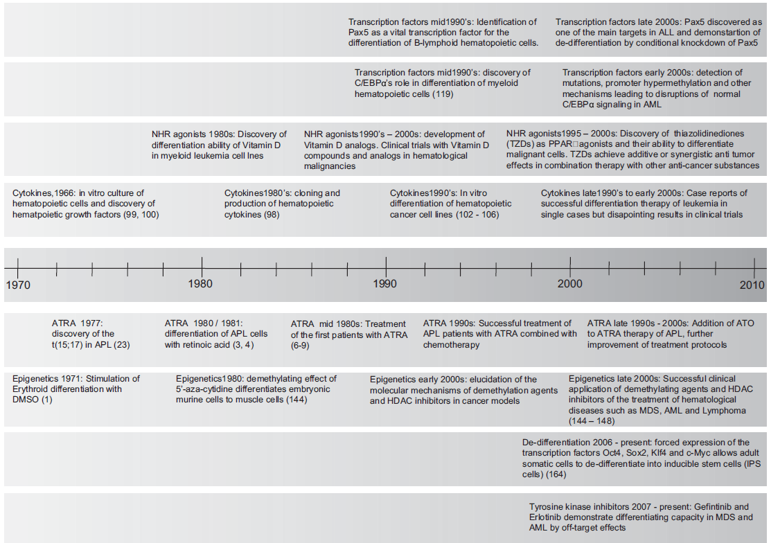
Time line of Differentiation Therapy and Epigenetic Modifiers⁸
Copyright © 2019 by ASPHO

Slide 16
Targeted Therapies
Copyright © 2019 by ASPHO

Slide 17
Targeted Therapies Promise of Cure¹⁴
Medications that interfere with specific molecular targets to stop the growth, progression or spread of cancer cells with minimal side effects
New understandings of molecular targets are being discovered almost daily which challenges all medical providers to stay up to date on the therapeutic entities available to treat pediatric cancers
Targeted therapies can have a huge impact on pediatric cancer outcomes especially in terms of event free survival with the reduction of short and long term toxicity caused by conventional chemotherapy and radiation
Copyright © 2019 by ASPHO

Slide 18
Targeted Therapies Lots of Options
Copyright © 2019 by ASPHO

Slide 19
Targeted Therapies Pediatric Biomarkers¹⁴
ALK = Anaplastic lymphoma kinase
BRAF = B-Raf protein gene
cMET = Tyrosine kinase MET or hepatocyte growth factor
EGRF = Epithelial Growth Factor Receptor
ERBB2 = ERB-B2 Receptor Tyrosine Kinase
MGMT = O-6-methylguanine-DNA methyltransferase DNA repair gene
PDGFRA = Platelet Derived Growth Factor Receptor Alpha protein encoding gene
PDGFRB = Platelet Derived Growth Factor Receptor Beta protein encoding gene
PIK3CA = Phosphatidylinositol 3-kinase catalytic subunit alpha gene
PTEN = Phosphatase and tensin homolog protein gene
SPARC = Secreted protein acidic and rich in cysteine gene
VEGF = Vascular Endothelial Growth Factor
Copyright © 2019 by ASPHO

Slide 20
Targeted Therapies Enzyme Targets¹⁴
BCR-ABL Kinase = breakpoint cluster region protein-abelson murine leukemia homolog 1 tyrosine kinase
mTOR = mechanistic target of rapamycin kinase
MEK-1 = dual threonine and tyrosine recognition kinase enzyme
Aurora Kinase = serine/threoine kinases enzyme
HDAC = Histone deacetylases enzymes
TOP1 = topoisomerase 1 enzyme
ERK = extracellular signal –regulated kinase enzymes
PARP = Poly (ADP-ribose) polymerase enzymes
Copyright © 2019 by ASPHO

Slide 21
Targeted Therapies Proteins¹⁴
KRAS = v-Ki-ras2Kirsten rate sarcoma viral oncogene homolog protein
RAS = family of proteins
SHH = Sonic hedgehog protein
SMO = Smoothened protein
NOTCH = Neurogenic locus notch homolog protein 1
IGF-1R = type 1 insulin-like growth factor receptor protein
C-kit = stem cell factor receptor protein
SRC = proto-oncogene non-receptor tyrosine protein kinase
EPH receptor A2 = ephrin type-A receptor 2 protein
FLT3 = fms-like tyrosine kinase 3 protein
JAK = Janus Associated Kinases
FGFR = fibroblast growth factor receptor
Copyright © 2019 by ASPHO

Slide 22
Targeted Therapies – Imatinib^{7,8,14}
Mechanism of Action: Inhibits BCR-ABL tyrosine kinase which blocks proliferation and induces cell death in Philadelphia chromosome positive chronic myeloid leukemia(CML) . In addition, inhibits PDGF, stem cell factor (SCF0) and c-KIT.
Route: oral
Indication: Ph+ ALL, Ph+ CML,
Side Effects/Monitoring:
Common: Bone marrow suppression, tumor lysis syndrome, moderate emetogenic, muscle spasms
Severe: skin rashes, heart failure, liver toxicity, renal toxicity, growth retardation, hypothyroidism, pleural effusion, pneumonitis, hypokalemia, visual changes
Copyright © 2019 by ASPHO

Slide 23
Targeted Therapies – Dasatinib^{7,8,14}
Mechanism of Action: Inhibits BCR-ABL tyrosine kinase that is specific for most Imatinib resistant mutations by binding to active and inactive ABL-kinase. In addition, inhibits SRC family, c-KIT, PDGFRB.
Route: oral
Indication: Ph+ ALL, Ph+ CLL
Side Effects/Monitoring:
Common: Bone marrow suppression, pain, minimal emetogenic, diarrhea(can be severe), hypoglycemia
Severe: skin rashes, QTC prolongation, heart failure, pulmonary hypertension, arthralgias /myalgias, renal toxicity, growth retardation, pleural effusion, pneumonitis, hemorrhage
Copyright © 2019 by ASPHO

Slide 24
Targeted Therapies – Sorafenib^{7,8,14}
Sorafenib
Mechanism of Action: multikinase inhibitor which inhibits growth and angiogenesis through inhibition of raf kinases and cell surface kinase receptors(VEGFR-1, VEGFR-2, VEGFR3, PFGFRB, cKIT, FLT-3 and others)
Route: oral
Indication: hepatocellular carcinoma, renal cell carcinoma, FLT3/ITD AML
Side Effects/Monitoring:
Common: flu like symptoms, decreased counts, hypocalcemia, hypophosphatemia, fatigue, pain, high emetogenic potential
Severe: hand-foot syndrome/ palmar-plantar erthrodysesthesia (within 1st 6 weeks) , hypertension, QTC prolongation, thyroid dysfunction, wound healing complications, liver effects
Copyright © 2019 by ASPHO

Slide 25
Targeted Therapies – Crizotinib^{7,8,14}
Crizotinib
Mechanism of Action: tyrosine kinase inhibitor inhibiting ALK, c-MET, and recepteur d”Origine Nantais (RON)
Route: oral
Indication: non-small cell lung cancer, neuroblastoma, anaplastic large-cell lymphoma,
Side Effects/Monitoring:
Common: moderate emetogenic potential, decreased blood counts, neuropathy, headache, dizziness, fatigue
Severe: QT prolongation, bradycardia, liver dysfunction, vision loss, interstitial lung disease, renal dysfunction
Copyright © 2019 by ASPHO

Slide 26
Targeted Therapies – Erlotinib^{7,8,14}
Mechanism of Action: tyrosine kinase activity which reversibly inhibits EGFR
Indication: non-small cell lung cancer, pancreatic cancer, malignant gliomas
Route: oral
Side Effects/Monitoring:
Common: minimal emetogenicity; skin rash, weakness, arthralgia, pain, fatigue, conjunctivitis, cough, fever
Severe: microangiopathic hemolytic anemia, liver toxicity, decreased tear production renal failure, insterstitial lung disease, radiation recall, hypothyroidism, thrombosis, depression, anxiety
Copyright © 2019 by ASPHO

Slide 27
Targeted Therapies – Ruxolitinib^{7,8,14}
Mechanism of Action: Inhibits JAK1 and JAK2 which mediate cytokine and growth factor signaling which are involved in hematopoiesis and immune function
Indication: myelofibrosis, polycythemia vera, steroid refractory graft versus host disease, leukemia
Side Effects/Monitoring:
Common: hematologic toxicity, headache, dizziness, fatigue, hypertriglyceridemia, diarrhea, minimal emetogenic potential
Severe: Liver toxicity, urinary tract infection, infections
Copyright © 2019 by ASPHO

Slide 28
Targeted Therapies – Pazopanib^{2,7,8,14}
Mechanism of Action: multi kinase inhibitor, inhibits VEGFR 1, 2, and 3 receptors, PDGFRA and PDGFRB, FGFR1 and 3, cKIT, interleukin-2 receptor inducible T-cell kinase, lymphocyte-specific protein tyrosine kinase (Lck), and transmembrane glycoprotein receptor tyrosine kinase (c-Fms)
Indication: ovarian cancer, soft tissue sarcomas, renal cell carcinoma
Route: oral
Side Effects/Monitoring:
Common: hypertension, hair discoloration, diarrhea, hematologic toxicity, hepatotoxicity, hyperkalemia, hypomagnesemia, hyponatremia, hypophosphatemia, pain, myalgias, insomnia, cough, low emetogenic potential
Severe: hand-foot skin reaction, hemorrhage, infections, ocular toxicity, pulmonary toxicity, QTC prolongation, wound healing complications, hyperlipidemia, thrombotic microangiopathy, pulmonary toxicities
Copyright © 2019 by ASPHO

Slide 29
Targeted Therapies – Sirolimus^{7,8,14}
Mechanism of Action: sirolimus inhibit the mTOR kinase activity by binding to an intracellular protein, FKBP-12. It halts cell cycle in the tumor cells in the G1 phase. It inhibits T-cell activation and proliferation in response to antigens and cytokine stimulation and inhibits antibody production
Route: oral
Indication: renal and liver rejection prophylaxis, graft vs host disease, potential for use in solid tumor, myelodysplastic syndrome and AML treatment
Side Effects/Monitoring:
Common: hypertension, hyperkalemia, increased lactate dehydrogenase, wound healing impairment
Severe: hypersensitivity reactions, interstitial lung disease, hyperlipidemia, renal toxicity, infection, liver toxicity, hematologic toxicity
Copyright © 2019 by ASPHO

Slide 30
Targeted Therapies Everolimus^{7,8,14}
Mechanism of Action: macrolide immunosuppressant and mTOR inhibitor which decreases angiogenesis through VEGF and hypoxia-inducible factor (HIF-1)
Route: oral
Indication: Breast cancer, neuroendocrine tumors, renal cell cancer, prevention of liver/renal/lung transplant rejections, tuberous sclerosis complex-associated subependymal giant cell astrocytoma, Hodgkin lymphoma, leukemia, recurrent solid tumors and brain tumors
Side Effects/Monitoring:
Common: low emetogenic potential, hypertension, hypokalemia, hypomagnesemia, hyperglycemia, hypophosphatemia,
Severe: hematologic toxicities, liver toxicity, renal toxicity, pulmonary toxicity
Copyright © 2019 by ASPHO

Slide 31
Targeted Therapies The Future^{4,14, 15,16}
Therapeutic Drug Level Monitoring
Most targeted therapies have fixed adult doses
Patient may benefit by measuring drug trough to maximize progression free outcomes and to minimalize dose related toxicities
Establish adequate therapeutic dosing in pediatric patients
Verify achievement of therapeutic levels when drug interactions are involved such as bioavailability changes due to stomach pH alterations or cytochrome P450 isoenzyme effects
Copyright © 2019 by ASPHO

Slide 32
Targeted Therapies Promise of Cure¹⁴
As therapies are developed for specific targets, clinical trials show that these medications may have both good and bad “off target” effects
As a result about 90% of the novel medications discovered never become part of standard treatment due to toxicities, lack of efficacy, or lack of improvement over current medications available
Copyright © 2019 by ASPHO

Slide 33
Targeted Therapies Not all response are on target!
Copyright © 2019 by ASPHO

Slide 34
Epigenome-targeted Therapies ^{5,6}
Epigenetics = the study of the mechanisms that turn genes on and off
Epigenome-Targeted Therapies = consist of medications that affect gene expressions and decrease uncontrolled cancer cell growth by causing alterations in proteins that regulate cell cycle progression, apoptosis, and cell survival
Epigenome changes seem to be a basis for many pediatric cancers especially hematologic malignancies
Two drug classes considered Epigenome therapies are currently available
Copyright © 2019 by ASPHO

Slide 35
Epigenome-targeted Therapies 2 drug classes^{5,6}
DNA Methyltransferase (DNMT) Inhibitors
Histone Deacetylase (HDAC) Inhibitor
Copyright © 2019 by ASPHO

Slide 36
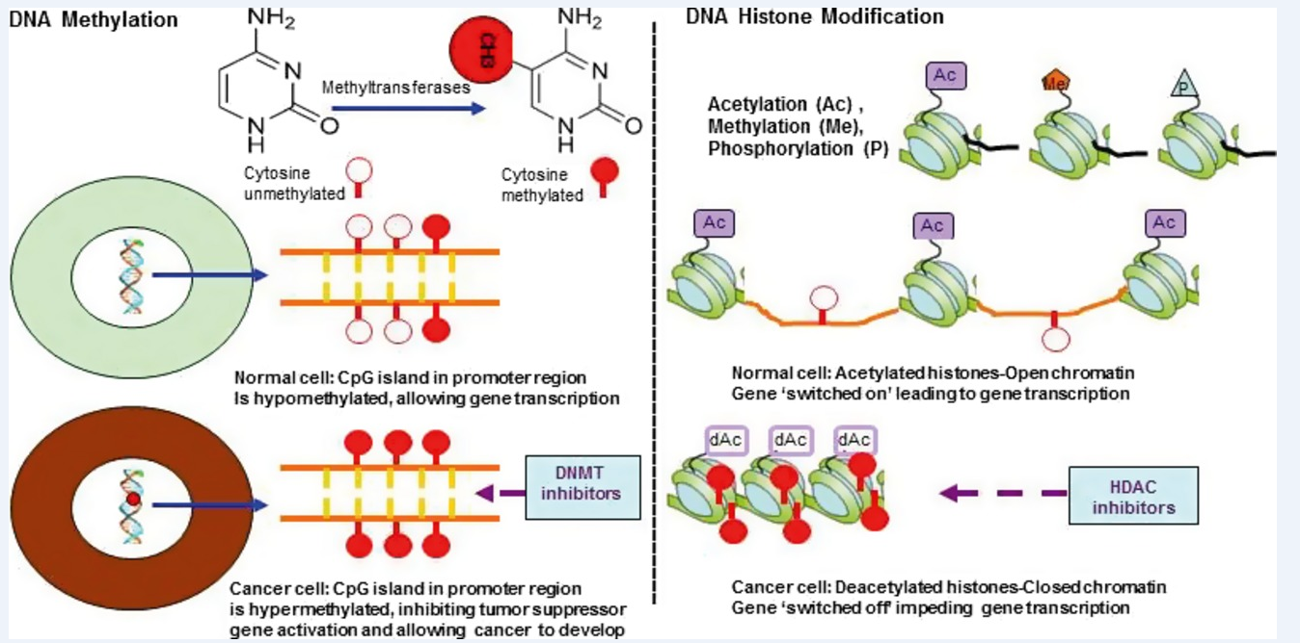
Copyright © 2019 by ASPHO

Slide 37
Epigenome-targeted Therapies DNA Methyltransferase Inhibitors ^{5,6}
DNA Methyltransfersase(DNMT) enzymes are a group of enzymes that add a methyl group to cytosine bases
It is thought that the methyl group is added within a promoter area of tumor suppressor genes which silences these genes. This causes the cancer cells to proliferate uncontrolled during cancer growth.
DNA Methyltransferase Inhibitors are azacitidine and decitabine which prevent the methyl group addition and turns the tumor suppressor genes back on
Copyright © 2019 by ASPHO

Slide 38
Epigenome-targeted Therapies DNA Methyltransferase Inhibitors ^{6,7,8}
Azacitidine
Mechanism of Action: Promotes DNA hypomethylation which restores normal gene differentiation and proliferation. It also kills abnormal hematopoietic cells in the bone marrow
Route: subcutaneous or intravenous
Indication: AML, MDS
Side Effects/Monitoring:
Common: moderate emetogenic potential, hematologic toxicity, injection site reactions, renal toxicity, tumor lysis syndrome, abdominal pain, bowel changes, myalgias/arthralgias, fever, fatigue
Severe: hypokalemia, pulmonary changes, CNS changes,
Copyright © 2019 by ASPHO

Slide 39
Epigenome-targeted Therapies DNA Methyltransferase Inhibitors ^{6, 7, 8}
Decitabine
Mechanism of Action: after phosphorylation in the cell, it causes hypomethylation of DNA which reestablishes normal cellular differentiation and proliferation. It also kills rapidly dividing cells.
Route: intravenous
Indication: MDS, AML
Side Effects/Monitoring:
Common: hematologic toxicities, hyperglycemia, hyperkalemia, hypoalbuminemia, hypomagnesemia, sodium bicarbonate level increases, diarrhea, backache, arthralgia, limb pain, headache, dizziness, insomnia, fever, minimal emetogenic potential
Severe: blood pressure changes, peripheral edema, liver toxicity, infections, asthenia,
pulmonary changes
Copyright © 2019 by ASPHO

Slide 40
Epigenome-targeted Therapies Histone Deacetylase Inhibitors ^{5,6}
Histones are proteins that put the DNA into nucleosomes and help the DNA to wrap around the chromatin within the nuclei
Histones can be changed by acetylation which allows the chromatin structure to change so that it will promote active transcription. It’s believed that the Histone acetyltransferases are overexpressed in cancer cells. These are responsible for cell cycle regulation, cell differentiation, and tissue development.
HDAC inhibitors inhibit the enzymes activity and help to promote gene silencing.
Copyright © 2019 by ASPHO

Slide 41
Epigenome-targeted Therapies 2 Histone Deacetylase Inhibitors ⁶
Vorinostat
Romidepsin
Copyright © 2019 by ASPHO

Slide 42
Epigenome-targeted Therapies Histone Deacetylase Inhibitors ^{6,7,8}
Vorinostat
Mechanism of Action: inhibits histone deacetylase enzymes which remove acetyl group from protein lysine and results in acetyl group accumulation. This changes the chromatin structure and transcription factor activation so cell growth is stopped and apoptosis occurs
Route: oral
Indication: cutaneous T-cell lymphoma, advanced melanoma
Side Effects/Monitoring:
Common: hematologic toxicities, QT prolongation, thrombosis, fatigue, chills, dizziness, low emetogenic potential, headache, fever
Severe: renal toxicity, hypokalemia, hypomagnesemia, liver toxicity, peripheral edema, diarrhea,
Copyright © 2019 by ASPHO

Slide 43
Epigenome-targeted Therapies Histone Deacetylase Inhibitors ^{6,7,8}
Romidepsin
Mechanism of Action: Inhibits histone deacetylase which creates accumulation of acetyl groups. This leads to changes in chromatin structure and transcription factor activation which stops cell growth and leads to cell death
Route: intravenous
Indication: peripheral T-cell lymphoma, non-Hodgkin T-cell lymphomas, primary cutaneous T-cell lymphoma
Side Effects/Monitoring:
Common: hypersensitivity reaction, hematologic toxicities, hypotension, skin rash, itching, hyperglycemia, magnesium changes, hyponatremia, hypokalemia, hypocalcemia, hypoalbuminemia, bowel changes, fatigue, fever, shivering, cough, dypsnea, moderate emetogenic potential
Severe: EKG changes, life threatening infections, tumor lysis syndrome, renal toxicity, liver toxicity , Epstein-Barr virus reactivation
Copyright © 2019 by ASPHO

Slide 44
Immune checkpoint Inhibitors ^{5,12,13}
Medications that prevent the patient’s immune system cells from being turned off by cancer cells and as a result, help the patient’s own immune system attack the cancer cells.
As is often the case, immune checkpoint inhibitors have been studied more extensively in adult cancers than pediatric cancers. Unlike other medications, the known immune checkpoint inhibitors have had few long lasting effects in pediatric cancers.
Copyright © 2019 by ASPHO

Slide 45
Immune checkpoint Inhibitors Differences in efficacy in pediatric cancers ^{5,12,13}
At this point in time, immune checkpoint inhibitors have not found as strong of a niche in pediatric cancers as adults…why?
These medications are most highly effective in cancers with more than 100 mutations per exome. Most pediatric cancers have mutation frequencies as low as 0.1 mutation for exome!
Adult cancers are thought to occur after a long chronic inflammatory phase of years whereas the pre cancer time period in pediatrics may be only weeks to months.
Copyright © 2019 by ASPHO

Slide 46
Immune checkpoint Inhibitors Potential checkpoints ^{5,12,13}
Mechanisms used to stop T-cell suppression that help cancer cells to “hide” from the immune systems
Cytotoxic T-lymphocyte antigen 4(CTLA-4)
Program Cell Death protein 1 (PD-1)
Programmed cell death ligand 1 (PD-L1)
Lymphocyte-activation gene-3(LAG-3)
CD200
IDO
And more to come!
Copyright © 2019 by ASPHO

Slide 47
Immune checkpoint Inhibitors How do they work?
Credit: National Cancer Institute / Terese Winslow; https://www.cancer.gov/news-events/cancer-currents-blog/2015/gulley-checkpoint
Copyright © 2019 by ASPHO

Slide 48
Immune checkpoint Inhibitors ^{5,12,13} Monoclonal Antibodies with Pediatric Potential
Ipilimumab = CTLA-4 inhibitor
Nivolumab = PD-1 inhibitor
Pembrolizumab = PD-1 inhibitor
Atezolizumab, Avelumab, and Durvalumab = PD-L1 inhibitor
Indoximod = IDO
Copyright © 2019 by ASPHO

Slide 49
Immune checkpoint Inhibitors Pediatrics ^{5,7,8,12,13}
Agent | Target | Potential Pediatric Indications
Ipilimumab | CTLA-4 | Melanoma, relapsed/refractory solid tumors or sarcoma, progressive osteosarcoma, B cell NHL, ALL, CLL
Nivolumab | PD-1 | Glioblastoma, relapsed/refractory neuroblastoma, refractory hodgkin lymphoma, refractory non-hodgkin lymphoma, advanced solid tumors
Pembrolizumab | PD-1 | Recurrent or progressive high-grade gliomas, diffuse intrinsic pontine glioma, melanoma, relapsed refractory PD-L1 positive tumors, lymphoma, alveolar soft tissue sarcomas, advanced solid tumors
Durvalumab, atezolizumab, avelumab | PD-L1 | Refractory or advanced solid tumors, recurrent or progressive osteosarcoma, lymphoma, or CNS tumors
Indoximod | IDO | Progressive primary malignant brain tumors
Copyright © 2019 by ASPHO

Slide 50
Immune checkpoint Inhibitors – Ipilimumab ^{7,8,12,13}
Mechanism of Action: recombinant human IgG1 immunoglobulin monoclonal antibody that binds to CTLA-4 which causes enhanced T-cell activation and proliferation.
Route: intravenous
Indication: metastatic or unresponsive melanoma, ongoing pediatric research(see previous table)
Side Effects/Monitoring:
Common: infusion related reactions, dermatologic toxicity, endocrinopathy, moderate to severe colitis, low emetogenic toxicity
Severe: pneumonitis, eye toxicities, immune related adverse reactions that can be fatal, neuropathy, encephalitis, hypophysitis, adrenal insufficiency, hyper/hypothyroidism, moderate to severe colitis, liver toxicity, renal toxicity
Copyright © 2019 by ASPHO

Slide 51
Immune Checkpoint Inhibitors – Nivolumab ^{7,8,12,13}
Mechanism of Action: fully human IgG4 immunoglobulin monoclonal antibody which inhibits PD-1 activity by binding to the PD-1 receptor to block the PD-L1 and PD-L2 from binding. This allows for antitumor response.
Route: intravenous
Indication: colorectal cancer, , ongoing pediatric research(see previous table)
Side Effects/Monitoring:
Common: infusion related reactions, dermatologic toxicity, moderate to severe colitis, minimum emetogenic toxicity
Severe: pneumonitis, eye toxicities, immune related adverse reactions that can be fatal, neuropathy, encephalitis, hypophysitis, adrenal insufficiency, hyper/hypothyroidism, moderate to severe colitis, liver toxicity, renal toxicity, myocarditis
Copyright © 2019 by ASPHO

Slide 52
Immune checkpoint inhibitors –Pembrolizumab ^{7,8,12,13}
Mechanism of Action: humanized monoclonal antibody that’s highly selective for PD-1 receptors on T-cells and block them the PD-1 receptors from inhibiting the pathway so T-cell suppression is reversed.
Indication:
PEDIATRIC: Hodgkin Lymphoma, microsatellite instability-high cancer, primary mediastinal large B-cell Lymphoma
ADULT: recurrence of cervical, gastric, head and neck cancer, hodgkin lymphoma, melanoma, non-small cell lung cancer, urothelial carcinoma, merkel cell carcinoma, ongoing pediatric research(see previous table)
Side Effects/Monitoring:
Common: infusion related reactions, dermatologic toxicity, moderate to severe colitis, minimum emetogenic toxicity, hematologic toxicities, headache, fatigue, hypophosphatemia, hyperkalemia, hyponatremia
Severe: pneumonitis, eye toxicities, immune related adverse reactions that can be fatal, neuropathy, hypophysitis, adrenal insufficiency, hyper/hypothyroidism, moderate to severe colitis, liver toxicity, renal toxicity, myocarditis
Copyright © 2019 by ASPHO

Slide 53
Immune checkpoint Inhibitors ^{5,12,13} Side Effects in the Pediatric World
Severe and possibly life threatening immune mediated reactions can occur
Consider corticosteroid treatment especially when severe
May affect any organ of the body and can occur days to months after medication is stopped
Copyright © 2019 by ASPHO

Slide 54
Immune checkpoint Inhibitors The way of the future? ^{5,12,13}
The explosion of clinical trials for immune checkpoint inhibitors began about 4 years ago
Time will tell as to which work and don’t work OR have dose limiting toxicities
Chances are the side effect will be Immune mediated so think STEROIDS to treat
Again, expect agents to come and go
Copyright © 2019 by ASPHO

Slide 55
Anti-angiogenic Agents
Medications that inhibit the growth of new blood vessels which helps to slow or stop the growth of cancer cells.
Copyright © 2019 by ASPHO

Slide 56
Anti-angiogenic Agents Basics of Angiogenesis Process ^{1,2,15}
Basics of Angiogenesis Process
Pro- angiogenic molecules
Example is vascular endothelial growth factor or VEGF
Present normally in adults only for wound healing and menstrual cycle
Abnormally present for diseases like arthritis, diabetic retinopathy, or cancer progression
Anti-angiogenic molecules
Example is Thrombospondin-1
Balance to keep blood vessels stable without growth
Copyright © 2019 by ASPHO

Slide 57
Anti-angiogenic Agents Angiogenic Switch ^{1,2,15}
In cancer cells, the system is shifted towards pro-angiogenesis
Hypoxia in the tumor is the main theory of what causes the shift to pro-angiogenesis
Hypoxia causes tumor cells to release pro-angiogenic factors and makes changes to the vessels basement membrane
More factors cause endothelial cells to migrate to the area to form a lumen structure and pericytes arrive to grow the neo-vessel
These neo-vessels bring nutrients to the tumor cells which increase the tumor’s growth
Copyright © 2019 by ASPHO

Slide 58
Anti-angiogenic Agents Angiogenic Switch^{1,2,15}
The pro-angiogenesis that occurs within the tumor creates a hyper-vascular structure that has dysfunctional neo-vessels which will leak and have increase permeability for other substances
Anti-angiogenic Agents work as the tumor grows beyond 2mm in size because then the tumor must develop it’s own blood supply to gain oxygen and nutrients to continue to grow
Copyright © 2019 by ASPHO

Slide 59
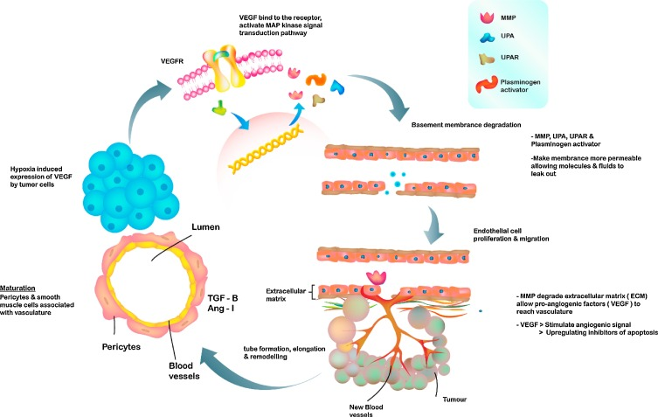
Anti-angiogenic Agents ²
Copyright © 2019 by ASPHO

Slide 60
Anti-angiogenic Agents – 3 main categories ^{1,2,15}
Monoclonal antibodies act as angiogenesis agents by blocking the VEGF from binding to it’s receptor
Tyrosine kinase inhibitors are the most common medications in this group and act as antiangiogenic agents by inhibiting the formation of kinases required for the angiogenesis
Miscellaneous Anti-angiogenic Agents were often researched for other uses as conventional drugs and found to have anti-angiogenic properties. Some of the mechanisms aren’t fully understood
Copyright © 2019 by ASPHO

Slide 61
Anti-angiogenic Agents – Bevacizumab ^{1,2,7,8,15}
Mechanism of Action: Recombinant, humanized monoclonal antibody which decreases VEGF effect and inhibits microvascular growth in all tissues.
Indication: refractory solid tumors, high/low grade gliomas, medulloblastoma, and adult cancers such as cervical cancer, colorectal cancer, non-small cell lung cancer, renal cell cancer, breast cancer, endometrial cancer, pleural mesothelioma, and soft tissue sarcoma
Side Effects/Monitoring:
Common: hyperglycemia, hyperkalemia, hypomagnesemia, hyponatremia, cough, minimum emetic potential, hypoalbuminemia, abdominal pain, bowel changes
Severe: GI perforation, heart failure, hemorrhage, hypertension, infusion related reactions, impaired wound
eye infections, jaw osteonecrosis , renal toxicity, thrombosis, ototoxicity
Copyright © 2019 by ASPHO

Slide 62
Anti-angiogenic Agents- Tyrosine Kinase Inhibitors ¹
Discussed in detail in Targeted Therapy Section
Medications used in pediatrics include:
Sorafenib
Sunitinib
Axitinib
Pazobanib
Copyright © 2019 by ASPHO

Slide 63
Anti-angiogenic Agents- Miscellaneous Agents Thalidomide ^{1,7,8,15}
Mechanism of Action: thought to have both antiangiogenic and immunomodulating effects. As antiangiogenic it’s thought to block the VEGF receptor. In addition, depending on the patient’s disease may either suppress or increase TNF- alpha, may increase natural killer cells and IL-2 levels
Indication: Orphan drug status for cancer indications such as primary brain malignancies, myelodysplastic syndrome, prevention of GVHD, multiple myeloma
Route: oral (distributed only through THALOMID REMS ™ program
Side Effects/Monitoring: ( woman must confirm not pregnant x 2 and males use mandatory contraception
Common: Neutropenia(hold if occurs), thrombocytopenia, drowsiness, constipation, fever, minimal emetogenic potential, pruritus
Severe: birth defects, tumor lysis syndrome, dypsnea, edema, back pain
Copyright © 2019 by ASPHO

Slide 64
Anti-angiogenic Agents- Miscellaneous Agents Lenalidomide ^{1,7,8,15}
Mechanism of Action: multiple mechanisms including immunomodulatory, antiangiogenic, and antineoplastic; works to inhibit vasculature through inhibiting signals to angiogenic factors in cells.
Indication: Orphan drug status for cancer indications such as diffuse B Cell lymphoma, CLL, myelodysplastic syndrome, prevention of GVHD, multiple myeloma, mantle cell lymphoma,
Route: oral (only distributed through REVLIMID REMS™ program
Side Effects/Monitoring:
Common: edema, pruritus, blurred vision, bronchitis, cough,
Severe: dermatologic reactions, hepatic failure, thyroid disorder so monitor,
secondary malignancies like AML myelodysplastic syndromes, Hodgkins lymphomas, tumor lysis syndrome, angioedema, interstitial nephritis, multiple organ failure, tumor flare
Copyright © 2019 by ASPHO

Slide 65
Anti-angiogenic Agents-Miscellaneous agents ^{1,7,8}
Vincristine and Vinblastine – inhibit endothelial cells motility, proliferation and migration
Paciltaxel –potent anti- angiogenic activity at low doses so trials of metronomic(continuous treatment) are ongoing
Curcumin – has wide range of cancer effects not completely understood including anti-angiogenic effects
Celebrex- effective because some tumors over express CO2 enzymes and newly formed blood vessels
Revervatrol/quercertin/genstein/gingko bilboa/capsaicin/berberine/silymarin…– fruit/vegetable/plant based natural compounds found to have anti-angiogenic effects
Copyright © 2019 by ASPHO

Slide 66
Anti-angiogenic Agents – Resistance ^{1,2,15}
Contradictory to initial high expectations of anti-angiogenic therapy as single agents, anti-angiogenic agents have been found to work best in combination with other chemotherapy agents and for some tumors not at all
WHY? 2 mechanisms of resistance
Adaptive resistance = malignant cells adapt to cope with the lack of blood supplied caused by the anti-angiogenic medications through upregulating other angiogenesis pathways to overcome the hypoxia
Intrinsic resistance = there are some tumors that are able to grow without vasculature and/or have other compensatory factors that activate angiogenic receptors
Copyright © 2019 by ASPHO

Slide 67
Anti-angiogenic Agents – Best Results ^{1,2,15}
Proposed current best use of anti-angiogenic agents is to use them in combination
It seems anti-angiogenic agents initially work in the tumor to normalize vascularization which improves the intratumoral perfusion
With improvement in intratumoral perfusion, nutrients, oxygen, and especially, chemotherapeutic agents have better penetration into the tumor
Each agent may have an optimal intratumoral drug delivery period with the best ability for drug accumulation so timing of antiangiogenic agents when used in combination is critical and continuing to be researched.
Copyright © 2019 by ASPHO

Slide 68
Reprinted from Critical Reviews in Oncology/Hematology, 89, 3, Sie, et al, Anti-angiogenic therapy in pediatric brain tumors: An effective strategy?,418-432, Copyright 2014, with permission from Elsevier
Copyright © 2019 by ASPHO

Slide 69
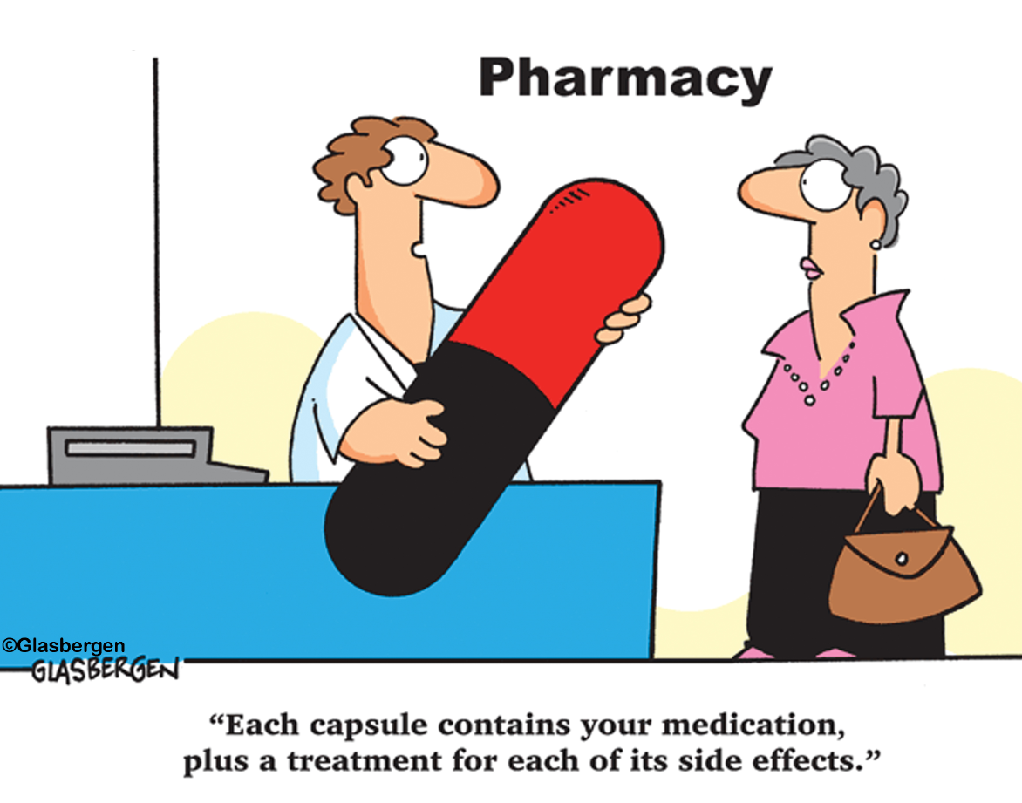
Why Use Novel Therapies for Cancer?
Copyright © 2019 by ASPHO

Slide 70
References:
Al-Abd A, Alamoudi A, Abdel-Naim A, Neamatallah T, Ashour O. Anti-angiogenic agents for the treatment of solid tumors: Potential pathways, therapy and current strategies – A review. J Adv Res. 2017;8(6):591-605. doi:10.1016/j.jare.2017.06.006
Chellappan D, Chellian J, Ng Z et al. The role of pazopanib on tumour angiogenesis and in the management of cancers: A review. Biomedicine & Pharmacotherapy. 2017;96:768-781. doi:10.1016/j.biopha.2017.10.058
Chemaitilly W, Sklar C. Childhood Cancer Treatments and Associated Endocrine Late Effects: A Concise Guide for the Pediatric Endocrinologist. Horm Res Paediatr. 2018:1-9. doi:10.1159/000493943
de Wit D, Guchelaar H, den Hartigh J, Gelderblom H, van Erp N. Individualized dosing of tyrosine kinase inhibitors: are we there yet?. Drug Discov Today. 2015;20(1):18-36. doi:10.1016/j.drudis.2014.09.007
Farkona S, Diamandis E, Blasutig I. Cancer immunotherapy: the beginning of the end of cancer?. BMC Med. 2016;14(1). doi:10.1186/s12916-016-0623-5
Feinberg A, Koldobskiy M, Göndör A. Epigenetic modulators, modifiers and mediators in cancer aetiology and progression. Nature Reviews Genetics. 2016;17(5):284-299. doi:10.1038/nrg.2016.13
IBM Watson Health Products: Please Login. Micromedexsolutions.com. http://www.micromedexsolutions.com/home/dispatch. Published 2018. Accessed December 3, 2018.
Login. Online.lexi.com. https://online.lexi.com/lco/action/doc/retrieve/docid/patch_f/7260. Published 2018. Accessed December 7, 2018.
Copyright © 2019 by ASPHO

Slide 71
References:
Mummaneni P, Shord S. Epigenetics and Oncology. Pharmacotherapy: The Journal of Human Pharmacology and Drug Therapy. 2014;34(5):495-505. doi:10.1002/phar.1408
Nakagawara A, Li Y, Izumi H, Muramori K, Inada H, Nishi M. Neuroblastoma. Jpn J Clin Oncol. 2018;48(3):214-241. doi:10.1093/jjco/hyx176
Nowak D, Stewart D, Koeffler H. Differentiation therapy of leukemia: 3 decades of development. Blood. 2009;113(16):3655-3665. doi:10.1182/blood-2009-01-198911
Pennock G, Chow L. The Evolving Role of Immune Checkpoint Inhibitors in Cancer Treatment. Oncologist. 2015;20(7):812-822. doi:10.1634/theoncologist.2014-0422
Ring E, Markert J, Gillespie G, Friedman G. Checkpoint Proteins in Pediatric Brain and Extracranial Solid Tumors: Opportunities for Immunotherapy. Clinical Cancer Research. 2016;23(2):342-350. doi:10.1158/1078-0432.ccr-16-1829
Saletta F, Wadham C, Ziegler D et al. Molecular profiling of childhood cancer: Biomarkers and novel therapies. BBA Clin. 2014;1:59-77. doi:10.1016/j.bbacli.2014.06.003
Sie M, den Dunnen W, Hoving E, de Bont E. Anti-angiogenic therapy in pediatric brain tumors: An effective strategy?. Crit Rev Oncol Hematol. 2014;89(3):418-432. doi:10.1016/j.critrevonc.2013.09.005
Suttorp M, Bornhäuser M, Metzler M, Millot F, Schleyer E. Pharmacology and pharmacokinetics of imatinib in pediatric patients. Expert Rev Clin Pharmacol. 2017;11(3):219-231. doi:10.1080/17512433.2018.1398644
van Leeuwen R, van Gelder T, Mathijssen R, Jansman F. Drug–drug interactions with tyrosine-kinase inhibitors: a clinical perspective. The Lancet Oncology. 2014;15(8):e315-e326. doi:10.1016/s1470-2045(13)70579-5
Yan M, Liu Q. Differentiation therapy: a promising strategy for cancer treatment. Chin J Cancer. 2016;35(1). doi:10.1186/s40880-015-0059-x
Copyright © 2019 by ASPHO

