Slide 2
Blood Coagulation Overview and Acquired Coagulation Disorders
Guy Young, MD
Copyright © 2019 by ASPHO

Slide 3
This talk will follow the topical structure suggested by the ABP:
Copyright © 2019 by ASPHO

Slide 4
Lecture Outline
Primary Hemostasis
Plasma coagulation
Clotting factors
Natural inhibitors
Fibrinolytic system
Laboratory Testing
Acquired Hemostatic Disorders
Copyright © 2019 by ASPHO

Slide 5
Copyright © 2019 by ASPHO

Slide 6
Primary Hemostasis
Subendothelium
Normal collagen
Tissue factor
Platelets
Need adequate number
Need adequate function (see platelet section for details)
von Willebrand factor
Need normal amount
Need normal function
Copyright © 2019 by ASPHO

Slide 7
Lecture Outline
Primary Hemostasis
Plasma coagulation
Clotting factors
Natural inhibitors
Fibrinolytic system
Laboratory Testing
Acquired Hemostatic Disorders
Copyright © 2019 by ASPHO

Slide 8
Lecture Outline
Primary Hemostasis
Plasma coagulation
Clotting factors
Natural inhibitors
Fibrinolytic system
Laboratory Testing
Acquired Hemostatic Disorders
Copyright © 2019 by ASPHO

Slide 9
Properties of Hemostatic Factors
Factor | Site of synthesis | Levels in infancy | Half-life | Vitamin K-dependent | Other
Fibrinogen (I) | Liver | Normal | 2-4 d | No | High fibrinogen increases ESR
Prothrombin (II) | Liver | Low | 3 d | Yes
Factor V | Liver Megakaryocytes | Low | 36 hr | No
Factor VII | Liver | Low | 3-6 hr | Yes
Factor VIII | Liver Endothelial Cells | Normal/High | 8-12 hr | No | Circulates with VWF Increased by DDAVP
Factor IX | Liver | Low | 22 hr | Yes
Factor X | Liver | Low | 40 hr | Yes
Factor XI | Liver | Low | 80 hr | No
Factor XIII | Liver/Macrophage | Low | 10 d | No | Important in wound healing
VWF | Endothelial cells Megakaryocytes | Normal/High | 12 hr | No | Stored in Weibel-Palade bodies in endothelial cells
Copyright © 2019 by ASPHO

Slide 10
Classical Coagulation Cascade
PK=Prekallikrein
K=Kallikrein
HMWK=High molecular weight kininogen
TF=Tissue factor
Ca++=Calcium
K
HMWK
PK
XII
XIIa
Ca++
VII
XI
XIa
TF
Ca++
VIIa
IX
IXa
VIII
VIIIa
Ca++
Ca++
X
Xa
X
Xa
Thrombin (IIa)
V
Va
XIII
Prothrombin (II)
Ca++
Thrombin (IIa)
Fibrinogen (I)
Fibrin
XIIIa
Cross-linked fibrin
Copyright © 2019 by ASPHO

Slide 11
Contact Activation System
K
HMWK
PK
Components of the contact activation system:
High molecular weight kininogen
Prekallikrein
Factor XII
Factor XI
XII
XIIa
Ca++
XI
XIa
C3
C1
Among the contact factors, only FXI deficiency is associated with bleeding (bleeding tendency is highly variable—some patients don’t bleed at all)
C3 active
C1 active
Complement system
Factor XIIa and Kallikrein are contact activation factors with interactions in the complement system
Bradykinin/Kinin (Inflammation)
Copyright © 2019 by ASPHO

Slide 12
Physiologic Coagulation
VII
TF
Ca++
VIIa
IX
IXa
VIII
VIIIa
Ca++
X
Xa
Thrombin (IIa)
V
Va
XIII
Prothrombin (II)
Ca++
Thrombin (IIa)
Fibrinogen (I)
Fibrin
XIIIa
Cross-linked fibrin
Copyright © 2019 by ASPHO

Slide 13
Physiologic Coagulation
Thrombin (IIa)
Ca++
VII
XI
XIa
TF
Ca++
VIIa
IX
IXa
VIII
VIIIa
Ca++
X
Xa
Thrombin (IIa)
V
Va
XIII
Prothrombin (II)
Ca++
Thrombin (IIa)
Fibrinogen (I)
Fibrin
XIIIa
Cross-linked fibrin
Copyright © 2019 by ASPHO

Slide 14
Physiologic Coagulation
Thrombin (IIa)
Ca++
VII
XI
XIa
TF
Ca++
VIIa
IX
IXa
VIII
VIIIa
Ca++
X
Xa
Thrombin (IIa)
V
Va
XIII
Prothrombin (II)
Ca++
Thrombin (IIa)
Fibrinogen (I)
Fibrin
XIIIa
Cross-linked fibrin
TAFI
Thrombin (IIa)
TAFIa
Copyright © 2019 by ASPHO

Slide 15
Thrombin’s procoagulant/antifibrinolytic effects on coagulation factors
VIII
VIIIa
XI
XIa
XIII
V
Thrombin (IIa)
XIIIa
Antifibrinolytic effect
Va
TAFI
Fibrinogen (I)
Fibrin
TAFIa
Copyright © 2019 by ASPHO

Slide 16
Thrombin’s interaction with platelets and endothelial cells
--platelet
TM
--Thrombomodulin
--fibrinogen
--endothelial cell
--fibrin
--activated platelet
--inhibits
Protein C
Protein Ca
Va and VIIIa
Thrombin (IIa)
Thrombin (IIa)
TM
Copyright © 2019 by ASPHO

Slide 17
Fibrinogen structure and gene
Chromosome 4
FGA FGB FGG
Aα chain
Bβ chain
γ chain
Thrombin binding site
Fibrinogen
Fibrinopeptide B
Fibrinopeptide A
Fibrin
Copyright © 2019 by ASPHO

Slide 18
Fibrin-platelet interaction
GPIIbIIIa
GPIIbIIIa
Fibrin
GPIIbIIIa
GPIIbIIIa
Copyright © 2019 by ASPHO

Slide 19
Lecture Outline
Primary Hemostasis
Plasma coagulation
Clotting factors
Natural inhibitors
Fibrinolytic system
Laboratory Testing
Acquired Hemostatic Disorders
Copyright © 2019 by ASPHO

Slide 20
Natural Coagulation Inhibitors
Inhibits ( )
Thrombin (IIa)
Ca++
VII
XI
XIa
Tissue factor pathway
inhibitor (TFPI)
TF
Ca++
VIIa
IX
IXa
VIII
VIIIa
Ca++
Ca++
X
Xa
X
Xa
Antithrombin
Thrombin (IIa)
V
Va
XIII
Prothrombin (II)
Ca++
Thrombin (IIa)
Protein S
Protein S
Fibrinogen (I)
Fibrin
Protein Ca
Thrombin (IIa)
Protein C
XIIIa
Cross-linked fibrin
Copyright © 2019 by ASPHO

Slide 21
Endothelial cell’s antithrombotic effects
PS
--Protein S
PC—protein C
APC—activated protein C
TPA
--tissue plasminogen activator
HS
--heparan sulfate
PAI-1
--plasminogen activator inhibitor type 1
PC
APC (PS)
Va and VIIIa
Thrombin
Thrombin
AT
TM
fibrinolysis
HS
PS
TPA
PAI-1
Copyright © 2019 by ASPHO

Slide 22
Lecture Outline
Primary Hemostasis
Plasma coagulation
Clotting factors
Natural inhibitors
Fibrinolytic system
Laboratory Testing
Acquired Hemostatic Disorders
Copyright © 2019 by ASPHO

Slide 23
Fibrinolysis and natural inhibitors
tPA-tissue plasminogen activator
uPA-urine plasminogen activator (urokinase)
PAI-1-plasminogen activator inhibitor-1
TAFI-thrombin activatable fibrinolysis inhibitor
tPA
uPA
PAI-1
Plasminogen
Plasmin
α2-antiplasmin
TAFIa
Thrombin (IIa)
TAFI
Fibrin clot
Clot lysis
Fibrin split products
D-dimer
Copyright © 2019 by ASPHO

Slide 24
Tests of fibrinolytic system
Signs of increased fibrinolysis
Abnormal in DIC, venous thrombosis and liver disease
D-dimer
Fibrin degradation (split) products
Assessment of fibrinolytic proteins
Decreased in deficiency states [congenital (rare), acquired] associated with thrombosis (at least in theory)
Plasmin
tPA
Assessment of fibrinolytic inhibitors
Decreased in deficiency states [congenital (rare)] associated with bleeding
PAI-1
α-2 antiplasmin
Copyright © 2019 by ASPHO

Slide 25
Fibrinolytic and anti-fibrinolytic drugs
Fibrinolytic
tPA (and analogs), uPA (not available in USA)
Used for treatment of arterial and venous thrombosis
Used to treat central venous catheter lumen occlusions
Antifibrinolytic
ε-aminocaproic acid and tranexamic acid (amino acid analogs of lysine)
Inhibit fibrinolysis by blocking plasmin’s binding site for fibrin (plasmin recognizes exposed lysine residues on fibrinogen)
Copyright © 2019 by ASPHO

Slide 26
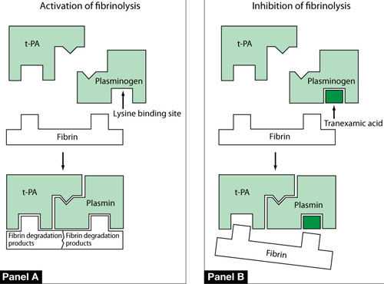
Mechanism of action of antifibrinolytic drugs
Reprinted by permission from Copyright Clearance Center: Springer Nature, DRUGS, Tranexamic Acid, Dunn, C.J. & Goa, K.L. (1999) 57: 1005.
Copyright © 2019 by ASPHO

Slide 27
Lecture Outline
Primary Hemostasis
Plasma coagulation
Clotting factors
Natural inhibitors
Fibrinolytic system
Laboratory Testing
Acquired Hemostatic Disorders
Copyright © 2019 by ASPHO

Slide 28
Factor Deficiencies and Coagulation Assays
Intrinsic Pathway=aPTT
K
HMWK
PK
Extrinsic Pathway=PT
XII
XIIa
VII
TF
VIIa
Ca++
XI
XIa
Ca++
IX
IXa/VIIIa
Common Pathway=PT and aPTT
Ca++
X
Xa/Va
Prothrombin (II)
Ca++
Thrombin (IIa)
Fibrinogen (I)
Fibrin
Copyright © 2019 by ASPHO

Slide 29
Thrombin Time
Thrombin (IIa)
Fibrinogen (I)
Fibrin
Assesses presence and function of fibrinogen
Abnormal in hypo- and afibrinogenemia
Abnormal in dysfibrinogenemia
Copyright © 2019 by ASPHO

Slide 30
Factor Deficiencies and Coagulation Assays
aPTT
PT
Contact factors
PK, HWMK, FXI, FXII
Factor IX
Factor VIII
Common Pathway
Factor X
Factor V
Factor II (Prothrombin)
Fibrinogen
Factor VII
Common Pathway
Factor X
Factor V
Factor II (Prothrombin)
Fibrinogen
Copyright © 2019 by ASPHO

Slide 31
PTT
NORMAL
PT
NORMAL
PT
PROLONGED
PROLONGED
FXIII deficiency
PROLONGED
FVII deficiency
NORMAL
Deficiencies of factors VIII, IX, XI, XII, Prekallikrein, HMWK
Circulating anticoagulant
Heparin effect
Liver disease
Vitamin K deficiency
Circulating anticoagulant
Warfarin effect
Afibrinogenemia
Dysfibrinogenemia
DIC
Heparin effect
Copyright © 2019 by ASPHO

Slide 32
Factor XIII and Coagulation Assays
The aPTT and PT reactions are complete once fibrin monomers are formed
They do not take into account the cross-linking effect of FXIII
Therefore deficiency of FXIII does NOT affect either of these tests
Testing for FXIII deficiency requires specifically assaying for the presence of this factor
Urea clot lysis assay (qualitative only and only abnormal in severe deficiency)
Chromogenic assay (quantitative but only available in selected laboratories)
XIII
Prothrombin (II)
Ca++
Thrombin (IIa)
Fibrinogen (I)
Fibrin
XIIIa
Cross-linked fibrin
Copyright © 2019 by ASPHO

Slide 33
Lecture Outline
Primary Hemostasis
Plasma coagulation
Clotting factors
Natural inhibitors
Fibrinolytic system
Laboratory Testing
Acquired Hemostatic Disorders
Copyright © 2019 by ASPHO

Slide 34
Lecture Outline
Primary Hemostasis
Plasma coagulation
Clotting factors
Natural inhibitors
Fibrinolytic system
Laboratory Testing
Acquired Hemostatic Disorders
Copyright © 2019 by ASPHO

Slide 35
Disorders of Coagulation
General
Screening tests
Artifacts in coagulation tests
Limitations as pre-operative tests
Factors that are acute phase reactants
Copyright © 2019 by ASPHO

Slide 36
Screening tests
PT, PTT, and TT (already covered above)
Bleeding time
Essentially a historical relic
Assesses primary hemostasis
Prolonged in disorders of primary hemostasis
Collagen disorders
Platelet function disorders/thrombocytopenia
May be abnormal in vWD
PFA-100
A “modern” bleeding time
Platelet aggregation studies
Abnormal in platelet function disorders (see platelet section)
Copyright © 2019 by ASPHO

Slide 37
Disorders of Coagulation
General
Screening tests
Artifacts in coagulation tests
Limitations as pre-operative tests
Factors that are acute phase reactants
Copyright © 2019 by ASPHO

Slide 38
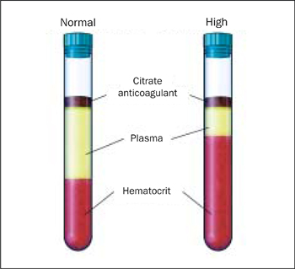
Artifacts in coagulation tests
PT, PTT, TT
Sample relies on proper ratio of plasma to citrate (9:1)
Too little plasma leads to elevated levels
Tube not properly filled
Patient with polycythemia
Too much plasma (severe anemia—falsely normal results)
Other pre-analytic issues that could lead to a falsely elevated result
Sample not processed quickly (temperature artifact)
Difficult lab draw (sample begins to clot consuming the factors)
Heparin in sample
Use heparin neutralization procedure
Copyright © 2019 by ASPHO

Slide 39
Disorders of Coagulation
General
Screening tests
Artifacts in coagulation tests
Limitations as pre-operative tests
Factors that are acute phase reactants
Copyright © 2019 by ASPHO

Slide 40
Limitations as pre-operative tests
PT, PTT screen for factor deficiencies not bleeding
Factor XII deficiency has no bleeding but very prolonged PTT
Factor XIII deficiency has severe bleeding but normal screening labs
PT, PTT are subject to many false positives (previous slide)
PT, PTT can be truly abnormal (aside from factor deficiencies) yet still not suggest an increased risk for bleeding
Lupus anticoagulant (more on this later)
Copyright © 2019 by ASPHO

Slide 41
Disorders of Coagulation
General
Screening tests
Artifacts in coagulation tests
Limitations as pre-operative tests
Factors that are acute phase reactants
Copyright © 2019 by ASPHO

Slide 42
Factors that are acute phase reactants
Factor VIII
vWF
Fibrinogen
Copyright © 2019 by ASPHO

Slide 43
This talk will follow the topical structure suggested by the ABP:
Copyright © 2019 by ASPHO

Slide 44
Disseminated intravascular coagulation
Basic Science and Pathophysiology
Epidemiology and Risk Assessment
Diagnosis
Management and Treatment
Copyright © 2019 by ASPHO

Slide 45
Inciting Event
Activation of coagulation (circulating tissue factor)
Consumption of prohemostatic clotting factors and platelets
Consumption of anticoagulant clotting factors
Disruption of endothelial cell anticoagulant surface
Bleeding
Thrombosis
Fibrinolysis
Copyright © 2019 by ASPHO

Slide 46
Disseminated intravascular coagulation
Basic Science and Pathophysiology
Epidemiology and Risk Assessment
Diagnosis
Management and Treatment
Copyright © 2019 by ASPHO

Slide 47
Causes of DIC
DIC does not occur as a primary illness
Typical causes in children
Sepsis
Kasabach-Merritt syndrome (unique to neonates)
Trauma (brain, burns, gunshot wounds)
Malignancy (APML)
Severe hemolysis
Severe protein C deficiency (unique to neonates)
Copyright © 2019 by ASPHO

Slide 48
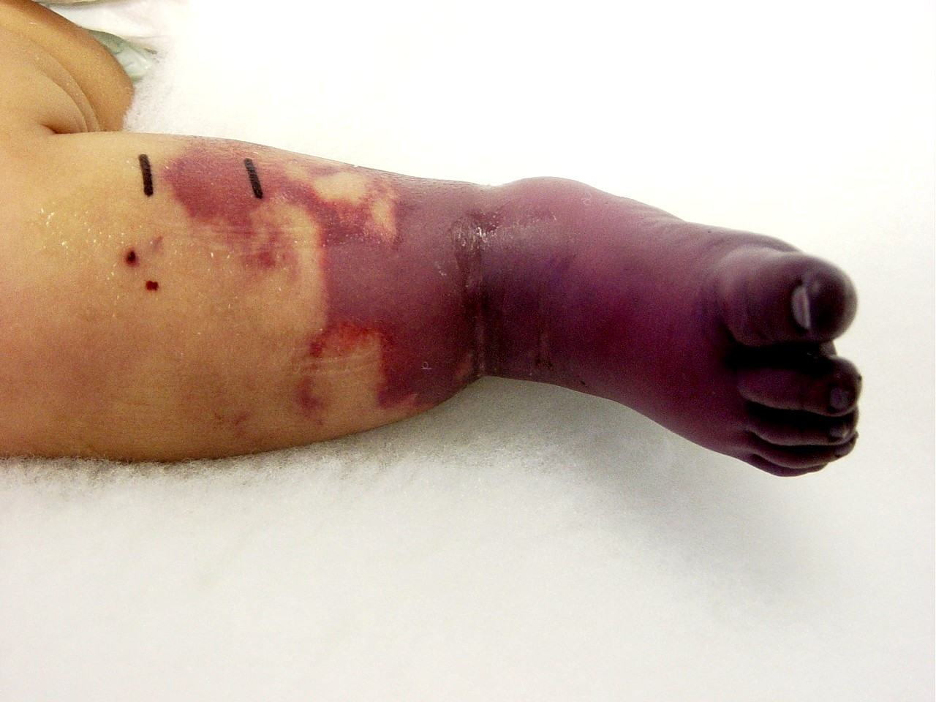
Purpura fulminans
Severe skin necrosis
Due to microvascular thrombosis
Acute onset
Copyright © 2019 by ASPHO

Slide 49
Disseminated intravascular coagulation
Basic Science and Pathophysiology
Epidemiology and Risk Assessment
Diagnosis
Management and Treatment
Copyright © 2019 by ASPHO

Slide 50
Clinical features
Symptoms
Patients may have no bleeding or thrombosis but still have DIC
Typical symptoms
Bleeding
Bruising, petechia, mucus membrane bleeding
Thrombosis
Purpura fulminans
Organ dysfunction
Hemolytic anemia
Copyright © 2019 by ASPHO

Slide 51
Laboratory findings
No single lab test diagnoses DIC
Common lab findings (none are required)
Prolonged PT and PTT
Any clotting factor can be reduced
Decreased fibrinogen
Thrombocytopenia
Elevated FDP, D-dimer, and fibrinopeptide A and B
Decreased protein C and S and antithrombin
Neonates are physiologically deficient in proteins C/S and antithrombin impairing their protective mechanisms for DIC
Copyright © 2019 by ASPHO

Slide 52
Disseminated intravascular coagulation
Basic Science and Pathophysiology
Epidemiology and Risk Assessment
Diagnosis
Management and Treatment
Copyright © 2019 by ASPHO

Slide 53
Management and Treatment
Treating the underlying disease is the main therapeutic option
Management of coagulopathy
No clear consensus
Transfusion therapy
Platelet transfusions are not generally indicated (risk for increased thrombosis)
Fresh frozen plasma
Provides balanced replacement of all prohemostatic clotting factors and their inhibitors (standard risks for FFP)
No evidence it affects outcome
Cryo
Can be given for low fibrinogen (if bleeding occurs)
No clear evidence of benefit (standard risks for cryo)
Anticoagulation is not indicated (risk of bleeding)
Copyright © 2019 by ASPHO

Slide 54
Vitamin K deficiency bleeding
Basic Science and Pathophysiology
Epidemiology and Risk Assessment
Diagnosis
Management and Treatment
Copyright © 2019 by ASPHO

Slide 55
Vitamin K metabolism
γ-carboxylated (functional) factor II, VII, IX, X
Factor II, VIII, IX, X precursor
(PIVKA)
CH
-COOH
CH₂
-COOH
-COOH
Vitamin K γ-glutamyl carboxylase
Vitamin K hydroxyquinone
Vitamin K epoxide
warfarin
Vitamin K
Epoxide reductase
Vitamin K
Epoxide reductase
Vitamin K
Dietary sources
Copyright © 2019 by ASPHO

Slide 56
Pathophysiology
Vitamin K is fat soluble
Tissue stores are limited
Can become deficient quickly
Human milk has little to no vitamin K
Copyright © 2019 by ASPHO

Slide 57
Vitamin K deficiency bleeding
Basic Science and Pathophysiology
Epidemiology and Risk Assessment
Diagnosis
Management and Treatment
Copyright © 2019 by ASPHO

Slide 58
Epidemiology
 | Early | Classical | Late
Age | First 24 hours | 2-7 days | 1-6 months (even later)
Risk factors | Maternal use of drugs that interfere with vitamin K metabolism (warfarin, anticonvulsants) | None (all newborns are prone) | Disorders that interfere with vitamin K intake (cystic fibrosis, other GI fat malabosrption disorders, chronic antibiotic use, liver disease)
Bleeding sites | ICH, GI, umbilical stump, bruising | ICH, GI, umbilical stump, bruising | ICH, GI, mucocutaneous
Treatment | Recognition of drugs that can cause this and eliminating them from maternal use | Prevention with neonatal vitamin K administration | Parenteral vitamin K
Copyright © 2019 by ASPHO

Slide 59
Drug-induced vitamin K deficiency
Warfarin
Children can get into adults medications
Pesticides (rats, mice) can contain warfarin-like drugs
Currently, declining in use due to resistance and better pesticides
These drugs are more potent with much longer half-lives than human warfarin (often weeks)
Can cause prolonged severe coagulopathy if accidentally ingested
Treatment is prolonged therapy with vitamin K (until poison has been cleared)
Copyright © 2019 by ASPHO

Slide 60
Vitamin K deficiency bleeding
Basic Science and Pathophysiology
Epidemiology and Risk Assessment
Diagnosis
Management and Treatment
Copyright © 2019 by ASPHO

Slide 61
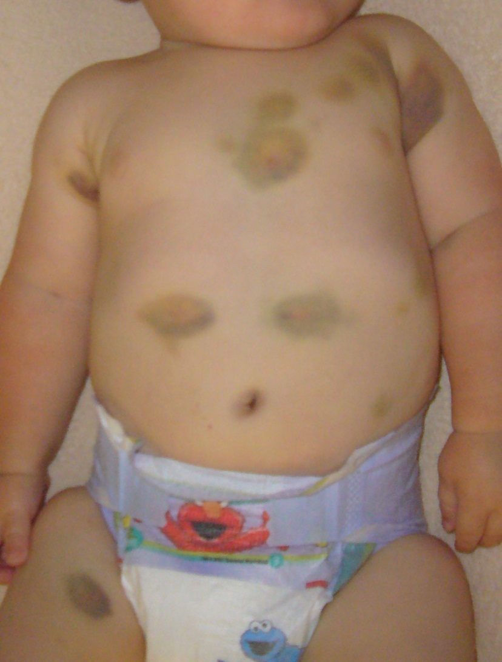
Vitamin K deficient newborn (did not receive prophylactic vitamin K)
Copyright © 2019 by ASPHO

Slide 62
Laboratory findings
Early and Classical
PT and PTT very prolonged (often unclottable, i.e. >200 seconds)
In less severe cases (tests do clot), PT can be as long or even longer than the PTT (absence of factor VII)
Vitamin K dependent factors (II, VII, IX, X, PC and PS severely deficient (if measured)
Copyright © 2019 by ASPHO

Slide 63
Vitamin K deficiency
Late
PT is always prolonged (factor VII has the shortest half-life)
PTT is variably prolonged (depends on severity)
Vitamin K dependent factors deficient (if measured)
Elevated PIVKA (sent only if diagnosis is in question)
PIVKA (proteins induced in vitamin K absence)
Copyright © 2019 by ASPHO

Slide 64
Vitamin K deficiency bleeding
Basic Science and Pathophysiology
Epidemiology and Risk Assessment
Diagnosis
Management and Treatment
Copyright © 2019 by ASPHO

Slide 65
Treatment and response
Replace vitamin K
Different preparations
Oral/Parenteral
Phytonadione (vitamin K1) is currently the only form of vitamin K approved by the FDA
It takes 12-24 hours after a parenteral dose to correct the deficiency
Prothrombin complex concentrates
Plasma-derived products containing factors II, VII, IX, and X
Can be given if immediate correction is warranted (ICH)
Carry a risk for thrombosis
Copyright © 2019 by ASPHO

Slide 66
Vitamin K deficient newborn before and 3 days after vitamin K
Copyright © 2019 by ASPHO

Slide 67
Liver disease coagulopathy
Basic Science and Pathophysiology
Epidemiology and Risk Assessment
Diagnosis
Management and Treatment
Copyright © 2019 by ASPHO

Slide 68
Pathophysiology
Mechanisms responsible for excess bleeding
Decreased production of liver synthesized factors
Most factors are decreased (see table on clotting factors)
FVIII is elevated in liver disease
Thrombocytopenia
Various causes
Hypersplenism
Decreased thrombopoietin production
Hyperfibrinolysis
Increased tPA release from endothelial cells
Copyright © 2019 by ASPHO

Slide 69
Liver disease coagulopathy
Basic Science and Pathophysiology
Epidemiology and Risk Assessment
Diagnosis
Management and Treatment
Copyright © 2019 by ASPHO

Slide 70
Epidemiology and risk assessment
Patients with liver failure
Infections
Metabolic disorders
Drugs
Mild liver disease can manifest with a mildly prolonged PT
Copyright © 2019 by ASPHO

Slide 71
Liver disease coagulopathy
Basic Science and Pathophysiology
Epidemiology and Risk Assessment
Diagnosis
Management and Treatment
Copyright © 2019 by ASPHO

Slide 72
Diagnosis
Patient with obvious (or not so obvious) liver disease
Abnormal liver function tests
Copyright © 2019 by ASPHO

Slide 73
Laboratory features (coagulation tests)
Elevated PT
Early marker of liver disease (short half-life of FVII)
Elevated PTT
Due to decreased production of most other factors
Low fibrinogen
Varies with severity of liver failure
Fibrinogen can be high as an acute phase reactant
Thrombocytopenia
Elevated D-dimers
Liver clears D-dimers
Hyperfibrinolysis
Copyright © 2019 by ASPHO

Slide 74
Liver disease coagulopathy
Basic Science and Pathophysiology
Epidemiology and Risk Assessment
Diagnosis
Management and Treatment
Copyright © 2019 by ASPHO

Slide 75
Treatment
Fresh frozen plasma (contains all the plasma clotting factors)
Cryoprecipitate (to correct low fibrinogen)
Platelet transfusions (for bleeding with thrombocytopenia)
rFVIIa
Useful if factor VII is particularly low
Prothrombin complex concentrates (PCCs)
Contain all the vitamin K-dependent factors (II, VII, IX, X)
Cases of thrombosis have been reported with PCC use in liver failure
Copyright © 2019 by ASPHO

Slide 76
Acquired coagulation inhibitors
Basic Science and Pathophysiology
Epidemiology and Risk Assessment
Diagnosis
Management and Treatment
Copyright © 2019 by ASPHO

Slide 77
Acquired coagulation factor inhibitors
Bleeding due to deficiency of a specific clotting factor
These are all extremely rare in children
Specific deficiencies
Factor VIII
Usually due to autoantibodies to FVIII (may be associated with systemic autoimmune disease)
Factor V
Usually seen following treatment with topical thrombin (bovine) and due to cross-reacting alloantibodies against human factor V from traces of bovine factor V in the product
Prothrombin (factor II)
Due to autoantibodies associated with antiphospholipid antibody syndrome (Lupus anticoagulant hypoprothrombinemia syndrome)
These antibodies cause increased clearance of prothrombin from the circulation
Other factors
Any factor could be affected (generally due to antibodies) but even more rare than the above
Copyright © 2019 by ASPHO

Slide 78
Transient lupus anticoagulant
These are transient antiphospholipid antibodies which interfere with the PTT and less commonly the PT
These are often found incidentally when performing pre-op screening by surgeons
Copyright © 2019 by ASPHO

Slide 79
Acquired coagulation inhibitors
Basic Science and Pathophysiology
Epidemiology and Risk Assessment
Diagnosis
Management and Treatment
Copyright © 2019 by ASPHO

Slide 80
Epidemiology and risk assessment
Lupus anticoagulants
These are very common and often found in children with recurrent upper respiratory infections
Specific factor deficiencies
All are extremely rare (<1 per million children)
Consider the diagnosis in children with autoimmune disorders and patients exposed to topical thrombin during surgery
Patients generally present with acute bleeding but without a personal or family history of bleeding
Copyright © 2019 by ASPHO

Slide 81
Lupus anticoagulant
Bleeding
Most lupus anticoagulants are transient, asymptomatic and result from an acute viral infection (one of the most common causes of a prolonged PTT)
Thrombosis
Lupus anticoagulant
Lupus anticoagulants can be part of the antiphospholipid syndrome and cause thrombosis (to be discussed in thrombosis section)
Rarely, patients with the lupus anticoagulant also have acquired hypoprothrombinemia (due to increased clearance of prothrombin) which can result in bleeding (known as “Lupus anticoagulant hypoprothrombinemia syndrome”)
Copyright © 2019 by ASPHO

Slide 82
Acquired coagulation inhibitors
Basic Science and Pathophysiology
Epidemiology and Risk Assessment
Diagnosis
Management and Treatment
Copyright © 2019 by ASPHO

Slide 83
Laboratory diagnosis
Mixing studies
Specific factor assays inhibitor assays
Testing for lupus anticoagulant
Copyright © 2019 by ASPHO

Slide 84
Mixing Studies
Prolonged aPTT
Mixing study with normal plasma
Corrects
Does not correct
Factor Deficiency
Inhibitors
Lupus anticoagulant
Specific factor inhibitors
Copyright © 2019 by ASPHO
Notes:
Correction of aPTT after mixing does not rule out inhibitor since FVIII inhibitor can correct aPTT if tested without incubation time
If incubation with normal plasma occurs, inhibitor effect becomes apparent (Brandt, page 1601)

Slide 85
Specific lab testing
Factor assays
Inhibitor assays (more in the next talk)
Lupus anticoagulant specific assays
Dilute Russell’s viper venom time (dRVVT)
Copyright © 2019 by ASPHO

Slide 86
Acquired coagulation inhibitors
Basic Science and Pathophysiology
Epidemiology and Risk Assessment
Diagnosis
Management and Treatment
Copyright © 2019 by ASPHO

Slide 87
Management and treatment
Specific factor deficiencies
Treat underlying condition if one exists
Discontinue topical thrombin (bovine) if patient was exposed
Management of bleeding
FVIII
Recombinant factor VIIa (more in hemophilia talk)
Activated prothrombin complex concentrates (more in hemophilia talk)
Recombinant porcine factor VIII
FV
FFP and platelet transfusions
Prothrombin
Prothrombin complex concentrates (contain factors II, VII, IX, and X)
Copyright © 2019 by ASPHO

Slide 88
Lupus anticoagulant management
Most lupus anticoagulants are transient/asymptomatic
Observation
Repeat assay in 6-12 weeks
No specific therapy is indicated
Bleeding (lupus anticoagulant hypoprothrombinemia syndrome)
Replace prothrombin with PCC for bleeding
Observation (usually transient)
Thrombosis in antiphospholipid antibody syndrome
Will be covered in thrombosis section
Copyright © 2019 by ASPHO

Slide 89
Miscellaneous acquired bleeding disorders
Hemophagocytic lymphohistioctyosis syndrome
Can have severe coagulopathy with hypofibrinogenemia
Treatment with asparaginase
Asparagine is important in many coagulation proteins
Patients can have thrombosis from decrease in antithrombin, proteins C and S
Patients can have bleeding from hypofibrinogenemia
Nephrotic syndrome
Leads to loss of antithrombin in the urine (follows albumin)
Increases the risk for thrombosis
Protein losing enteropathy
Loss of proteins C/S and antithrombin
Increased risk for thrombosis
Copyright © 2019 by ASPHO

