Slide 1
Disorders of Leukocytes
Carl Allen MD, PhD
ceallen@txch.org

Slide 2
DISCLOSURES
Scientific Steering Committee Novimmune 0501 Study
Consultant Roche/Genentech
Research Support Bristol/Myers/Squibb
No drugs discussed are approved for Pediatric Hematology/Oncology
THIS TALK/SLIDEDECK IS ORGANIZED TO “TEACH TO THE TEST”
(Updated from Daniel Ambruso 2015 Lecture)
RED = PAY ATTENTION
Copyright © 2019 by ASPHO

Slide 3
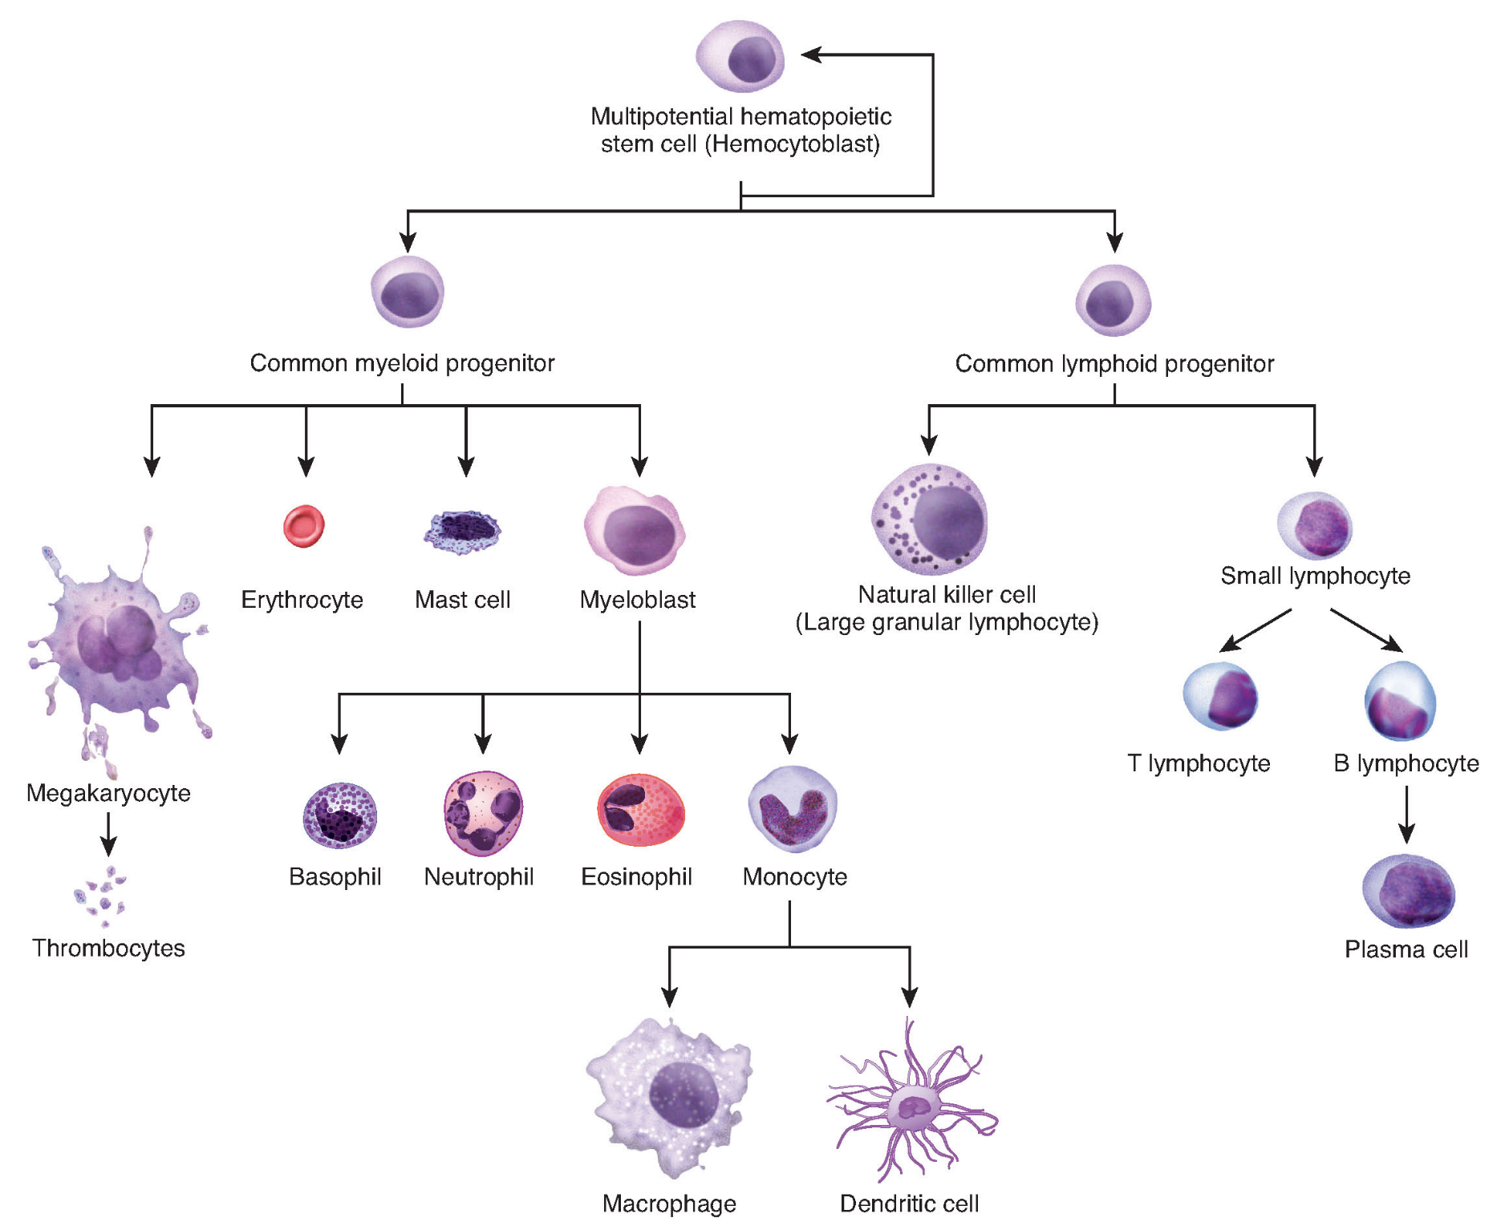
© 1999-2016, Rice University. Except where otherwise noted, content created on this site is licensed under a Creative Commons Attribution License 4.0 License.; partners@openstaxcollege.org.
Copyright © 2019 by ASPHO

Slide 4
© 1999-2016, Rice University. Except where otherwise noted, content created on this site is licensed under a Creative Commons Attribution License 4.0 License.; partners@openstaxcollege.org.
Copyright © 2019 by ASPHO

Slide 5
Part I:
Granulocytes
(pus bonum et laudable; good and laudable pus)*
Copyright © 2019 by ASPHO
*The phagocytes: neutrophils and monocytes. Dale et al., Blood 2008

Slide 6
INNATE IMMUNITY
  Immune responses present at birth; not “learned” in response to exposure to antigen.
    Bacteria reproduce -> 30 minutes
    Adaptive immune response –> weeks
  Phagocytes respond to pattern recognition receptors (PRRs)
    PRRs recognize Pathogen-Associated Molecular Patterns (PAMPs)
  Activated innate immune system results in clinical inflammation (tumor, rubor, calor, dolor)
Copyright © 2019 by ASPHO

Slide 7
INNATE IMMUNITY
INFECTION/
TISSUE DAMAGE
INFLAMMATION
Mediators released/activated
TLR activated
Lipids (PAF, LTB4)
Chemokines (IL-8, MCP-1, Rantes)
Complement (C3a, C5a)
Kinins
Coagulation proteins
Innate immune response
Vascular permeability
Emigration of phagocytes
Adaptive immune response
Emigration of lymphocytes
Copyright © 2019 by ASPHO

Slide 8
NEUTROPHILS
  MARINES of the immune system
    First recruited to sites of infection
    Most abundant circulating phagocytes
    Attracted by chemokines/cytokines: e.g. C5a, leukotriene B4, IL-8
    Phagocytose cells tagged with complement C3 and IgG
    Ingested microbes filled with oxidants generated by NADPH oxidase
Copyright © 2019 by ASPHO

Slide 9
SCF
IL-3
GM-CSF
FLT3L
SCF
Tpo
IL-3
GM-CSF
SCF
Epo
IL-3
GM-CSF
IL-3
SCF
G-CSF
IL-6
IL-3
GM-CSF
IL-3
IL5
GM-CSF
SCF
M-CSF
IL-6
IL-3
GM-CSF
© 1999-2016, Rice University. Except where otherwise noted, content created on this site is licensed under a Creative Commons Attribution License 4.0 License.; partners@openstaxcollege.org.
Copyright © 2019 by ASPHO

Slide 10
Granulocyte Homeostasis
circulating
tissue
G-CSF
GM-CSF
marginating
Short capillary segments
(e.g. lung alveoli)
Copyright © 2019 by ASPHO

Slide 11
Granulocyte Homeostasis
Compartment | Cells | Process | % Grans | Time
Progenitors BM PRECURSORS | Stem cells | Proliferation Lineage development | <1
Myeloid precursors (cycling) BM PRECURSORS | Myeloblast Promyelocyte Myelocyte Metamyelocyte | Proliferation Maturation | 1 4 16 22 | 10-14 days
Neutrophils STORAGE COMPARTMENT | Band Segmented | Maturation | 30 21
Neutrophils PERIPERAL BLOOD MARGINATING POOL |  | Mobilization | 2 3 | 9-12 hours
Neutrophils TISSUE |  | Apoptosis Immune clearance | ? | 24 hours
Copyright © 2019 by ASPHO

Slide 12
NEUTROPHILS
Rolling
Adherence
Diapedesis
Phagocytosis
Chemotaxis
Copyright © 2019 by ASPHO
Ingestion

Slide 13
PHAGOCYTE FUNCTION
FUNCTION | RECEPTORS/LIGANDS | MECHANISMS
ROLLING/ADHERENCE | Sialyl LeX L-selectins B2 integrins (CD11b/CD18) | Plasma membrane associated receptors Granules containing stores of receptors Actin cytoskeleton and accessory proteins
CHEMOTAXIS | C5a N-formyl oligopeptides Lipids (LTB4, PAF) GMCSF, GCSF, IL8, TNF… | Plasma membrane associated receptors Actin cytoskeleton and accessory proteins Granules Glycolysis
Copyright © 2019 by ASPHO

Slide 14
PHAGOCYTE FUNCTION
FUNCTION | RECEPTORS/LIGANDS | MECHANISMS
INGESTION | FCγRI, FCγRII, FCγRIII -bind antibody CD11b/CD18 -bind iC3b (cleaved C3b) C receptor 1 (CR-1) -binds C3b/C4b | Plasma membrane Actin cytoskeleton and accessory proteins Glycolysis
DEGRANULATION/ KILLING | Downstream of chemotaxis and ingestion | Plasma membrane associated receptors Actin cytoskeleton and accessory proteins Azurophilic and specific granules Phagolysosome formation Glycolysis
Copyright © 2019 by ASPHO

Slide 15
SELECTINS
  Cell adhesion proteins that bind carbohydrates
  -sialyated, fucosylated carbohydrates
 | L-selectin | E-selectin | P-selectin
Cells | PMN, monocytes, lymphocytes | activated endothelium | activated endothelium, platelets
Function | lymphocyte homing, inflammation | Inflammation | Inflammation, platelet function
Copyright © 2019 by ASPHO

Slide 16
β2 integrins (CD18 + CD11x)
Transmembrane receptors that facilitate cell-cell and cell-extracellular matrix interactions
 | LFA-1 | Mac-1 (C3) | P150,95 | αβ₂
Cells | All leukocytes | PMN, monocytes, macrophages, LGL | PMN, monocytes, macrophages, some lymphocytes | PMN, monocytes, macrophages, T cells
α subunit | α2 (CD11a) | α_{m} (CD11b) | α_{x} (CD11c) | α_{d} (CD11d)
β subunit | β2 (CD18) | β2 (CD18) | β2 (CD18) | β2 (CD18)
Ligands | ICAM 1-3 | ICAM-1 iC3b, fibrinogen | iC3b | ICAM-3
Copyright © 2019 by ASPHO

Slide 17
Granulocyte Differentiation
Myeloblast
Pro-myelocyte
Myelocyte
Meta-myelocyte
Band
Mature “Segmented”
Mitotic Compartment
Post-Mitotic Compartment
azurophilic granule
specific granule
tertiary and secretory granules
Copyright © 2019 by ASPHO

Slide 18
Granules
 | Content | Function
Azurophilic | Proteinases -cathepsin G -elastase -proteinase 3 Lysozyme | Degradation Digestion Destruction
 | Defensins | O2-independent killing
 | MPO | O2-dependent killing
Specific/Secondary | Lactoferrin | Binds and sequesters iron and copper
 | Transcobalamin II | Binds B₁₂
 | Lysozyme | Degradation, digestion, destruction
 | Plasma membrane proteins | Receptors and enzymes for movement, adhesion, ingestion
 | Cytochrome b₅₅₈ | Oxidative killing
Copyright © 2019 by ASPHO

Slide 19
Granules
 | Content | Function
Tertiary | CD11b/CD18 (iC3b receptor) FcγRIII Gelatinase | Ingestion Digestion
 | Cytochrome b₅₅₈ | Oxidative killing
Secretory | Serum albumin | “Spare parts” of plasma membrane proteins
Copyright © 2019 by ASPHO

Slide 20
Antimicrobial Mechanisms
O₂
NADPH
O₂⁻
NADP
H+
H₂O₂
+
MPO
HOCl
MPO
+
Cl⁻
cytoplasm
phagosome
Copyright © 2019 by ASPHO

Slide 21
Part II:
Not Enough Neutrophils
Copyright © 2019 by ASPHO

Slide 22
POP QUIZ
  A 13 year old presents with lymphadenopathy and ANC 900. Most likely diagnosis?
  ALL
  Viral illness
  AML
Copyright © 2019 by ASPHO

Slide 23
POP QUIZ
  A 13 year old presents with lymphadenopathy and ANC 900. Most likely diagnosis?
  ALL
  Viral illness
  AML
Copyright © 2019 by ASPHO

Slide 24
NEUTROPENIA
  Lower than normal absolute neutrophil count (ANC=bands + segs)
  ANC/μl varies with age:
    0-1 week: <3,000
    Infant (1 wk-2 yrs) <1,100
    Child-adult <1,500
    African/AA <900
    Altitude Lower ANC above 5k ft
Copyright © 2019 by ASPHO

Slide 25
NEUTROPENIA
  ANC/ml Grade Risk
  1,000-1,500 Normal None
  500-1,000 Mild Minimal
  250-500 Moderate Skin lesions, mucositis
  <250 Severe Sepsis, pneumonia…
Copyright © 2019 by ASPHO

Slide 26
NEUTROPENIA
  EVALUATIONS
  History
    Duration/periodicity, trend over time
    Exposure to toxins/drugs
    Infectious symptoms
    Family History
  2. Physical exam
    Growth curve
    Signs of infection
    Mucosal membranes
    Lymphadenopathy, hepatosplenomegaly
    Congenital anomalies
Copyright © 2019 by ASPHO

Slide 27
NEUTROPENIA
  EVALUATIONS
  3. Laboratory
    CBC with retic and differential twice weekly x 6 weeks
    Peripheral smear
    Peripheral blood immunophenotype and quant IgGAME
    Bone marrow: aspirate, biopsy, cytogenetics
    Blood chemistries: LDH, uric acid, alkaline phosphatase
    Anti-neutrophil antibodies
    Viral studies
    Nutrition assessment
    Pancreatic function
    Skeletal radiograph
    ANA, C3, C4, anti-DNA
    Whole exome sequencing
Copyright © 2019 by ASPHO

Slide 28
NEUTROPENIA-Acquired
CAUSE | ETIOLOGY | ASSOCIATED
Infection | Virus, bacteria, protozoa, fungi, rickettsia | Redistribution, impaired production, destruction
Drug-induced | Phenothiazines, sulfonamides, anticonvulsants, aminopyrine | Hypersensitivity reaction, anti-neutrophil antibodies
Immune | Alloimmune, autoimmune | Decreased mature forms in bone marrow
Bone marrow replacement | Malignancy | Immature myeloid cells in peripheral blood
Chemotherapy/radiation | Toxicity to precursor cells | Hypoplastic marrow
Aplastic anemia | Stem cell failure | Pancytopenia
Vitamin B12, folate, or copper deficiency | Malnutrition or congenital or acquired vitamin deficiencies | Megaloblastic anemia, hypersegmented neutrophils, other cytopenias
Maternal pre-eclampsia | Impaired myeloid proliferation | none
Chronic idiopathic | Impaired myeloid proliferation | none
Paroxysmal nocturnal hemoglobinuria | Acquired stem cell defect (mutation of PIG-A) | Pancytopenia, thrombosis
“Mechanical” activation | ECMO, bypass surgery, hemodialysis activate neutrophils; sequestered in lungs/capillaries | Systemic inflammation
Copyright © 2019 by ASPHO

Slide 29
NEUTROPENIA – Infection Associated
  Most common cause of neutropenia
  Generally acute – resolves in days-months
  Treatment – Supportive, treat infections, G-CSF in some cases
  Common infections:
  EBV, CMV, influenza, RSV, parvo, HIV, varicella, measles, rubella
  Sepsis in an infant
  Note: Rickettsia, malaria, leismaniasis, histoplasmosis
  Multiple mechanisms:
    Increased utilization
    Complement-mediated margination
    Marrow suppression (more in infants)
    Cytokine/chemokine-induced margination
    Antibody production
    Splenic sequestration
Copyright © 2019 by ASPHO

Slide 30
NEUTROPENIA – Drug Associated
  Relatively rare in children compared to adults
  Treatment: stop the drug, and in some cases give G-CSF
Mechanism | Drugs | Characteristics
Immune | Penicillins Cephalosporins | -Acute symptoms: days-weeks -Recurrence with small dose -Antibody (+)
Toxic | Phenothiazine | -Later onset: weeks to months -Direct toxicity to cells -May relapse with re-challenge
Hypersensitivity | Dilantin Phenobarbitol | -Later onset: weeks to months -Direct toxicity to cells -Associated systemic symptoms: rash, fever, lymphadenopathy, hepatitis, nephritis, pneumonitis, aplastic anemia
Copyright © 2019 by ASPHO

Slide 31
NEUTROPENIA – Immune
  Associated with antibodies against neutrophils
  -May require multiple tests to detect
  Increased turnover of neutrophils; decreased vascular compartment
  Marrow production normal to increased; storage pool normal to decreased
  Categories:
  -Alloimmune
  -Chronic benign neutropenia of childhood
  -Autoimmune
  -Drug induced
Copyright © 2019 by ASPHO

Slide 32
NEUTROPENIA – Alloimmune
  Mechanism:
    Maternal alloimmunization to neutrophil antigens
  Clinical features:
    0.2% of pregnancies
    May present with delayed cord separation
    Skin infections, fever, pneumonia within first 2 weeks after birth
    Easily confused with neonatal sepsis (may present with sepsis)
    Marrow with myeloid hyperplasia with maturation arrest at mature precursors
  Treatment:
    Supportive care and antibiotics
    IVIG (?)
    G-CSF for severe infection
Copyright © 2019 by ASPHO

Slide 33
NEUTROPENIA
Chronic Benign Neutropenia of Childhood
  AKA Autoimmune Neutropenia of Infancy (AIN)
  Mechanism:
    Anti-neutrophil antibody (against FCγRIII common)
  Clinical features:
    Relatively common (1/100,000)
    Median age: 8-11 months
    ANC <500, but generally asymptomatic
    Marrow: normal to increased myeloid series with decrease at band/segmented level
    Median age at resolution: 20 months
  Treatment:
    Observation
    Evaluate and treat infections
    G-CSF may be helpful in patients with infections
Copyright © 2019 by ASPHO

Slide 34
NEUTROPENIA – Autoimmune
  Mechanism:
    Auto-antibody
  Clinical features:
    May be associated with other autoimmune cytopenias
      e.g. ITP/Evan’s Syndrome, AIHA
    May be associated with other autoimmune diseases
      e.g. SLE, HIV, Felty’s syndrome, Hashimoto/Graves, hepatitis
    Variable ANC, marrow with normal cellularity with late maturation arrest
  Treatment:
    Treat primary autoimmune disorder
    Evaluate and treat infections
    G-CSF may be helpful if marrow storage pool is depleted
Copyright © 2019 by ASPHO

Slide 35
POP QUIZ
  A 2 year old has recurrent infections, low IgG, warts, and severe neutropenia. What does BM show?
  hypoplasia
  increased myeloid precursors
  hemophagocytosis
Copyright © 2019 by ASPHO

Slide 36
POP QUIZ
  A 2 year old has recurrent infections, low IgG, warts, and severe neutropenia. What does BM show?
  hypoplasia
  increased myeloid precursors
  hemophagocytosis
Copyright © 2019 by ASPHO

Slide 37
NEUTROPENIA
Congenital Disorders of Stem Cells and Precursors
Syndrome | Gene (Inheritance) | Characteristics (+ neutropenia)
Primary Disorders of Myelopoiesis
Cyclic Neutropenia | ELA2 (AD) Encodes neutrophil elastase | -21-day cycles (+/- 4 days) -Recurrent fever, aphthous ulcers, peridontitis
Severe Congenital Neutropenia | ELA2, GFL1 (AD) CSF3R (acquired) WASP (X-linked) | -Risk of MDS/AML -Platelet defect with WAS -Apoptosis of myeloid precursors with maturational arrest -Monocytosis, eosinophilia -Recurrent purulent infections -Pneumonia and deep tissue abscesses are life-threatening
Kostmann Syndrome | HAX1 (AR) | -Neurologic abnormalities -Otherwise, like Severe Congenital Neutropenia
Copyright © 2019 by ASPHO

Slide 38
NEUTROPENIA
Congenital Disorders of Stem Cells and Precursors
Disorders of Ribosome Function
Shwachman-Diamond Syndrome | SBDS (AR) | Pancreatic insufficiency, variable neutropenia, bone abnormalities
Dyskeratosis congenita | Telomerase defects: DKC1 (XL) TER (AD) TERT (AR) | Bone marrow failure, nail dystrophy, leukoplakia, hyperpigmented skin
Fanconi Anemia | Various | Hypersensitivity to DNA damage, cytopenias, radial defects
Copyright © 2019 by ASPHO

Slide 39
NEUTROPENIA
Congenital Disorders of Stem Cells and Precursors
Syndrome | Gene (Inheritance) | Characteristics (+ neutropenia)
Granule/cytotoxic defects
Chediak-Higashi Syndrome | LYST (AR) | Albinism, giant granules in myeloid cells, platelet defects, HLH
Griscelli Syndrome, type II | RAB27a (AR) | Partial albinism (silver hair), HLH
Hermansky-Pudlak Syndrome, type II | AP3P1 (AR) | Cyclic neutropenia, partial albinism, HLH
Copyright © 2019 by ASPHO

Slide 40
NEUTROPENIA
Congenital Disorders of Stem Cells and Precursors
Syndrome | Gene (Inheritance) | Characteristics (+ neutropenia)
Disorders of Metabolism
Glycogen storage disease type I | G6PT1 (AR) | Hepatic enlargement, growth retardation, neutrophil dysfunction
Glucose-6-phosphate catalytic subunit 3 deficiency | G6PC3 (AR) | Heart defects, urogenital anomalies, venous angiectasia
Barth syndrome | TAZ1(XL) | Episodic neutropenia, cardiomyopathy, methylglutaconic aciduria, pancytopenia
Pearson syndrome | Mitochondrial | Vacuolization of erythroid and myeloid precursors, ringed sideroblasts, pancytopenia
Copyright © 2019 by ASPHO

Slide 41
NEUTROPENIA
Congenital Disorders of Stem Cells and Precursors
Syndrome | Gene (Inheritance) | Characteristics (+ neutropenia)
Immune Deficiencies
Common variable immunodeficiency | Various (e.g. TNFRSF13B) | Hypogammablobulinemia, other immune defects
IgA Deficiency | Various (e.g. TNFRSF13B) | Decreased IgA
SCID | Various | Absent humoral immune function
WHIM Syndrome | CXCR4 (AD) | Warts, hypogam, infections, myelokathexis (neutrophils stuck in bone marrow)
Cartilage-hair hyperplasia | RMRP (AR) | Lymphopenia, dwarfism, fine sparse hair
Copyright © 2019 by ASPHO

Slide 42
NEUTROPENIA – Chronic Idiopathic
  Mechanism:
    Myeloid hypoplasia
    Maturation arrest at myelocyte, metamyelocyte or band stage
    Sporadic; no specific inheritance
  Clinical features:
    Moderate to severe neutropenia
    Recurrent infections
    No other associated findings
    No antibodies against neutrophils
  Treatment:
    Supportive care
    G-CSF with severe infections
Copyright © 2019 by ASPHO

Slide 43
Part III:
Neutrophils Don’t Work
Copyright © 2019 by ASPHO

Slide 44
POP QUIZ
  A 2 year old has recurrent skin infections, had delayed cord separation, and abscesses lack pus with poor wound healing and elevated ANC. What gene is mutated?
  PRF1
  LYST
  CD18
Copyright © 2019 by ASPHO

Slide 45
POP QUIZ
  A 2 year old has recurrent skin infections, had delayed cord separation, and abscesses lack pus with poor wound healing and elevated ANC. What gene is mutated?
  PRF1
  LYST
  CD18
Copyright © 2019 by ASPHO

Slide 46
Leukocyte Adhesion Deficiencies
  Mechanism:
    Absent or impaired adhesion molecules involved in trafficking
  Clinical features:
    Delayed umbilical cord separation
    Recurrent bacterial infections (skin and mouth)
    Absent pus formation (no neutrophils in wound biopsy)
    Impaired wound healing
    Leukocytosis
    Severity of symptoms related to degree of genetic defect
  Treatment:
    G-CSF/GM-CSF NOT helpful
    Mild-moderate: Antibiotics as needed; wound care
    Severe: BMT
Copyright © 2019 by ASPHO

Slide 47
Leukocyte Adhesion Deficiencies
Syndrome | Gene (Inheritance) | Characteristics
LAD-I | CD18 (AR) | β2 integrin dysfunction Absent/decreased CD18 expression See above
LAD-II | GDP-fructose transporter 1 (SLC35C1); probably others (AR) | Defective fucosylation of macromolcules – so no SLeX on myeloid cells (no CD15) AB0 antigens abnormal (Bombay phenotype – no H antigen) Only 10 patients reported Not as severe as “severe” as LAD I Severely mentally retarded, short stature, distinctive facial appearance.
LAD-III | CalDAG-GEF1, FERMT3 (expresses Kindlin-3) (AR) | Defective integrin ACTIVATION Also with impaired NK function and osteoporosis due to osteoclast defects, and bleeding due to platelet dysfunction
Copyright © 2019 by ASPHO

Slide 48
LAD
Rolling
Adherence
Diapedesis
LAD I
LAD III (activation)
LAD II
Copyright © 2019 by ASPHO

Slide 49
Neutrophil Degranulation Defects
  CHEDIAK-HIGASHI SYNDROME
  Mechanism:
    Defect in membrane fusion and lysosome trafficking– formation of giant, leaky granules
    LYST/CHS1 (AR)
  Clinical features:
    Oculocutaneous albinism
    Recurrent skin infections
    Neurodegeneration
    Giant granules
    HLH
  Treatment:
    Supportive care
    Immune suppression with “accelerated phase” (EBV)
    BMT
Copyright © 2019 by ASPHO

Slide 50
Neutrophil Degranulation Defects
  Specific Granule Deficiency
    Mechanism
      Defect in C/EBPε (AR)
        Transcription factor required for expression of specific granule proteins
    Clinical Features:
      Decreased chemotaxis and microbicidal activity
      Mild neutropenia with bi-lobed neutrophils
      Recurrent skin and deep tissue infections (S. aureus, Gram-negative bacteria, Pseudomonas aeruginosa, Candida albicans)
      Diagnosis: microscopic examination of neutrophils (or sequencing)
    Treatment:
      Prophylactic antibiotics and supportive care
Copyright © 2019 by ASPHO

Slide 51
POP QUIZ
  Child has recurrent granulomatous infections. Mother’s DHR (below). Gene defect:
  gp22^{phox}
  gp91^{phox}
  LYST
counts
DHR (stimulated)
Copyright © 2019 by ASPHO

Slide 52
POP QUIZ
  Child has recurrent granulomatous infections. Mother’s DHR (below). Gene defect:
  gp22^{phox}
  gp91^{phox}
  LYST
counts
DHR (stimulated)
Copyright © 2019 by ASPHO

Slide 53
Neutrophil Oxidative Metabolism Defects
  CHRONIC GRANULOMATOUS DISEASE
  Mechanism:
    Defects in phagocyte NADPH oxidase complex
      Most common clinically significant inherited disorder of neutrophil function
Subunit | Inheritance | Characteristics
gp91^{phox} (70%) | XL | Integral membrane glycopotein; Absent b₅₅₈
gp22^{phox} (5%) | AR | Integral membrane protein; Absent b₅₅₈
p47^{phox} (25%) | AR | Deletion mutations Absent p47^{phox} Not as severe as the others
p67^{phox} (5%) | AR | Deletion mutations Absent p67^{phox}
Copyright © 2019 by ASPHO

Slide 54
CGD = Defective Oxidative Burst
O₂
NADPH
O₂⁻
NADP
H+
H₂O₂
+
MPO
HOCl
MPO
+
Cl⁻
cytoplasm
phagosome
Copyright © 2019 by ASPHO

Slide 55
Neutrophil Oxidative Metabolism Defects
  CHRONIC GRANULOMATOUS DISEASE
    Clinical Course:
      Recurrent infections in skin, lung, LN in infancy
      Liver abscess and osteomyelitis from hematogenous spread
      S. aureus, Burkholderia cepacia, Serratia marcescens, Aspergillus, Nocardia
      Chronic inflammatory granulomas
        Can cause obstruction of urinary or GI tract
    Diagnosis:
      Nitroblue tetrazolium
        Reduced from yellow to purple by activated neutrophils
      Dihydrorhodamine 123 (DHR)
        Flow-based
      Family history, targeted sequencing or WES
    Treatment:
      Prophylaxis with sulfa and itraconazole
      Prophylactic IFN-g (enhance nonoxidative phagocytsis)
      BMT
Copyright © 2019 by ASPHO

Slide 56
Neutrophil Oxidative Metabolism Defects
  Myeloperoxidase Deficiency
    Mechanism
      Partial or complete deficiency of myeloperoxidase (MPO), (AR)
        Defect in post-translational processing
        Inhibits formation of hypochlorous acid
    Clinical Features:
      Not usually a problem unless the patient has diabetes mellitus
      Impaired killing of C.albicans and Aspergillus
    Treatment:
      Usually none
      Antifungals for patients with diabetes mellitus
Copyright © 2019 by ASPHO

Slide 57
Neutrophil Defects - Miscellaneous
Syndrome | Gene (Inheritance) | Characteristics
G6PD Deficiency | G6PD (XL) | In addition to hemolytic crises, can develop CGD-like disease
Rac2GTPase Deficiency | Rac2GTPase (AD) | Symptoms similar to LAD-I -Rac required for chemotaxis -Impaired oxidative burst
IRAK4 Deficiency | IRAK4 (AR) | Involved in IL-1R-induced NFκB activation -Severe, recurrent infections -Poor inflammatory response -No response to LPS or TLR6/9 ligands, IL-1β or IL-18
Copyright © 2019 by ASPHO

Slide 58
Part IV:
Other Myeloid Dysfunction
Copyright © 2019 by ASPHO

Slide 59
© 1999-2016, Rice University. Except where otherwise noted, content created on this site is licensed under a Creative Commons Attribution License 4.0 License.; partners@openstaxcollege.org.
Copyright © 2019 by ASPHO

Slide 60
IMPAIRED MACROPHAGE FUNCTION AND ATYPICAL MYCOBACTERIAL INFECTION
  Mechanism
    Mutations in:
      Interferon γ-receptor binding chain (IFNGR1) (AD, AR)
      IL-12 receptor B1 chain (IL12RB1) (AR)
      IL-12 p40 deficiency (IL12B) (AR)
  Clinical features:
    Defective IFNγ-mediated killing by monocytes and macrophages.
    Increased incidence of infections with atypical mycobacteria, Salmonella, and Listeria
  Treatment:
    IFN-γ
    BMT for severe symptoms
Copyright © 2019 by ASPHO

Slide 61
Hyper-IgE Syndromes
  Mutations in:
      STAT3 (AD) [aka Job’s Syndrome]
      Tyrosine kinase 2 (TYK2) (AR)
      DOCK8 (AR)
  Clinical features:
    Defects in JAK-STAT signaling - impaired cytokine responses (IFN-γ)
    Defects in neutrophil chemotaxis, T-cell responses (IL-17), abnormal IgE regulation (very high), elevated eosinophil count
    Sinopulmonary infections, fungal infections of nails and mucosa
    Severe skin lesions (eczematous, pruritic), superinfection
      Note: Satan covered Job in sore boils.
    Abnormal teeth, facial features, connective tissue, osteopenia (AD-HIES)
  Treatment:
    Supportive care, antimicrobial prophylaxis
    BMT for severe symptoms
Copyright © 2019 by ASPHO

Slide 62
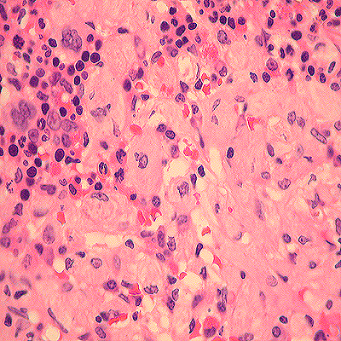
Pop Quiz
  1 year old is losing milestones and develops hepatosplenomegaly and cytopenias with this bone marrow aspirate
  JMML
  CML
  Fanconi Anemia
  Gaucher’s Disease
Image courtesy of Tarek Elghetany
Copyright © 2019 by ASPHO

Slide 63
Pop Quiz
  1 year old is losing milestones and develops hepatosplenomegaly and cytopenias with this bone marrow aspirate
  JMML
  CML
  Fanconi Anemia
  Gaucher’s Disease
Image courtesy of Tarek Elghetany
Copyright © 2019 by ASPHO

Slide 64
Storage Diseases: Gaucher’s Disease
  Mechanism
      Classic example of storage disease impact on blood cells
      Mutation in glucocerebroside (GBA) (AR)
  Clinical features:
    Accumulation of glucocerebroside from senescent blood cells in monocytes and macrophages
    High incidence in Ashkenazi Jews
    Cytopenias, hepatosplenomegaly, bone abnormalities, pulmonary involvement (Type I without CNS involvement)
    Diagnosis: Gaucher cells (crumpled paper bag) in bone marrow or liver biopsy, absent or decreased enzyme activity, genetic mutation analysis
  Treatment:
    Enzyme replacement
    BMT for severe symptoms (gene therapy?)
Copyright © 2019 by ASPHO

Slide 65
Too Many Myeloid Cells
  Neutrophilic leukocytosis (ANC>7700)
    “Left shift”
      Infection
      Inflammation/autoimmune disease
      Glucocorticoids (other medications, G-CSF)
      Sweet Syndrome: acute febrile neutrophilic dermatosis
      Asplenia
      Cigarette smoke
      Stress/exercise
    Myeloproliferative disorders
      CML, JMML, other malignancy
      Down syndrome (Transient myeloproliferative disorder)
    Genetic disorders
      Leukocyte adhesion deficiency
      Chronic hereditary neutrophilia (CSF3R)
    Lab error
Copyright © 2019 by ASPHO

Slide 66
Too Many Myeloid Cells
  Monocytic leukocytosis (Absolute monocyte count > 800)
    Acute bacterial infection, tuberculosis
    Primary EBV infection
    Acute and chronic monocytic leukemia
    Bone marrow recovery (relative monocytosis)
  Basophilic leukocytosis (Absolute basophil count >500)
    Myelopoliferative neoplasms, other myeloid malignancies, allergic or inflammatory reactions (hypersensitivity, ulcerative colitis, rheumatoid arthritis), endocrinophathy (hypothyroid), parasitic infections, TB
Copyright © 2019 by ASPHO

Slide 67
Too Many Myeloid Cells
  Eosinophilic leukocytosis
  AEC: Mild (>1500); moderate (1500-5000); severe (>5000)
  “Hypereosinophilia”
    >1500 x 2 occasions > 1 month
    Marked tissue eosinophilia
  Hypereosinophilic syndrome: Hypereosinophilia with end organ damage
    Primary: Expansion due to problem with the stem cell (clonal)
      MPN, fusion gene mutations activating PDGFRA, PDGFRB or FGFR1 [rare in kids]
      Myeloid leukemias
    Secondary/Reactive: Polyclonal expansion in response to stimulus
      Associated with increased IL-3, IL-5, GM-CSF
      Infections: parasitic, fungal, viral
      Atopy: eczema, allergic rhinitis, asthma
      GI disease: Infections, esophagitis, IBD
      Immune deficiency/dysregulation
      Autoimmune disease
      Drug
        DRESS: Drug reaction with eosinophilia and systemic symptoms)
Copyright © 2019 by ASPHO

Slide 68
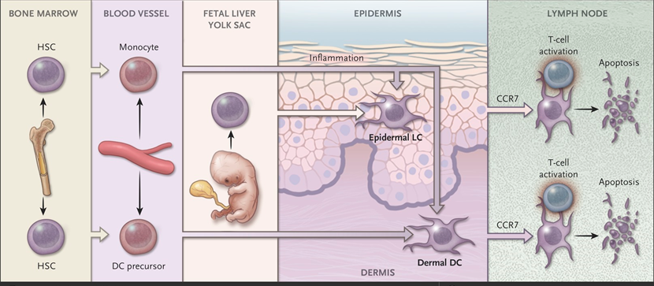
Dendritic Cell Ontogeny:
Fetal yolk sac/Embryonic liver origin for tissue resident DCs
May be replaced by bone marrow-derived monocytes and precursors
Activated DCs migrate to LN and interact with T cells (activate or inhibit).
From The New England Journal of Medicine, Carl E. Allen, et al, Langerhans-Cell Histiocytosis, 379, 856-868 © 2018 Massachusetts Medical Society. Reprinted with permission from Massachusetts Medical Society.
Copyright © 2019 by ASPHO

Slide 69
Basic Dendritic Cell Function
-
ANTIGEN
DC
T
INFLAMMATION
+
+
Copyright © 2019 by ASPHO

Slide 70
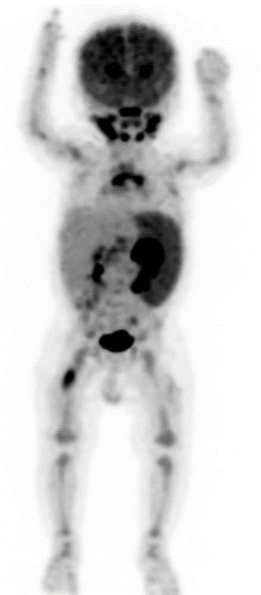
Too Many Myeloid Cells
  Myeloproliferative and Histiocytic Disorders
    Covered in other presentation
Copyright © 2019 by ASPHO

Slide 71
Not Enough Myeloid Cells
  GATA2 Deficiency– MonoMAC syndrome
    Immune deficiency - absent/decreased monos or macs
      May also have absent/decreased B and/or NK cells
    Susceptibility to mycobacterial infections, HPV
    Pulmonary alveolar proteinosis
    Lymphedema + MDS/AML = Emberger Syndrome
    Associated with pediatric monosomy 7 MDS
    Variable presentations
    Increased FLT3 ligand (bone marrow stress)
    Patients merit close follow-up for bone marrow function and development of MDS
    BMT curative - better prior to MDS
Copyright © 2019 by ASPHO

Slide 72
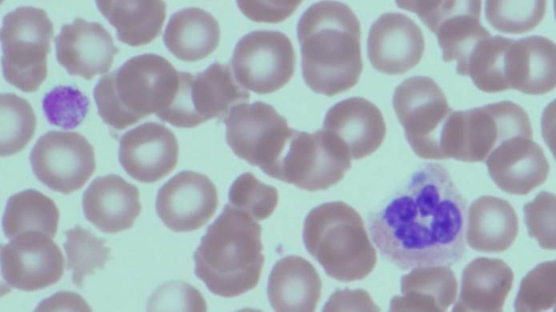
Bonus Question
What’s condition is this?
Image courtesy of Tarek Elghetany
Copyright © 2019 by ASPHO

Slide 73
Image courtesy of Tarek Elghetany
  Pelger-Huet anomaly
  May-Hegglin anomaly
  Chediak-Higashi syndrome
  Gaucher’s disease
Copyright © 2019 by ASPHO

Slide 74
Image courtesy of Tarek Elghetany
  Pelger-Huet anomaly
  May-Hegglin anomaly
  Chediak-Higashi syndrome
  Gaucher’s disease
Copyright © 2019 by ASPHO

Slide 75
Bonus Slide
  Pelger-Huet anomaly
    Autosomal dominant
    Hyposegmented nuclei in mature neutrophils (bi-lobe, dumbell, peanut shape)
    Mutations in laminin B receptor (LBR) gene
    Can be associated with skeletal defects
    “pseudo-Pelger-Huet” – can be acquired with leukmia or MDS
  May-Hegglin anomaly
    Autosomal dominant
    Thrombocytopenia, giant platelets, inclusions in peripheral blood leukocytes
    “MYH9-related diseases”
      Spectrum of phenotype associated with mutations that can include bleeding, deafness, nephritis, cataracts
Copyright © 2019 by ASPHO

Slide 76
Homework Slide
  Images of:
    Neutrophil maturation
    Chediak-Higashi
    Secretory granule deficiency
    Pelger-Huet anomaly
    May-Hegglin anomaly
    Gaucher cells
Copyright © 2019 by ASPHO

Slide 77
BONUS!
  ALPS (Autoimmune Lymphoprolif Syndrome)
    Lymphadenopathy
    Splenomegaly
    Double-negative T cells
    FAS/FASL/CASP10 mutations
    Autoimmune cytopenias
    Elevated B12
    Treatment:
      MMF, Ritux, IVIG, mTOR inhibitor
      Don’t take out spleen if possible
Copyright © 2019 by ASPHO

Slide 78
QUESTIONS?
GOOD LUCK!!
ceallen@txch.org
Copyright © 2019 by ASPHO

