Slide 2
Principles of Treatment in Pediatric Oncology
Leo Mascarenhas M.D., M.S
Children’s Hospital Los Angeles
Keck School of Medicine
University of Southern California
Copyright © 2019 by ASPHO

Slide 3
Disclosure Information
AstraZeneca: Research grant to institution
Lilly Oncology: Research grant/consulting agreement with institution
Bayer: Speakers Bureau
No discussion of unlabeled uses of medications.
Copyright © 2019 by ASPHO

Slide 4
Syllabus: ABP Pediatric Hematology-Oncology Content Outline
Domain 7: General Oncology Issues
A. Anti-neoplastic therapy
Principles of Chemotherapy
Principles of Radiation Therapy
Cytotoxic chemotherapy including alkylating agents, anti-metabolites, intercalating agents, DNA breaking agents, mitotic inhibitors and glucocorticoids (in handout only)
B. Supportive care
Oncologic Emergencies
Anti-emetic management
C. Cancer predisposition
Genetic disorders predisposing to malignancy
Copyright © 2019 by ASPHO

Slide 5
7. A. 1. Principles of Chemotherapy
Cure
Low therapeutic index
Clinical Trials
Phase 1- Toxicity and determine MTD
Phase 2- Response rate and toxicity
Phase 3- Efficacy vs. standard
Phase 4- Efficacy, safety, long-term effects after approval
Copyright © 2019 by ASPHO

Slide 6
Principles of Chemotherapy
Multi-drug therapy
Overcome drug resistance to individual agents
Neo-adjuvant vs. adjuvant chemotherapy
Goldie-Coldman hypothesis
Dose intensity
Maximum tolerated dose rate
Supportive care
Copyright © 2019 by ASPHO
Notes:
Microscopic tumor has a larger number of proliferating cells and smaller burden implies that there is a lower chance of drug resistant cells being present.
Curable tumor is one with no drug resistant cells. Chance of cure is maximized if all active agents are used simultaneously in the adjuvant setting when there is minimal residual disease and the probability of drug resistance is low.

Slide 7
Definitions
Pharmacokinetics
Drug disposition in the body- ADME
Clearance, half life, AUC, volume of distribution, bioavailability and biotransformation
Age, organ function, drug interactions
Pharmacodynamics
Effects of drug on the body, relationship between drug concentration and effect
Pharmacogenomics
Genetic variations on spectrum of drug action
Copyright © 2019 by ASPHO
Notes:
Cytochrome P-450 enzymes catalyze oxidation and demethylation (Phase 1 enzymes) TPMT, UGTA1A ( Phase 2 enzymes). Methylation of MGMT gene promoter modulates response of gliomas to carmustine.

Slide 8
Definitions (continued)
Cell Cycle
G₀- resting phase, cell has left the cell cycle
G₁- cells increase in size, ready for DNA synthesis
S - DNA replication
G₂- cells increase in size, ready for mitosis
M - mitosis
Copyright © 2019 by ASPHO
Notes:
G0- Chemo resistant. S phase antimetabolites, G2, M- mitotic inhibitors, no cell cycle specific alkylators.

Slide 9
Drugs- Cell Cycle
Drug class | Cell Cycle Phase
Alkylating agents | G0
Antitumor Antibiotics | Cell cycle non-specific
Antimetabolites | S
Plant alkaloids | M
Hormones | Cell cycle non-specific
Copyright © 2019 by ASPHO

Slide 10
Drug Resistance- mostly genetic
Drug specific mechanisms
Decreased drug uptake by cells
corticosteroids, methotrexate
Decreased intracellular drug activation
cytarabine, methotrexate
Increased intracellular drug catabolism
cyclophosphamide
Increased or altered affinity of target
methotrexate, vincristine
Increased production of competitive substrate
cytarabine, l-asparaginase
Copyright © 2019 by ASPHO
Notes:
Abnormal glucocorticoid receptors, decreased folate transporter
Decreased Deoxycytidine kinase, Decreased Folylpolyglutamate synthase
Increased aldehyde oxidase
Increased DHFR,
Increase asparagine synthase in lymphoblasts

Slide 11
Drug Resistance (continued)
Multidrug resistance mechanisms
Decreased drug accumulation
Increased P-glycoprotein
Increased drug detoxicfication
Increased Glutathione-S-transferase
Decreased or altered affinity of target
Decreased Topoisomerase II
Increased DNA repair
Increased Alkylguanine-DNA-alkyltransferase
Decreased apoptosis
Increased Bcl-2 expression
Copyright © 2019 by ASPHO
Notes:
PGP- Anthracyclines, epipodophylotoxins, vinca alkaloids, taxanes
MGMT- Temozolomide. Nitrosoureas and dacarbazine
Alkylating agents and anthracylines

Slide 12
CNS Pharmacology
Relevance
Primary site- CNS tumors
Sanctuary site- Leukemia
Metastatic site- Solid Tumors
Determinants of CNS penetration
Drug properties
Lipophilicity, molecular size, degree of ionization, free plasma concentration
Cerebral blood flow
Copyright © 2019 by ASPHO

Slide 13
CNS Pharmacology (continued)
Strategies to enhance CNS penetration
High-dose systemic chemotherapy
Methotrexate, cytarabine
Drugs that penetrate the BBB
nitrosoureas, thiotepa, camptothecins
Disrupting the BBB
mannitol
Administration of drug into the intrathecal space
methotrexate, cytarabine
Copyright © 2019 by ASPHO

Slide 14
CNS Pharmacology (continued)
Age based intra-thecal dosing
Age (years) | Methotrexate (mg) | Cytarabine (mg)
< 1 | 6 | 15
1 | 8 | 30
2 | 10 | 50
>/=3* | 12 | 70
Copyright © 2019 by ASPHO

Slide 15
Classification/Mechanism of Action
See Handout
Copyright © 2019 by ASPHO

Slide 16
7. A.2. Principles of Radiation Therapy
Production and targeted delivery of ionizing radiation to a patient to cause a biologic effect.
Dependent on the principles and accuracy of radiation physics.
Goal to deliver prescribed dose to target volume relatively sparing normal tissue
Copyright © 2019 by ASPHO

Slide 17
Mechanism of Action
Radiation interacts with intracellular components
Direct effects on DNA
Indirect effects by ionizing water
Free hydroxyl radicals- DNA damage
Lethal damage
Accumulation of double strand breaks (DSB)
Sub-lethal damage
Limited DSB, single stand breaks, cross-links, or base damage
Copyright © 2019 by ASPHO

Slide 18
Time: Dose Relationship
Total dose measured in Gray
Amount of radiation depositing 1 joule of energy in 1 kilogram.
1 Gy= 100 rad
1 rad= 0.01 Gy or 1 centiGray (cGy)
Total time determined by number of fractions to deliver dose
Typically 18-65 Gy in 1.5- 2 Gy fractions
Copyright © 2019 by ASPHO

Slide 19
Factors Affecting Radiation Sensitivity
Cell Type
Growth and replicative activity
Cell cycle phase at the time of exposure
Genetic mutations in oncogenes and tumor suppressor genes
Microenvironment
Radiation hypersensitivity
Ataxia Telangiectasia
Nijmegen breakage syndrome
Copyright © 2019 by ASPHO

Slide 20
External Beam Radiation Therapy
Photon therapy
High energy X-rays- electromagnetic radiation (skin sparing)
Electron therapy
Absorbed more superficially, increased absorption in bone
Proton therapy
Plateau dose distribution
Neutron therapy
Unfavorable depth-dose characteristics
Heavy charged iron therapy
Similar to protons
Copyright © 2019 by ASPHO

Slide 21
Intensity Modulated Radiation Therapy (IMRT)
Manipulating radiation to create custom 3D dose distributions
Photons or Protons
Alter dose distribution to tumor and normal tissue
Especially important for tumors that need a high dose of radiation
Complexity increases errors- dose calculation, distribution, delivery and machine failure.
Proton Beam Radiation Therapy (PBRT)
Favorable dose distribution
Spare normal tissue
No exit dose leading to sparing underlying normal tissue
Potential decrease in entrance dose
100% dose delivered at Bragg peak (determined by proton energy)
Spread out Bragg peak (SOBP)- multiple Bragg peaks at different depths.
Copyright © 2019 by ASPHO

Slide 22
Brachytherapy
Uses radioactive implants or molds to deliver local radiation
Interstitial, intracavitary or surface
Short time frame usually 3-5 days
Limited by size of tumor bed
Collaboration with surgery
Rhabdomyosarcoma, retinoblastoma
Copyright © 2019 by ASPHO

Slide 23
Tumor Volume Definitions
Gross Tumor Volume (GTV)
Volume occupied by tumor at diagnosis
Same for photons, protons and brachytherapy
Clinical Target Volume (CTV)
Includes GTV and sites of suspected occult disease and involved adjacent lymph nodes
Same for photons, protons and brachytherapy
Planning Target Volume (PTV)
Includes CTV including surrounding geometric area accounting for variability in set up, breathing and motion during treatment
PTV is not the same as photons for protons
PTV is same as CTV for brachytherapy
Copyright © 2019 by ASPHO

Slide 24
Organ at Risk COG Radiation Oncology Recommendations
Organ | Volume | Dose (cGy)
Bladder | 100% | 4500
Esophagus | 50% | 4000
Heart | 100% | 3000
Liver | 100%/50% | 2340/3000
Optic chiasm/Optic Nerve | 100% | 5400
Rectum | 100% | 4500
Small Bowel | 75% | 4500
Spinal Cord | Any volume | 5040
Kidney | 100%/50% | 1440/2400
Lung | 100%/<36% | 1500/2000
Eye | 100% | 4500
Lens | 100% | 600
Cochlea | 100% | 4000
Copyright © 2019 by ASPHO

Slide 25
Central Nervous System (CNS) Threshold Radiation Dose
Condition | Dose (cGy)
Brain necrosis | 6000
IQ deficits | 1200-1800
Growth hormone deficiency | 1800-2500
Precocious puberty | 2000
TRH/TSH deficiency | 4000
LH/FSH deficiency | 4000
ACTH deficiency | 4000
Hyperprolactinemia | 4000
Copyright © 2019 by ASPHO

Slide 26
Pediatric Radiation Oncology
Growing and developing tissue more sensitive to late effects
Combined with pharmacologic agents (chemoradiotherapy)
Technological advances
Intensity modulated radiation therapy (IMRT)
Image guided radiation therapy (IGRT)
Stereotactic body radiotherapy (SBRT)
Stereotactic radiosurgery (SRS)
Copyright © 2019 by ASPHO

Slide 27
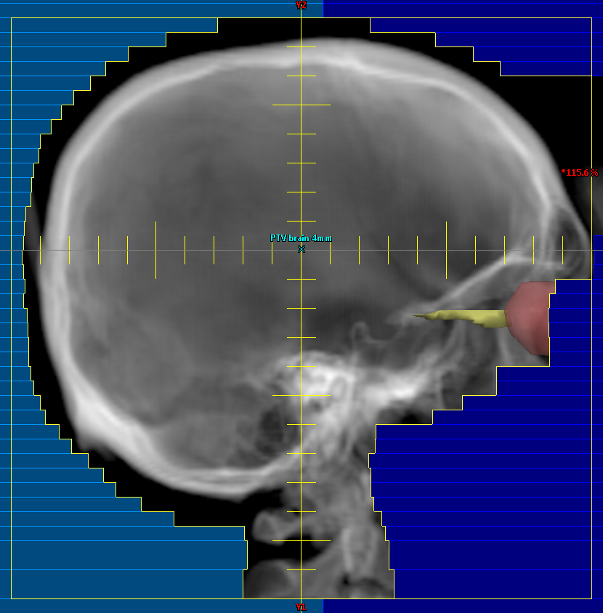
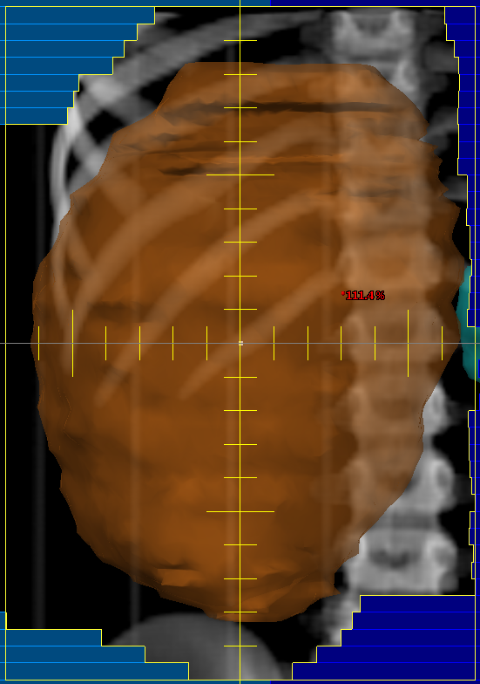
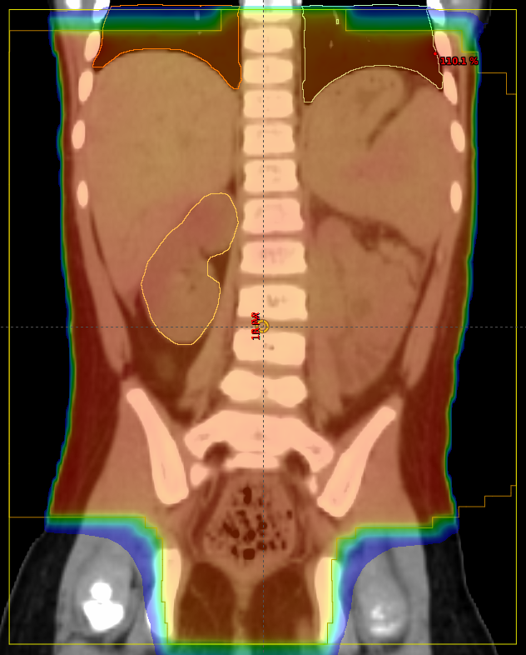
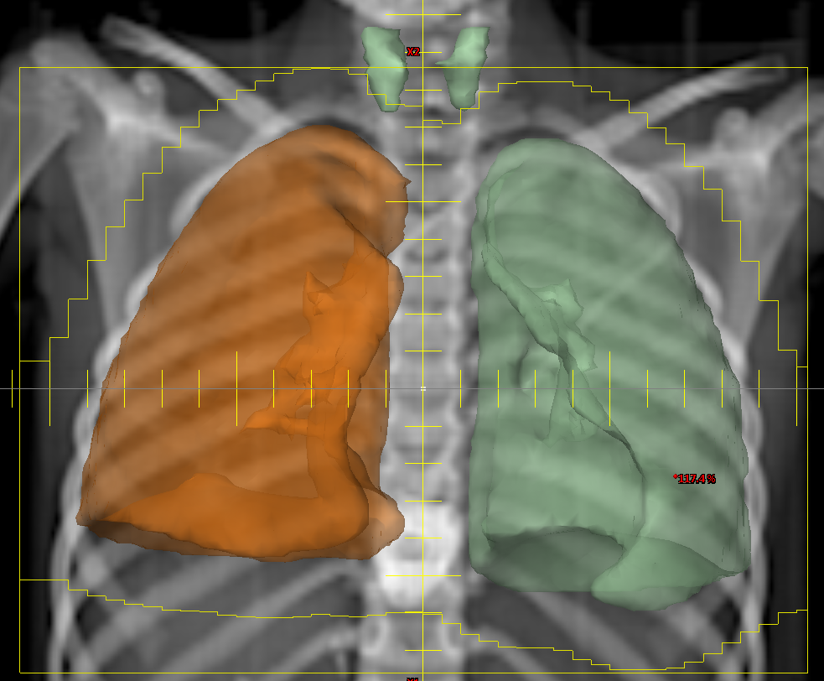
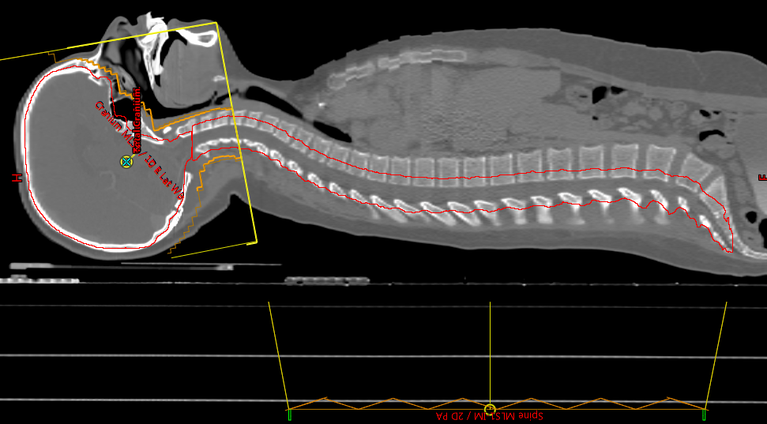
Cranial irradiation for ALL includes posterior half of eye and C2
Flank irradiation for Wilms Tumor includes whole vertebral body
Irradiation for tumor spillage and peritoneal metastases includes
pelvis
4. Whole lung irradiation may not be able to avoid thyroid gland
Spinal irradiation includes thecal sac and extends to S3
Images courtesy Dr. Kenneth Wong, CHLA/USC
Copyright © 2019 by ASPHO

Slide 28
7.B.1. Oncologic Emergencies
Tumor Lysis Syndrome
Hyperleukocytosis
Superior Mediastinal Syndrome (SMS)/ Superior Vena Cava Syndrome (SVCS)
Increased Intracranial Pressure
Spinal Cord Compression
Febrile Neutropenia
Copyright © 2019 by ASPHO

Slide 29
Tumor Lysis Syndrome
Most common emergency in patients with hematologic malignancy at diagnosis
Non- Hodgkin Lymphoma (Burkitt) and acute leukemia
Hyperuricemia, hyperkalemia, hyperphosphatemia, hypocalcemia
Renal insufficiency, cardiac arrhythmias, seizures, death.
Copyright © 2019 by ASPHO

Slide 30
Laboratory Tumor Lysis Syndrome
Serum Uric Acid > 8mg/dL in adults or > ULN in children
Serum Phosphorus > 4.5 mg/dL in adults or > 6.5 mg/dL in children
Serum Potassium > 6 meq/L
*Corrected serum calcium < 7 mg/dL or ionized calcium < 4.5 mg/dL
* Corrected calcium in mg/dL= measured calcium in mg/dL + 0.8 X (4-albumin in gms/dL)
Copyright © 2019 by ASPHO

Slide 31
Pathophysiology
Cell break down
Degradation of DNA to purines and phosphates
Release of intracellular potassium
Metabolic conversion of purine analogues to hypoxanthine, xanthine and uric acid by xanthine oxidase
Hyperphosphatemia leads to secondary hypocalcemia
Cytokine release hypotension and inflammation resulting in renal injury
Increased uric acid and calcium phosphate crystals lead to nephropathy
Copyright © 2019 by ASPHO

Slide 32
Management
Intravenous hyperhydration
Forced diuresis with loop diuretic if urine output lags
Urine alkalinization only if no hyperphosphatemia
Allopurinol (xanthine oxidase inhibitor) if low tumor burden and normal labs
Rasburicase (recombinant urate oxidase) if abnormal labs and high tumor burden
Monitor urine output and tumor lysis labs
Manage hyperkalemia (glucose+ insulin, B-agonists, hemodialysis
Administer calcium at lowest does only for symptomatic hypocalcemia
Copyright © 2019 by ASPHO

Slide 33
Hyperleukocytosis
Peripheral leucocyte count > 100,000/mm³
Clinically significant hyperleukocytosis
> 200,000/mm³ for AML
> 300,000/mm³ for ALL
Infant ALL, AML, blast phase CML, T-cell ALL, APL, leukemia with
t(4:11), t(9:22) and 11q23.
Tumor lysis, CNS hemorrhage and thrombosis, pulmonary leukostasis
Poor outcome with higher counts
Hyperviscosity, cytokines
Copyright © 2019 by ASPHO

Slide 34
Hyperleukocytosis- Clinical Features
Asymptomatic
Mental status changes, headaches, blurred vision, seizures, coma, stroke, papilledema, retinal artery and vein distension
Tachypnea, dyspnea, hypoxia, cyanosis, hemoptysis, pulmonary infiltrates
Priapism, clitoral engorgement, dactilytis
Copyright © 2019 by ASPHO

Slide 35
Hyperleukocytosis- Management
Hyperhydration
Leukapheresis or exchange transfusion
Management of Tumor Lysis
Urgent initiation of systemic chemotherapy
Glucocorticoids, hydroxyurea
Copyright © 2019 by ASPHO

Slide 36
SVCS and SMS
SVCS-compression, obstruction or thrombosis of SVC
SMS- SVCS and tracheal compression
Malignant mediastinal masses- T-cell ALL, Hodgkin Lymphoma, non-Hodgkin Lymphoma, germ cell tumors, sarcomas
Cough, dyspnea, orthopnea, dysphagia, wheezing, hoarseness, facial edema, chest pain, pleural effusion, pericardial effusion, discoloration of face, neck and upper extremities, venous distension.
Copyright © 2019 by ASPHO

Slide 37
SVCS, SMS- Management
Chest X-ray PA/Lat
Mediastinal mass, mediastinal deviation, tracheal narrowing, pleural effusion, pericardial effusion
Echocardiogram
Pericardial effusion, cardiac tamponade
General anesthesia, sedation, anxiolytics contraindicated
Risk factors for anesthesia risk
Tumors > 45% of thoracic diameter, < 50% predicted tracheal diameter, < 50% predicted peak expiratory flow
Copyright © 2019 by ASPHO

Slide 38
SVCS, SMS- Management
Diagnosis
Peripheral blood- peripheral smear, tumor markers
Pleural or pericardiocentesis
Biopsy with local anesthesia
Treatment
Glucocorticoids
Empiric chemotherapy
Emergency radiation
Anti-coagulation if thrombotic etiology
Copyright © 2019 by ASPHO

Slide 39
Febrile Neutropenia
Fever 38 deg C X 2 at least 1 hour apart, single episode of 38.4 deg C
ANC </= 500/cmm³
History including underlying malignancy, last chemotherapy treatment, current medications
Physical including general appearance, heart rate, blood pressure, lung, abdominal and skin exam
Blood cultures from all lumens of central venous catheter
Peripheral blood cultures controversial; increase detection of bacteremia
Chest X-ray only if respiratory symptoms and signs
Copyright © 2019 by ASPHO

Slide 40
Febrile Neutropenia
Rapid institution of broad spectrum antibiotics.
Antipseudomonal β-lactam, 4th generation cephalosporin or carbapenem as monotherapy for high risk pediatric patients.
Addition of a second gram negative agent or glycopeptide if a resistant organism is suspected.
Discontinue second agent is 72 hours if patient responds to treatment and no specific microbiologic finding mandating continuation.
Step down or oral antibiotics may be considered for low risk patients if suitable infrastructure for monitoring and follow-up present.
Discontinue antibiotics when afebrile for 24 hours, signs of hematologic recovery and no pathogen isolated in 48 hours for high risk patients; Discontinue in low risk patients in 72 hours if afebrile irrespective of hematologic status.
Copyright © 2019 by ASPHO

Slide 41
Increased Intracranial Pressure (ICP)
Mass lesion blocks the flow of CSF usually at the level of 3rd or 4th ventricle or compresses the cerebellum and brainstem forcing it through the foramen magnum.
Brain tumor, blocked shunts, rarely infection
Pseudotumor cerebri- retinoic acid and glucorticoids
Irritable, vomiting (projectile), occipital headache (morning), visual disturbances
Herniation due to progressive ICP or LP in patient with brain mass
Cushing’s triad, Cheyne-Stokes respiration, respiratory arrest
Copyright © 2019 by ASPHO

Slide 42
Increased Intracranial Pressure (ICP)
CT scan +/- MRI of brain
Dexamethasone 1-2 mg/kg IV (max 10 mg) followed by 0.25 mg/kg Q6H (max 6 mg)
Hyperosmolar therapy
Hypertonic saline
Endotracheal intubation for mild hyperventilation
Ventriculostomy
Removal of mass if possible
Copyright © 2019 by ASPHO

Slide 43
Spinal Cord Compression
Urgent attention to minimize long term neurologic dysfunction
Known or undiagnosed malignancy
Primary tumors or metastatic disease
Sarcomas, neuroblastoma, lymphoma, germ cell tumors
Back pain, weakness, sensory abnormalities, urinary and/or stool incontinence/retention, paraplegia/quadriplegia
MRI spine imaging study of choice
Copyright © 2019 by ASPHO

Slide 44
Spinal Cord Compression
Dexamethasone (dosing controversial)
Surgical decompression (usually if diagnosis unknown)
Radiation
Chemotherapy
> 50% regain function (children)
Copyright © 2019 by ASPHO

Slide 45
7.B.2. Anti-emetic management
Chemotherapy induced nausea and vomiting (CINV)
Acute: Within 24 hours of receiving chemotherapy
Delayed: 1-5 days after receiving chemotherapy
Breakthrough: occurring despite prophylactic therapy
Refractory: occurring during subsequent cycles when antiemetic therapy has previously failed
Anticipatory: triggered by anxiety, vision, odor, taste, memory
Copyright © 2019 by ASPHO

Slide 46
Emetogenic Chemotherapy
High (> 90%)- cisplatin, carmustine, mechlorethamine, dacarbazine, anthracycline/cyclophosphamide combination, cyclophosphamide (>1500 g/m2)
Moderate (30-90%)- busulfan, carboplatin, doxorubicin, idarubicin, cyclophosphamide (< 1500 mg/m2), cytarabine (> 1000 mg/m2), irinotecan, temozolomide, thiotepa
Low (10-30%)- cytarabine (< 1000 mg/m2), etoposide, gemcitabine, methotrexate, paclitaxel, docetaxel, topotecan, mitoxantrone
Minimal (< 10%)- vinblastine, vincristine, vinorelbine
Copyright © 2019 by ASPHO

Slide 47
Anti- emetic agents
Dexamethasone
5-HT₃ antagonists- ondansetron, granisetron, palonosetron
NK1 receptor antagonists- aprepitant
Olanzapine
Histamine blockers- diphenhydramine, meclozine, promethazine
Metoclopramide
Cannabinoids- dronabinol
Benzodiazepines- lorazepam, diazepam
Complementary: Ginger, acupuncture, acupressure
Copyright © 2019 by ASPHO

Slide 48
Pediatric Recommendations for CINV (ASCO)
High- 3-drug combination: 5-HT₃ receptor antagonist, dexamethasone, aprepitant
If patient cannot get aprepitant, 2-drug combination: 5-HT₃ receptor antagonist, dexamethasone
If patient cannot get dexamethasone: palonosetron and aprepitant
Moderate- 2-drug combination: 5-HT₃ receptor antagonist, dexamethasone
If patient cannot get dexamethasone: 5-HT₃ receptor antagonist, aprepitant
Low- odansetron or granisetron
Minimal- no antiemetics
Copyright © 2019 by ASPHO

Slide 49
7.C.1. Cancer Predisposition
Germline mutation in 7-10% of pediatric cancer patients
Family history of same or related cancer
Bilateral, multifocal or multiple cancers
Early age of diagnosis of a sporadic tumor
Physical findings of a cancer predisposition syndrome
Occurrence of a cancer that frequently occurs in a known condition
Copyright © 2019 by ASPHO

Slide 50
Cancer and Predisposition Syndromes
Cancer | Predisposition Syndrome | Gene
Adrenocortical Carcinoma | Li-Fraumeni, Beckwith Weideman | TP53, 11p15.5
Choroid Plexus Carcinoma, Anaplastic rhabdomyosarcoma, hypodiploid ALL | Li Fraumeni | TP53
Hepatoblastoma | Beckwith Weideman, FAP | 11p15 meth, APC
Juvenile Myelomonocytic Leukemia | NF1, Noonan | NF1, KRAS, PTPN11, CBL
Medullary Thyroid Cancer | MEN-2A, MEN-2B | RET
Neuroblastoma | Familial NB, CCHS | ALK, PHOX2B
Pheochromocytoma/paraganglioma | PPS, MEN2, NF1, VHL | RET, NF1, VHL, SDHx
Pleuropulmonary blastoma | DICER1 syndrome | DICER1
Renal Cell Carcinoma | Von Hippel Lindau, HLRCC | VHL, FH
Retinoblastoma | Heritable RB | RB1
Rhabdoid tumors | Rhabdoid Tumor Syndrome | SMARCB1
Wilms Tumor | Beckwith Weideman, WAGR, DDS, PS | 11p15 meth, WT1, D1S3L2
Copyright © 2019 by ASPHO

Slide 51
Cancers for testing TP53 germline mutation
Anaplastic Rhadomyosarcoma (~75%)
SHH Medulloblastoma (~75%)
Adrenocortical carcinoma < 15 years (~50%)
Choroid Plexus Carcinoma (~ 50%)
Hypodiploid ALL (~ 50%)
Early onset breast cancer in absence of BRCA1/2 mutations (~ 10%)
Copyright © 2019 by ASPHO

Slide 52
Li Fraumeni Syndrome (LFS)
Clinical
Proband diagnosed with sarcoma before age 45 years
First degree relative with cancer before age 45 years
First or second degree relative with cancer before age 45 or sarcoma at any age
Chompret criteria
Proband with tumor belonging to LFS tumor spectrum before age 46 AND at least one first or secondary degree relative with LFS before age 56 or with multiple tumors (except breast cancer if proband has breast cancer)
Proband with multiple tumors two of which belong to LFS tumor spectrum, one of which occurred before age 46
Proband has adrenocortical carcinoma or chorpoid plexus carcinoma regardless of family history
Copyright © 2019 by ASPHO

Slide 53
Additional reading
Cancer Predisposition and Screening
Pediatric Oncology Series, Clinical Cancer Research, 2017 (18 articles)
Supportive Care
Clinical Practice Guidelines for pediatric febrile neutropenia (JCO), chemotherapy nausea and vomiting (PBC), ASCO guidelines
Copyright © 2019 by ASPHO

Slide 54
?
Copyright © 2019 by ASPHO

Slide 56
7.A.3. CYTOTOXIC CHEMOTHERAPY
Copyright © 2019 by ASPHO

Slide 57
Classification/Mechanism of Action
Alkylating Agents
Antimetabolites
Antibiotics
Plant Products
Miscellaneous
Kinase Inhibitors
Other small molecule targeted agents
Monoclonal antibodies
Copyright © 2019 by ASPHO

Slide 58
Mechanism of Action
Etoposide
Teniposide
Topotecan
Irinotecan
Actinomycin-D
Doxorubicin
Daunomycin
Idarubicin
Mitoxantrone
Ara-C
Intercalators
Doxorubicin
Daunomycin
Idarubicin
Bleomycin
CMP
dCMP
Topo Inhibitors
Free Radical Damage
DNA
5-FU
dTMP
Nelarabine
Cladrabine
Alkylator
Mechlorethamine
Cyclophosphamide
Ifosfamide
Melphalan
Carboplatin
Cisplatin
Oxaliplatin
Nitrosureas
Busulfan
Dacarbazine
Procarbazine
Temozolomide
FH₂
dUMP
Purines
MP, TG
FH₄
MTX
RNA
De novo Synthesis
Salvage Pathway
Protein
Asparaginase
Tubulin
Vincristine
Vinblastine
Paclitaxel
Copyright © 2019 by ASPHO
Courtesy of Peter Adamson, MD- modified

Slide 59
Alkylating Agents
Nitrogen Mustards
Alkylation, cross-linking
Mechlorethamine, Cyclophosphamide, Ifosfamide, Melphalan
Nitrosoureas
Alkylation, cross-linking, carbamoylation
Lomustine, Carmustine
Platinum compounds
Platination, cross-linking
Cisplatin, Carboplatin, Oxaliplatin
Copyright © 2019 by ASPHO

Slide 60
Alkylating Agents (continued)
Busulfan
Alkylating, cross-linking
Dacarbazine, Procarbazine, Temozolomide
Methylation, free radical formation
Toxicity-
Nausea/vomiting, Myelosuppression, Hemorrhagic cystitis
Infertility, secondary leukemia
Fanconi Syndrome, Neurotoxcity (Ifosfamide)
Pulmonary toxicity (Busulfan)
Copyright © 2019 by ASPHO

Slide 61
Antimetabolites
Folate Analogs
Interference with folate metabolism
Methotrexate, trimetrexate, premetrexed
Pyrimidine Analogs
Incorporated into DNA/RNA, inhibit DNA polymerase, inhibit ribonucleotide reductase
Cytarabine (Ara-C), gemcitabine, fluorouracil, hydroxyurea
Copyright © 2019 by ASPHO

Slide 62
Antimetabolites (continued)
Purine Analogs
Incorporated into DNA/RNA, blocks purine synthesis and interconversion, inhibit DNA polymerase, ribonucleotide reductase
Mercaptopurine, thioguanine, fludarabine, clofarabine, cladrabine, nelarabine (Ara-G)
Toxicity
Myelosuppression, hepatotoxicity (Thioguanine)
Rash (clofarabine)
Neurotoxicity (nelarabine)
Copyright © 2019 by ASPHO

Slide 63
Antibiotics
Intercalation, DNA strand breaks (Topoisomerase II), free radical formation
Dactinomycin, Doxorubicin, Daunorubicin, Idarubicin, Mitoxantrone, Bleomycin
Toxicity
Nausea/vomiting, mucositis, cardiac, extravasation burn, secondary leukemia
Pulmonary, anaphylaxis (Bleomycin)
Copyright © 2019 by ASPHO

Slide 64
Plant Products
Vinca Alkaloids
Mitotic inhibitor, blocks microtubule polymerization
Vincristine, vinblastine, vinorelbine
Toxicity
Neurotoxicity, SIADH, thrombocytosis (vincristine)
Extravasation burn
Myelosuppression (Vinblastine, Vinorelbine)
Copyright © 2019 by ASPHO

Slide 65
Plant Products (continued)
Taxanes
Microtubule inhibitor, blocks microtubule depolymerization
Paclitaxel, docetaxel
Toxicity
Infusion reactions, skin toxicity
Copyright © 2019 by ASPHO

Slide 66
Topoisomerase inhibitors
Epipodophyllotoxins
Topoisomerase II inhibitors
Etoposide (VP16), Teniposide (VM-26)
Camptothecins
Topoisomerase I inhbitors
Topotecan, Irinotecan
Toxicity
Myelosuppression, Hypersensitivity reaction, 11q23 leukemia (etoposide, teniposide)
Myelosuppression, gastrointestinal toxicity (irinotecan)
Copyright © 2019 by ASPHO

Slide 67
Miscellaneous (1)
Asparaginase/PEG Asparaginase/Erwinase
Depletes circulating pool of asparagine
Sensitive tumor cells cannot upregulate asparagine synthase
PEGylation decreases immunogenicity and increases half life
Decreases clearance of dexamethasone
Toxicity
Allergy, coagulopathy, hyperglycemia, pancreatitis, hepatotoxicity, encephalopathy
Copyright © 2019 by ASPHO

Slide 68
Miscellaneous (2)
Corticosteroids
Receptor- mediated lympholysis
Apoptosis by binding to intracellular glucocorticoid receptors
Drug concentration in CSF is the same as plasma
Toxicity
Increased appetite, centripedal obesity, immunosuppression, myopathy, osteoporosis, avascular necrosis, gastritis, pancreatitis, hypertension, hyperglycemia, growth failure, impaired wound healing, cataracts
Copyright © 2019 by ASPHO

Slide 69
Toxicity
Acute Toxicity | Agent
Allergy | Corticosteroids, diphenhyramine, epinephrine, anti-histamines
Nausea and Vomiting | Anti-emetics
Myelosuppression | Growth factors, hematopoietic progenitor cells
Infection | Antibiotics, antifungals, antivirals
Tumorlysis | Allopurinol, rasburicase
Hemorrhagic cystitis (oxazaphosphorines) | Mesna
Cardiac toxicity | Dexrazoxane
Nephrotoxicity (cisplatin) | Mannitol diuresis
Methotrexate toxicity | Leucovorin, glucarpidase, dextromethorphan
Neurotoxicity (ifosfamide) | Methylene blue
Retinoic acid syndrome (ATRA) | Dexamethasone
Copyright © 2019 by ASPHO

Slide 70
Toxicity (continued)
Chronic Toxicity | Drug
Cardiac | Anthracyclines
Pulmonary | Bleomycin, Busulfan, Carmustine
Infertility | Alkylating agents
Osteonecrosis | Corticosteroids
Secondary Leukemia/MDS 11q23 Monosomy 7, del 5q | Topoisomerase II inhibitors Alkylating agents
Hearing loss | Cisplatin
Nephrotoxicity | Cisplatin, Ifosfamide
Radiation recall injury | Anthracyclines, dactinomycin
Copyright © 2019 by ASPHO

Slide 71
Toxicity (continued)
Chronic Toxicity | Drug
Cardiac | Anthracyclines
Pulmonary | Bleomycin, Busulfan, Carmustine
Infertility | Alkylating agents
Osteonecrosis | Corticosteroids
Secondary Leukemia/MDS 11q23 Monosomy 7, del 5q | Topoisomerase II inhibitors Alkylating agents
Hearing loss | Cisplatin
Nephrotoxicity | Cisplatin, Ifosfamide
Radiation recall injury | Anthracyclines, dactinomycin
Copyright © 2019 by ASPHO

Slide 72
Oxazaphosphorines
Cyclophosphamide (C) and Ifosfamide (I)
Prodrugs
Metabolized to phospho/iphosphoramide mustard and acrolein (hemorrhagic cystitis)
Dechlorethylation I>C (neurotoxicity)
Busulfan blocks activation of cyclophosphamide
Copyright © 2019 by ASPHO

Slide 73
Busulfan
Oral busulfan PK is age dependent and highly variable
IV busulfan decreases interpatient variability
Metabolized by Glutathione-S- transferase
Good CSF penetration
High dose used for myeloablation in BMT conditioning regimens
Copyright © 2019 by ASPHO

Slide 74
Platinum compounds
Cisplatin- nephrotoxicity, ototoxicity
Carboplatin- myelotoxicity
Oxaliplatin- neurotoxicity
Carboplatin clearance highly correlated with GFR
Targeted dosing of carboplatin using AUC (usually 6-10mg X min/mL)
Copyright © 2019 by ASPHO

Slide 75
Thiopurines
MP and TG are prodrugs
MP- TGMP ( 3 steps); TG- TGMP (1 step)
TGMP is phosphorylated to TGTP which is then converted by ribonucleotide reductase to dTGTP which is incorporated into DNA.
Thiopurine methyl transferase (TPMT)- S-methylation of thiopurines (active metabolites)
Homozygous TPMT deficiency- severe toxicity (5-10% dosing)- 1 in 300
Heterozygotes TPMT- more frequent dose reductions
Copyright © 2019 by ASPHO
Notes:
Mm- TIMP- TXMP- TGMP
Hypoxanthine guanine phosphoribosyl transferase (HGPRT)

Slide 76
Thiopurines
MP catabolized to thiouric acid by xanthine oxidase
Allopurinol increases MP toxicity
TG catabolized to thiouric acid by aldehyde oxidase via 8-OH-thioguanine
Allopurinol has no effect on TG toxicity
Copyright © 2019 by ASPHO

Slide 77
Temozolomide
Prodrug
Spontaneous change to MTIC in solution at physiological pH
Delayed myelosuppression- nadir 21 days
O⁶-methylguanine-DNA methyltransferase (MGMT)- DNA repair protein- removes methyl adduct from O⁶ position of guanine
Increased expression of MGMT causes temozolomide resistance
Copyright © 2019 by ASPHO

Slide 78
Methotrexate
Inhibits DHFR and prevents conversion of folates to active tetrahydrofolate
Single carbon donor for purine synthesis
Tetrahydrofolate pools depleted
Intracellular methotrexate is polyglutamated and accumulates within the cell leading to apoptosis
Asparaginase depletes glutamine (Capizzi I) rescuing cells from methotrexate toxicity
Copyright © 2019 by ASPHO

Slide 79
Leucovorin rescue
Does not require DHFR and can be metabolized to tetrahydrofolate
Cancer cells lack transporter for leucovorin
Usually initiated 12-20 hours after end of methotrexate infusion and continues till serum levels are < 0.1 microM ( some cases 0.5 microM)
Copyright © 2019 by ASPHO

Slide 80
Methotrexate Toxicity
Copyright © 2019 by ASPHO

Slide 81
Methotrexate Toxicity
Salicylates, NSAIDS, penicillins, probenicid, sulfasoxazole, iodinated radiographic contrast, proton pump inhibitors
Glucarpidase hydrolyzes methotrexate to DAMPA and glutamic acid
Indicated when serum creatinine X 2 times baseline, 24 hour level > 50 microM, 48 hour level > 5 microM OR 42 hour level > 10 microM and serum creatinine X1.5 times baseline
Leucovorin should not be given 2 hours before & after
Copyright © 2019 by ASPHO

Slide 82
Irinotecan
Prodrug- converted in liver and GI tract to SN-38
100-1000 fold more potent
Myelosuppression and diarrhea are dose limiting
SN-38 conjugated in liver to SN-38G by UGT1A1
UGT1A1 deficiency (Gilbert, Crigler Najjar) or drugs that inhibit UGT1A1 (valproate, sorafenib) can increase irinotecan toxicity
Bacterial beta-glucoronidase convert SN-38G to SN38 causing delayed diarrhea
Cefexime/Cefpodoxime eliminate gut bacteria decreasing the incidence of irinotecan induced diarrhea
Copyright © 2019 by ASPHO

Slide 83
Mechanisms of Drug Resistance (1)
Alkylating agents
Decreased transport, Increased DNA repair, increased intracellular catabolism, decreased uptake, increased glutathione-S-transferase
Antimetabolites
Decreased transport, increased target enzyme, decreased polyglutamation, increased intracellular catabolism, decreased intracellular activation, increased target enzyme
Copyright © 2019 by ASPHO

Slide 84
Mechanisms of Drug Resistance (2)
Antibiotics
Multidrug resistance, decreased topoisomerase II, increased intracellular catabolism, increased DNA repair
Vinca alkaloids
Multidrug resistance, altered tubulin subunit
Corticosteroids
Loss or defect in glucocorticoid receptor
Copyright © 2019 by ASPHO

Slide 85
Mechanisms of Drug Resistance (3)
Asparaginase
increased intracellular asparagine synthase, neutralizing antibodies
Retinoids and Arsenic
Mutations in PML/RAR-alpha
Imatinib
Abl-kinase domain mutations, MDR overexpression
Copyright © 2019 by ASPHO

Slide 86
Mechanism of Resistance | Drug | Pharmacologic Defect
Decreased uptake | Methotrexate | expression of folate receptor
Decreased activation | Ara-C, Fludarabine, Cladribine Methotrexate | deoxycytidine kinase folylpolyglutamyl synthetase
Increased drug target | Methotrexate, 5-FU, Imatinib | Amplified DHFR, TS, bcr-abl kinase
Altered drug target | VP-16, Doxorubicin, Imatinib | Altered topo II, DHFR, bcr-abl kinase
Increased detoxification | Alkylators | glutathione or glutathione transferase
Enhanced DNA repair | Alkylators, platinum analogs Nitrosoureas, procarbazine, temozolomide | nucleotide excision repair O⁶-alkyl-guanine alkyl transferase
Defective recognition of DNA adducts | Cisplatin | Mismatch repair defect
Increased drug efflux | Doxorubicin, VP-16, vinca alkaloids, paclitaxel, topotecan | MDR expression or MDR gene amplification
Defective checkpoint function and apoptosis | Most anticancer drugs | p53 mutations
Copyright © 2019 by ASPHO

